Slide 1
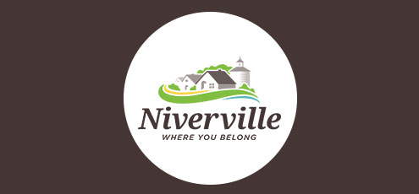
Niverville, Manitoba, was named after an 18th–century explorer and fur trader– Joseph-Claude Boucher de Niverville.

Slide 2
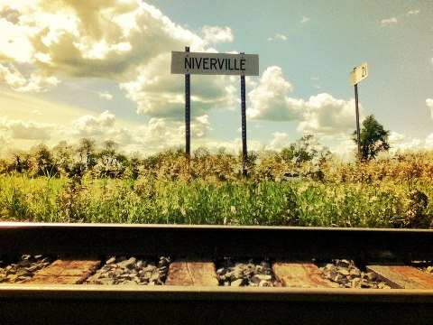
This choice of name was made by the Canadian Pacific Railway in 1877—one year before the railway into town was built.

Slide 3

It would be safe to say that many residents of Niverville today still see History in the light of His Story, that is, a meta-narrative, or an over-arching story that provides a structure for one’s beliefs that give meaning and purpose to one’s life experiences. We each find our story within that larger story that leads us from our past into a future destiny!

Slide 4
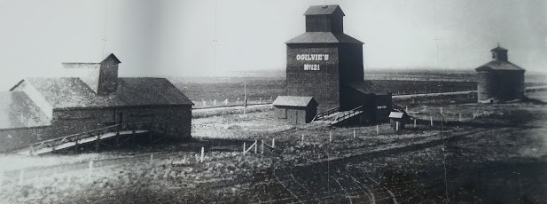
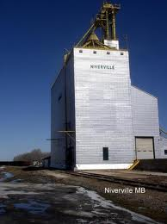
To understand our history is to understand our destiny to be a blessing to our region, our nation and the nations. Niverville’s history, much like the biblical narrative, is closely connected to grain and to agriculture.

Slide 5
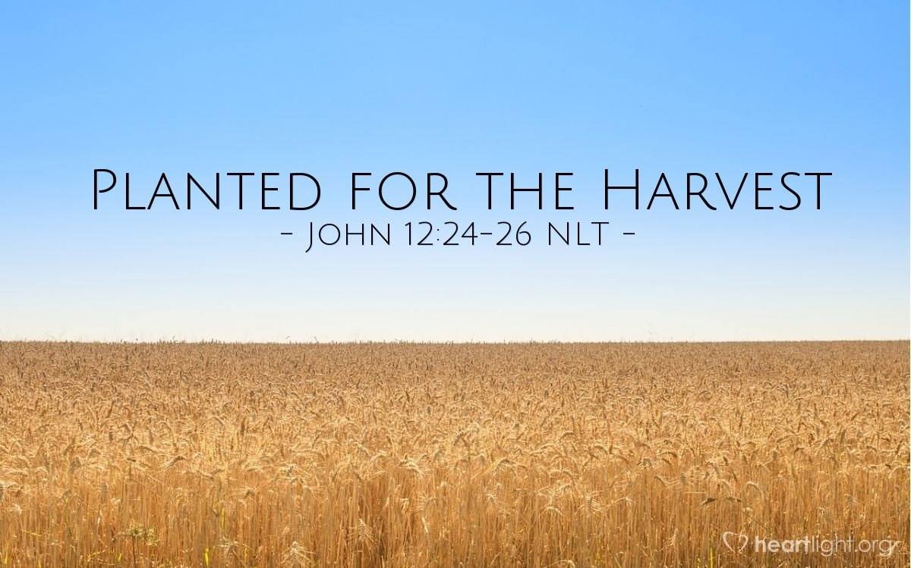
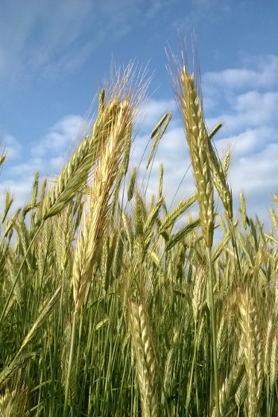
Every farmer in this region plants his seed in the ground every spring in faith that the seed will multiply after it is planted, and that it will reproduce and come to maturity. The destiny of seed-time is harvest so that there will be food to feed not only Niverville, but we can export grain to feed the hungry in other regions and nations.

Slide 6
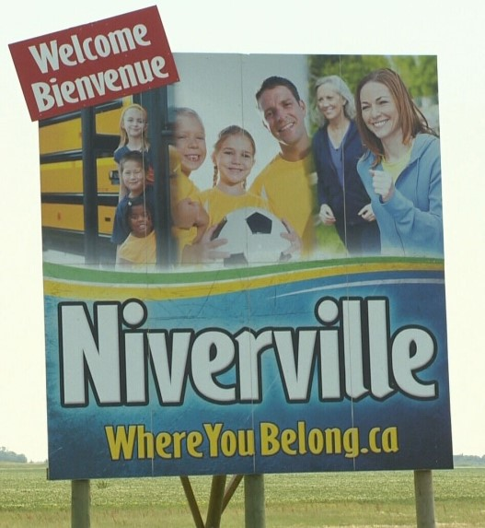
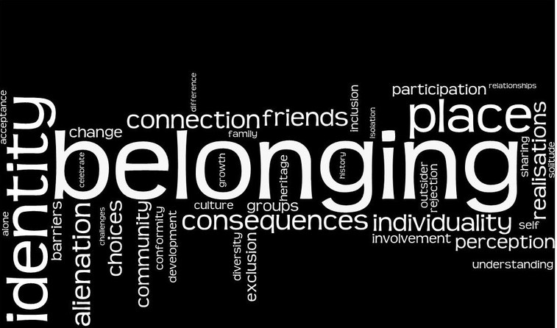
Niverville—a town with a history, and a town with a destiny, a place where people can belong and feel at home. Regardless of whether we believe exactly the same, we still belong in the family, and are destined to mature!

Slide 7
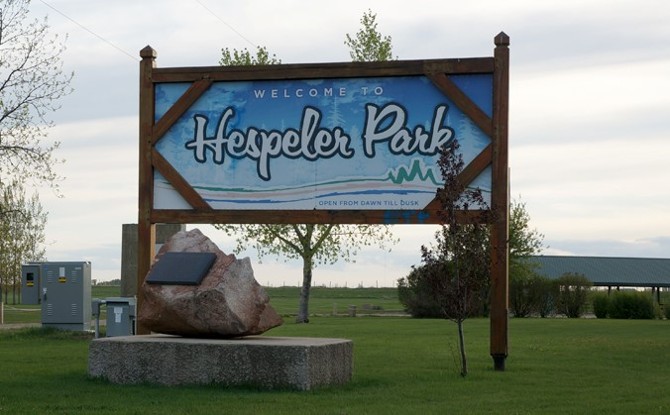
Today, one of Niverville’s best-known parks is named after William Hespeler, who was hired by the Government of Canada as an immigration agent in 1871. The Canadian authorities sent him to Russia in order to persuade persecuted Mennonites to emigrate from Russia to Canada instead of to the United States as they had previously planned.

Slide 8
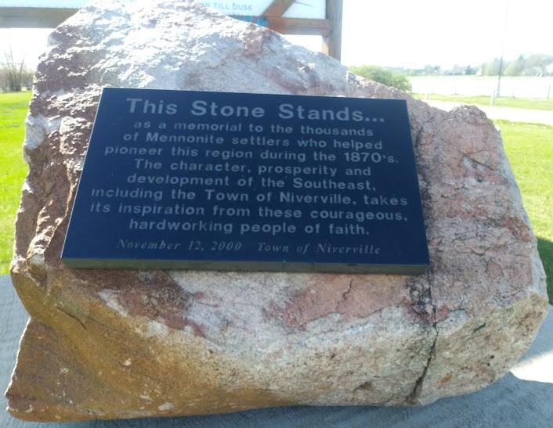
The large rock boulder in front of the “Hespeler Park” sign reads, “This Stone Stands…as a memorial to the thousands of Mennonite settlers who helped pioneer this region during the 1870’s. The character, prosperity and development of the Southeast, including the Town of Niverville, takes its inspiration from these courageous, hardworking people of faith.”

Slide 9
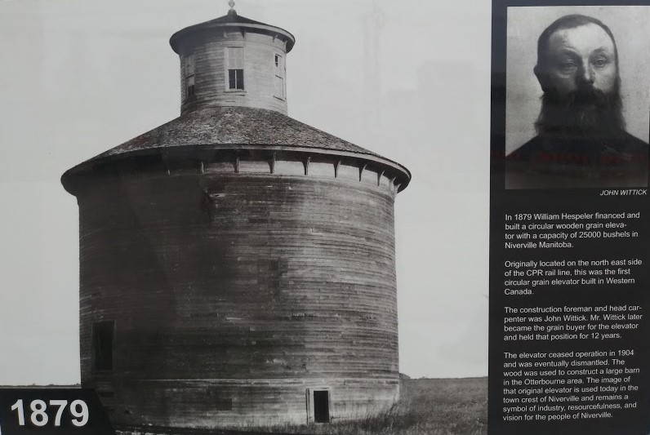
.
In 1879, William Hespeler financed and built a circular wooden grain elevator with a capacity of 25,000 bushels in Niverville, Manitoba. This was the first circular grain elevator built in Western Canada. The construction foreman and head carpenter was John Wittick who also became the grain buyer for the elevator.

Slide 10
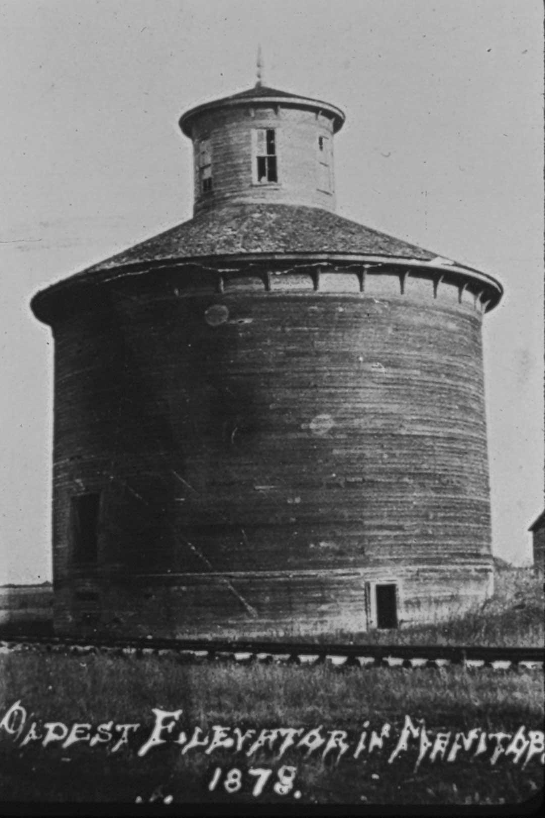
From this grain elevator, the first barley was shipped to overseas markets. The image of this original grain elevator is used today in the town crest of Niverville, and it remains a symbol of industry, resourcefulness and vision for the people of Niverville.

Slide 11
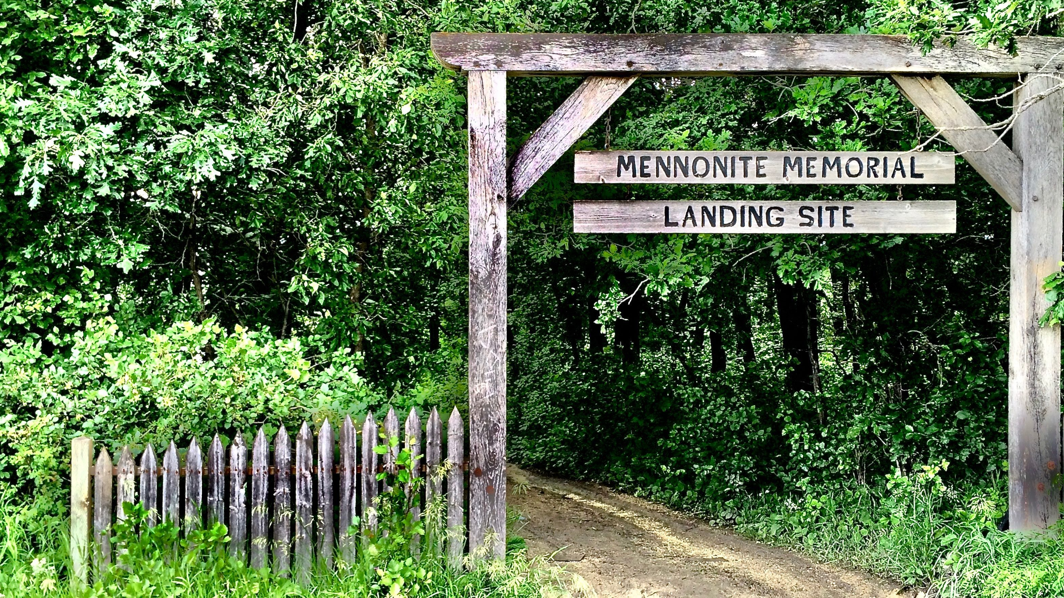
Through the work of immigration agents such as William Hespeler, arrangements were made for the first installment of Mennonite immigrants to be dropped off at the Mennonite Landing on Treaty #1 land at the confluence of the Red and Rat Rivers, near Niverville, on August 1, 1874.

Slide 12
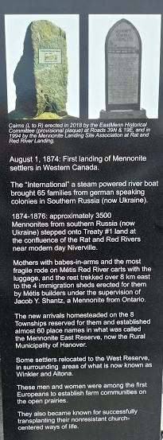
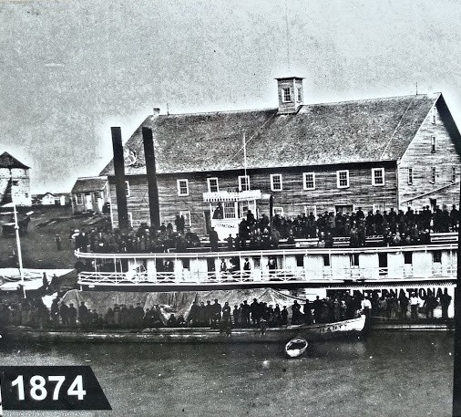
On this date, August 1, 1874, the “International,” a steam-powered river boat, brought 65 families from German-speaking colonies in southern Russia (now Ukraine).

Slide 13
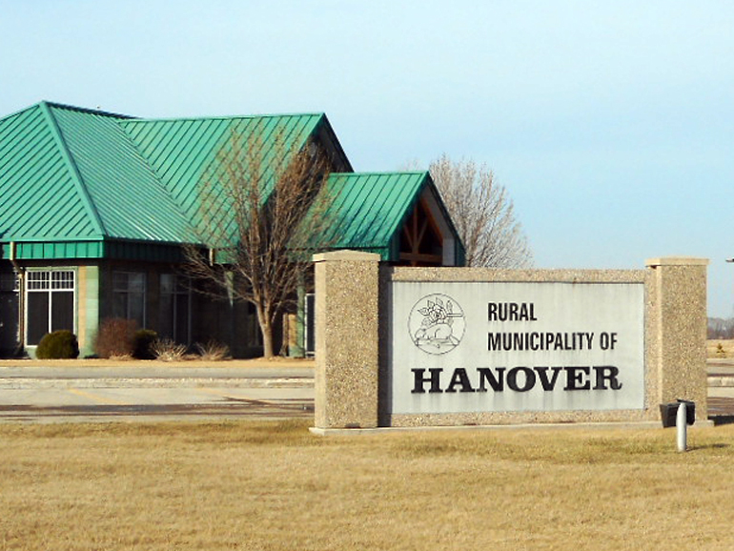
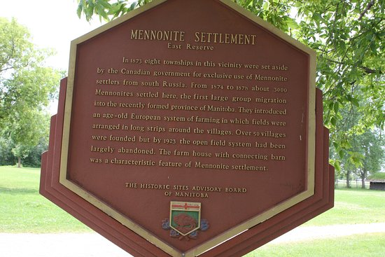
Between 1874 and 1876, some 3,500 Mennonites arrived at this very site near modern-day Niverville, and new arrivals established some 54 villages in what was called the Mennonite East Reserve (essentially a gift from the Canadian government), now the Rural Municipality of Hanover.

Slide 14
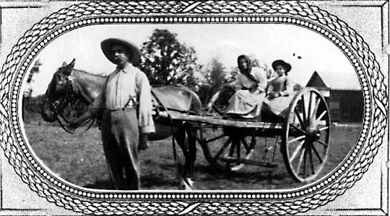
Mothers with babe-in-arms and the most fragile rode on Métis Red River Carts with the luggage, and the rest trekked over 8 kilometers east to the four immigration sheds erected for them by Métis builders under the supervision of Jacob Shantz, a Mennonite from Ontario.

Slide 15
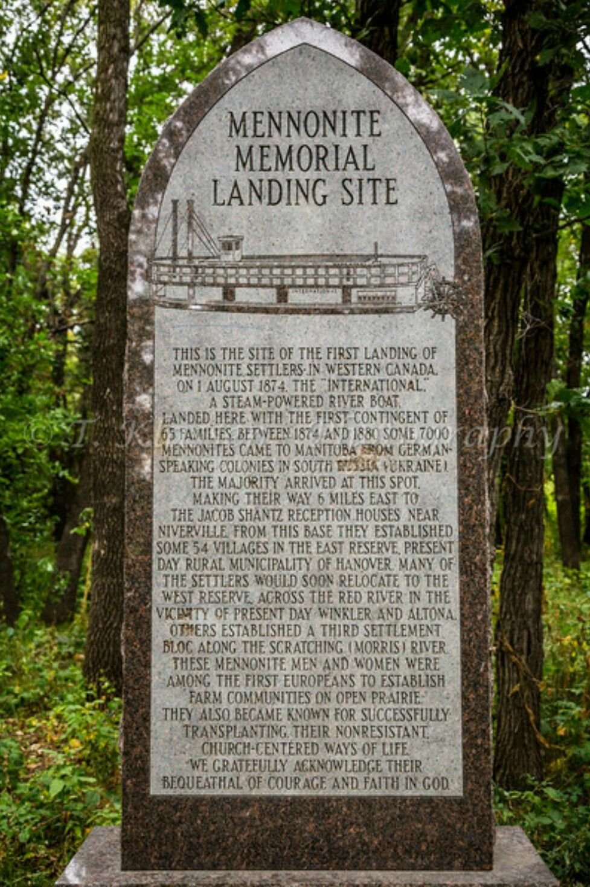
Although the Niverville area was first settled by people of British ancestry, with names like Stott, Church and Wallace, an influx of the first Canadian Mennonite farmers in 1874 soon saw their population eclipse that of the earlier group. Between 1874 and 1880, some 7,000 Mennonites came to Manitoba from South Russia (Ukraine) to begin farming. The majority arrived at this spot. These British and mostly Mennonite men and women were among the first Europeans to establish farm communities in open prairie.

Slide 16
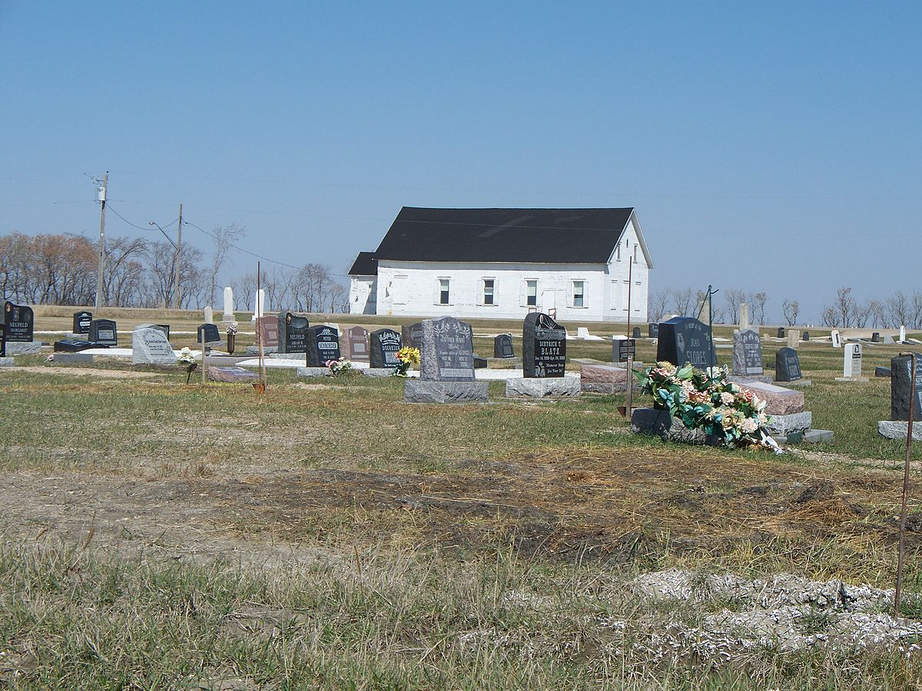
The cairn at the Mennonite Landing site (just 3 miles south-west of Niverville), concludes with the words, “We gratefully acknowledge their bequeathal of courage and faith in God.”
One of the 54 villages in the East Reserve was Chortitz, one mile west from present-day Randolph, where the Chortitz Heritage Church was first erected on this site, and functional by 1877. 20 years later, that original building was replaced by this one, with Sunday services held in it from 1897 to 2010. It is still standing today, and used for special, historical and memorable occasions.

Slide 17
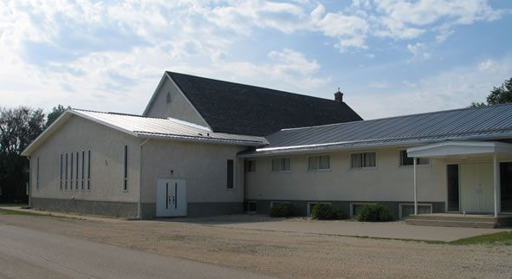
The Niverville Chortitzer Mennonite Church (presently Niverville CMC) was first built in 1936. The second CMC Church was built in 1950. An education wing was added in 1971, and the foyer added in 1977.

Slide 18
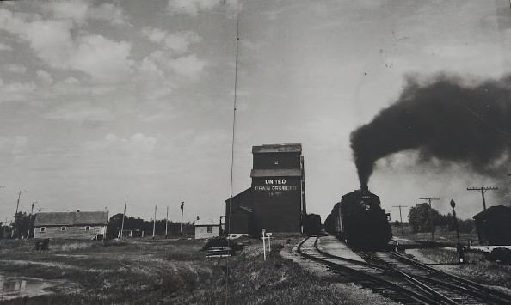
The Niverville Pioneers (both British and Mennonite) inspired many other groups to settle the Prairies by demonstrating its enormous agricultural potential. The hardiness and determination of the early settlers, coming from a harsh environment in Russia, ensured that this unforgiving land would be transformed into a place from which livelihoods could be wrested, albeit at considerable effort and cost.

Slide 19
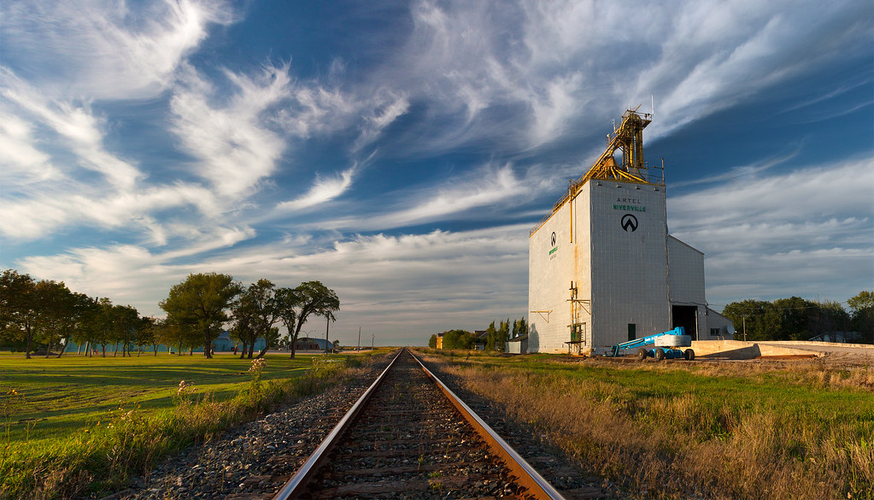
In later years, these generous settlers sent grain in relief to others suffering from famine in Russia. This is perhaps a part of Niverville’s destiny, to be blessed to be a blessing, so that this community can be like “a city set on a hill” that brings help to the helpless and hope to the hopeless in showing compassion to those less fortunate.

Slide 20

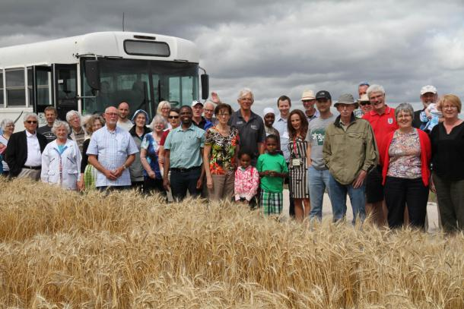
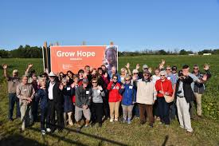
In more recent years, this important work of not only growing grain to meet our own needs, but to feed the hungry with the overflow, has been carried on by such ministries as the Niverville Food Grain Bank and the Grow Hope Project sponsored by local farmers such as Grant Dyck. As local farmers, they are a part of the global community of food producers who take on the responsibility to use their lands carefully, and to attend to the sharing of the harvest, much like in biblical times. Ruth 2:2-10; Deuteronomy 24:19-22.

Slide 21
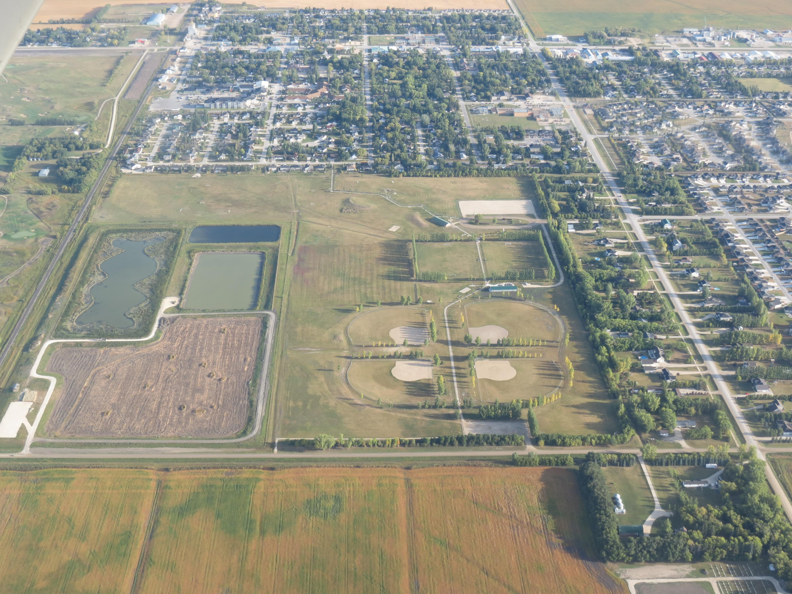
Niverville has today become a culturally diverse and open community. Many of its present inhabitants are from Mennonite or British stock, with a growing number of immigrants from other backgrounds. This is all based on a history that includes contributions from many groups, including the French settlers, the Métis, the Scottish settlers in addition to the British and the Mennonites. All have some unique and valuable gifts to offer.

Slide 22
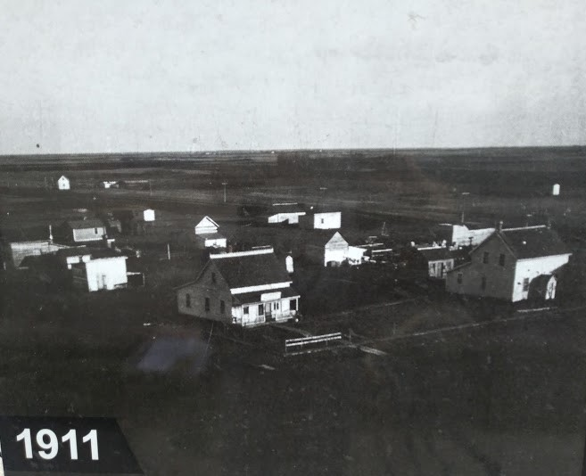
Prior to 1969, Niverville was unincorporated, and until that year was a part of the Rural Municipality of Hanover. Here are a few snapshots of its growth over time, beginning with this shot of the community in 1911.

Slide 23
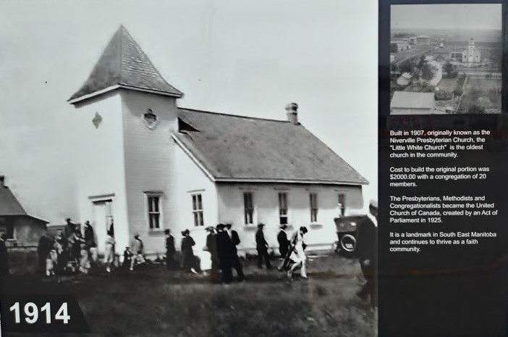
While this picture was taken in 1914, the Niverville Presbyterian Church was built in 1907, and is the oldest church building in the community, known as the “Little White Church.” The Presbyterians, Methodists and Congregationalists became the United Church of Canada in the year of 1925.

Slide 24
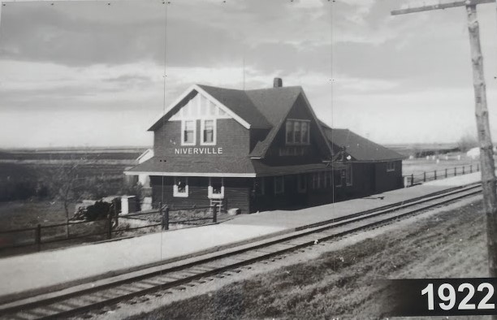
This was taken in 1922, and the picture can be seen driving into Niverville over the tracks on Main Street from the East side right in the vicinity where the train station once stood.

Slide 25
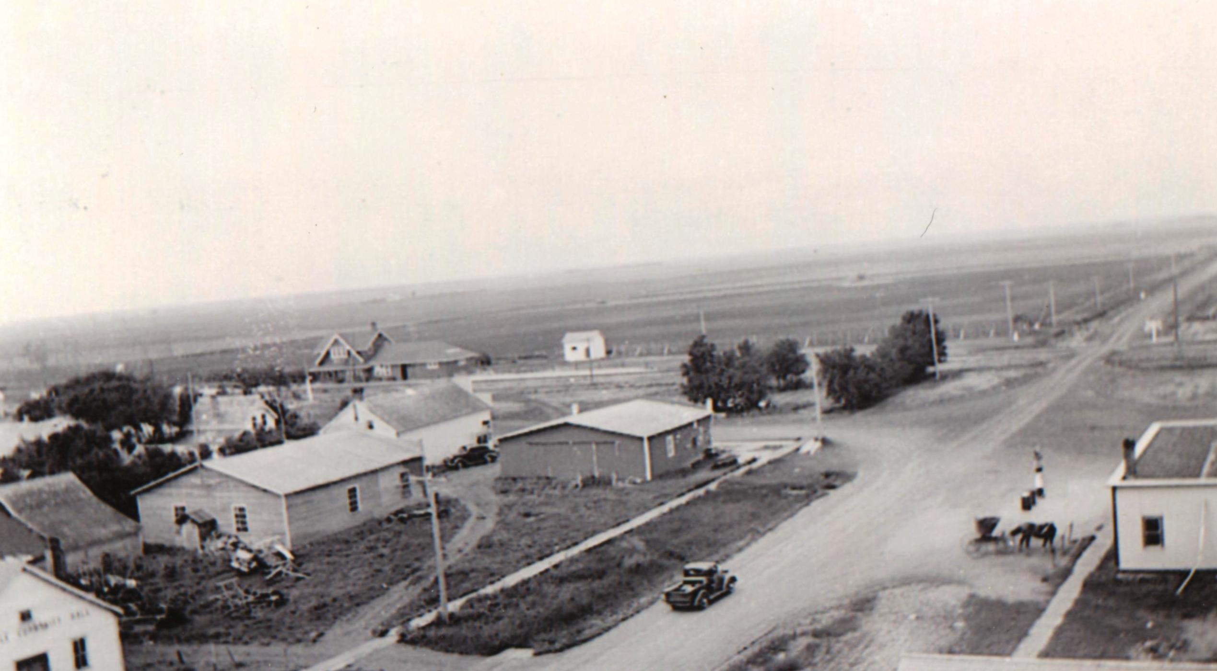
In 1937, the Niverville Hotel and Train Station can be seen on this photo.

Slide 26
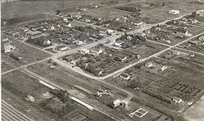
This aerial view of Niverville was taken in the late 1950’s, and gives one some idea of the size that the community was becoming when it was incorporated as a village some 10 years later.

Slide 27
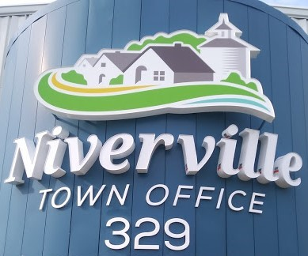
As mentioned, Niverville was originally within the Rural Municipality of Hanover, but was incorporated as a village in 1969 and later as a town in 1993.

Slide 28
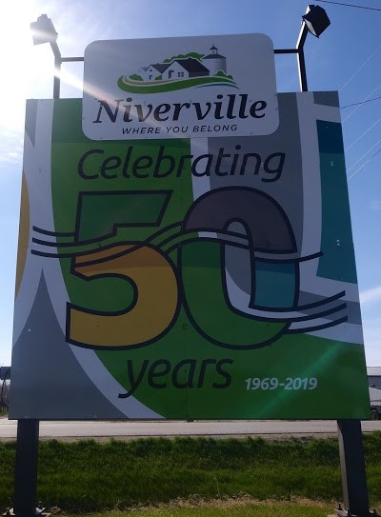

That means that during this Year of 2019, Niverville is celebrating it’s 50th Year of being an incorporated community! This year, we have an opportunity to celebrate a Year of Jubilee where families are restored, debts are forgiven, and where those imprisoned within old thought patterns based upon past hurts can be set free through forgiveness and the dropping of past offences.

Slide 29

Jesus prayed that His followers would be “made perfect (or brought to maturity) in oneness or unity” (John 17:23), showing that unity is a key to the maturity of the church. Just as the Father and the Son are different personalities, but are yet unified in heart and purpose to the end that every human being find a family, a home where they belong, and where there is provision and protection, it will take the same passion for the church to reveal the Father’s heart.
Could this speak to Niverville’s destiny as a unified community with the common purpose that we exist not just to bless ourselves, but to bless other communities, regions and nations as well? While every congregation in Niverville is needed, and here for a purpose, yet we still have one common mission to reach out beyond ourselves to those less fortunate.

Slide 30
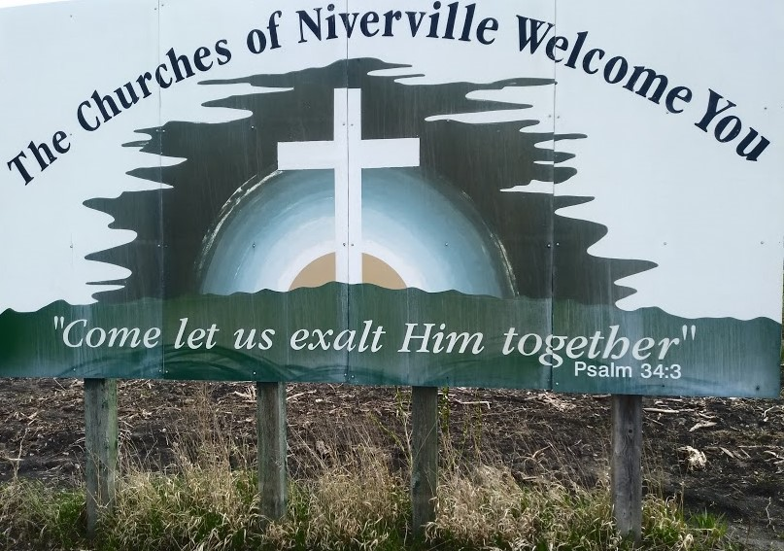
Some 30 years ago, when this Welcome sign was first erected, it stated that “The Churches of Niverville Welcome You.” Even back then, however, there were some who noted that the sign should really have said that “The Church of Niverville Welcomes You” It was recognized back then, already that while there are several congregations who meet in different locations, but that there is only One Church in Niverville!

Slide 31
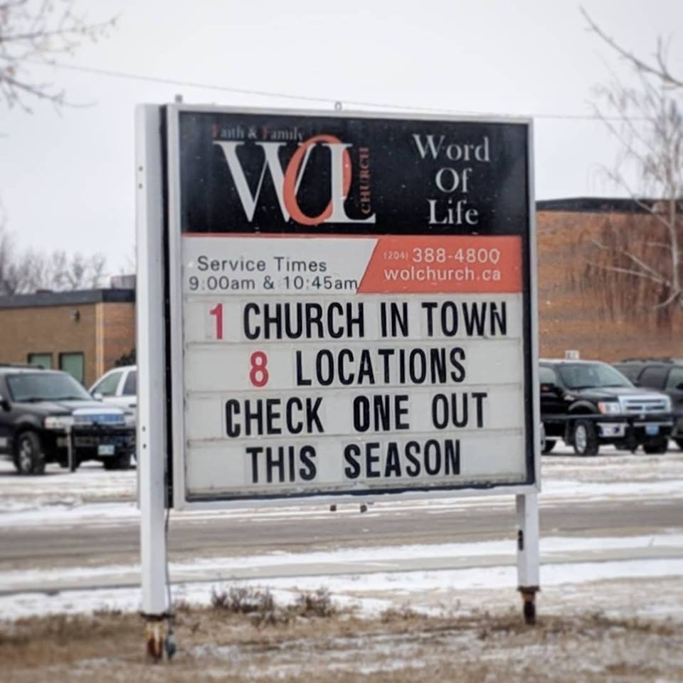
Today, there is a growing movement of people from different congregations who believe and who recognize that there is only one Church in Niverville! This sign recently displayed by the Word of Life Mission Church expresses the heart of this understanding very well!

Slide 32
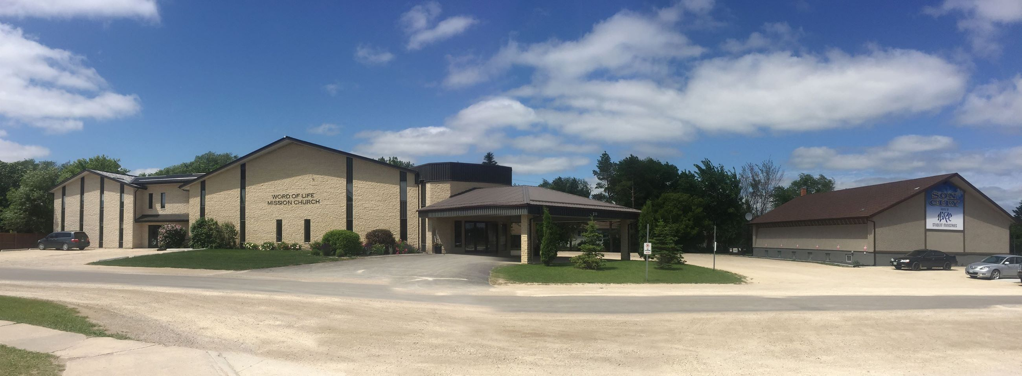
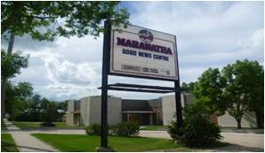
This present understanding is significant in light of the fact that in the past, there has been major church splits that separated congregations, and that did not reflect the Father’s heart for unity at the heart level. Years ago, there was a split between the Elim congregation and the Mennonite Conference congregation, but in more recent years they have amalgamated to form the Niverville Community Fellowship.
In 1963, there was a split between the Niverville CMC and the Word of Life congregation, and in 1978, there was a split between the Word of Life congregation and Maranatha.

Slide 33
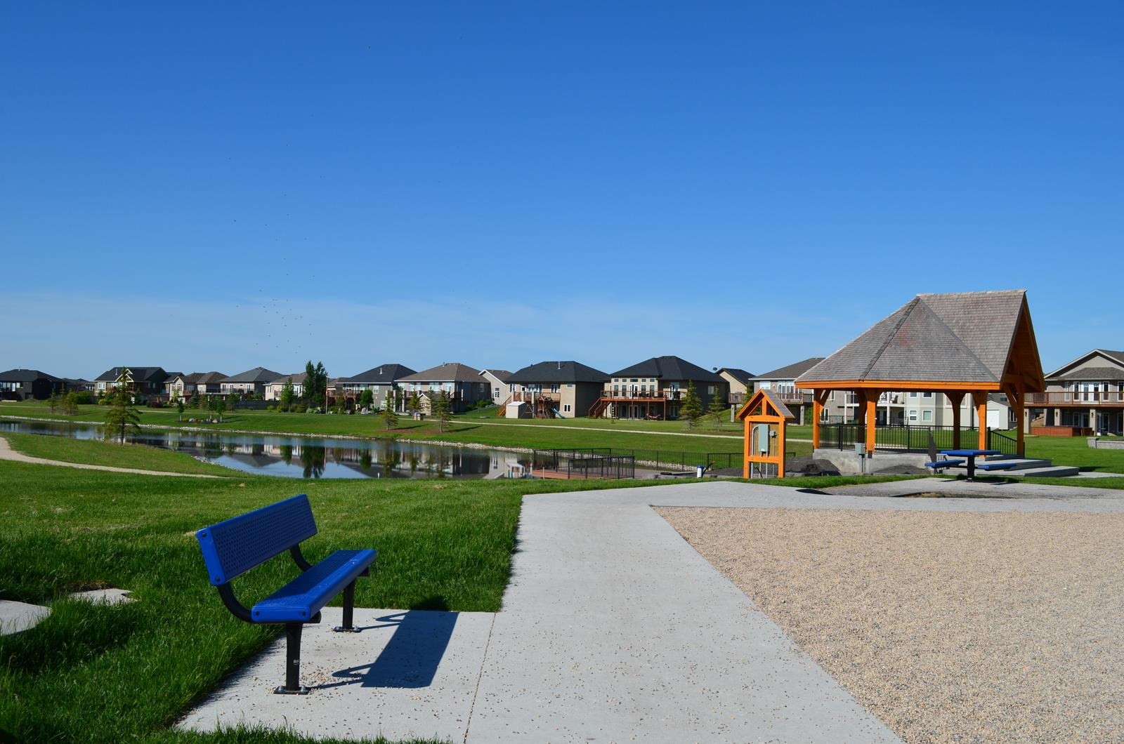
Yet today, in 2019, worship teams in good standing with their local church leadership (from Word of Life, Niverville CMC and Maranatha) have been leading Community Worship Events both indoors and outdoors.
The Hampton Amphitheatre Park, for example has been used for public worship festivals (courtesy of the Niverville Recreation Department) for the past three years. To date, this is the only kind of public event that this community park has been used for.

Slide 34
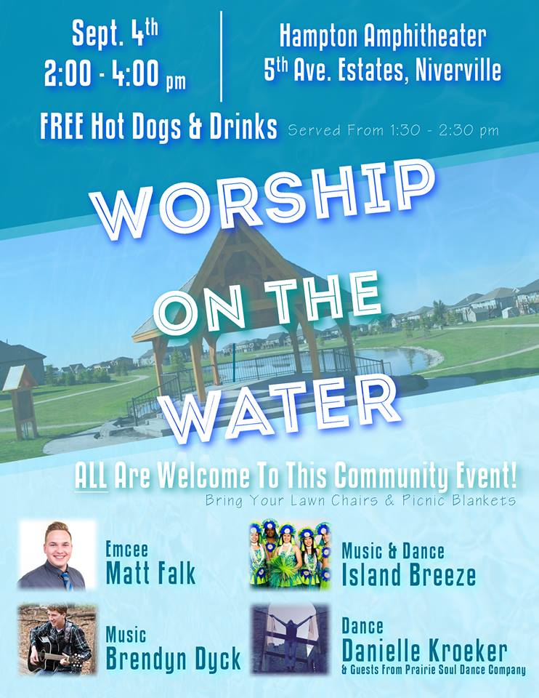
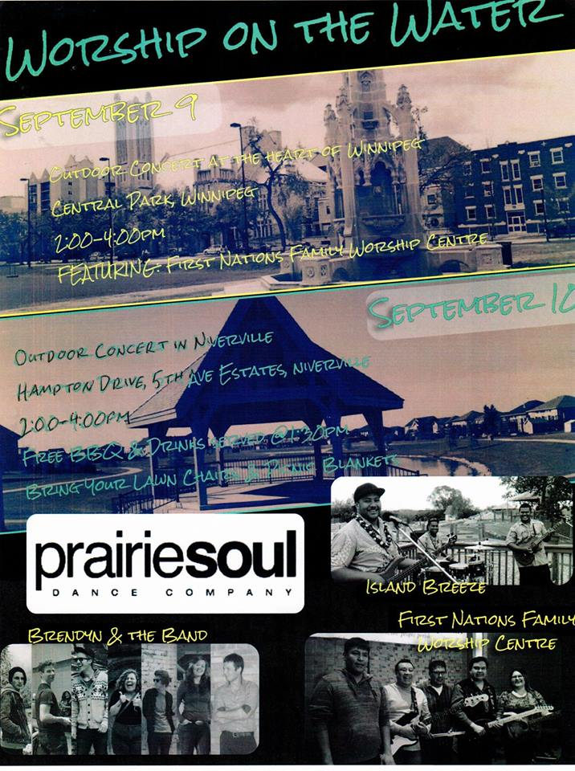
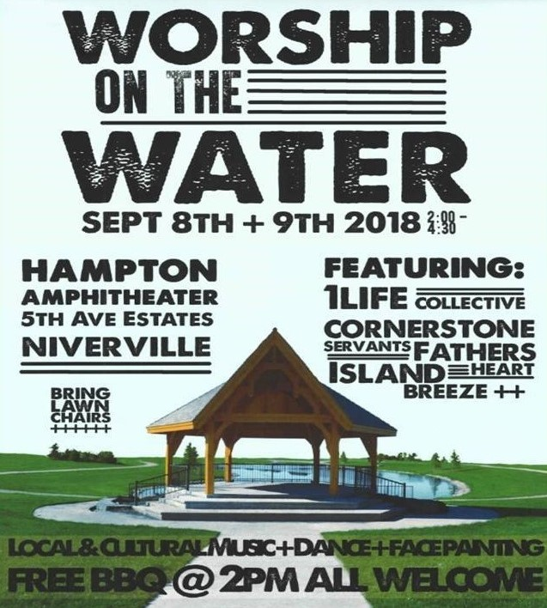
In September of 2016, it was a one-day public worship event at the Hampton Amphitheatre Park led by Matt Falk, and in September of 2017 and 2018, it became a two-day public worship event led by Brendyn Dyck and Daniel Fewster, with participation by First Nations Father’s Heart Worship Team, Island Breeze Manitoba, 1Life Collective (WOL) and Cornerstone Servants (Niverville CMC) with rap music led by Bradney Harder.

Slide 35


In addition to this public expression of unified worship in a park, there have been Niverville Community Worship Events that are now being dubbed One Voice taking place every several months. This is a movement made up of many members, several congregations, but One Voice in agreement in expressing our love for God and love for our fellow human beings in Niverville and beyond. Unity is a key to maturity.

Slide 36
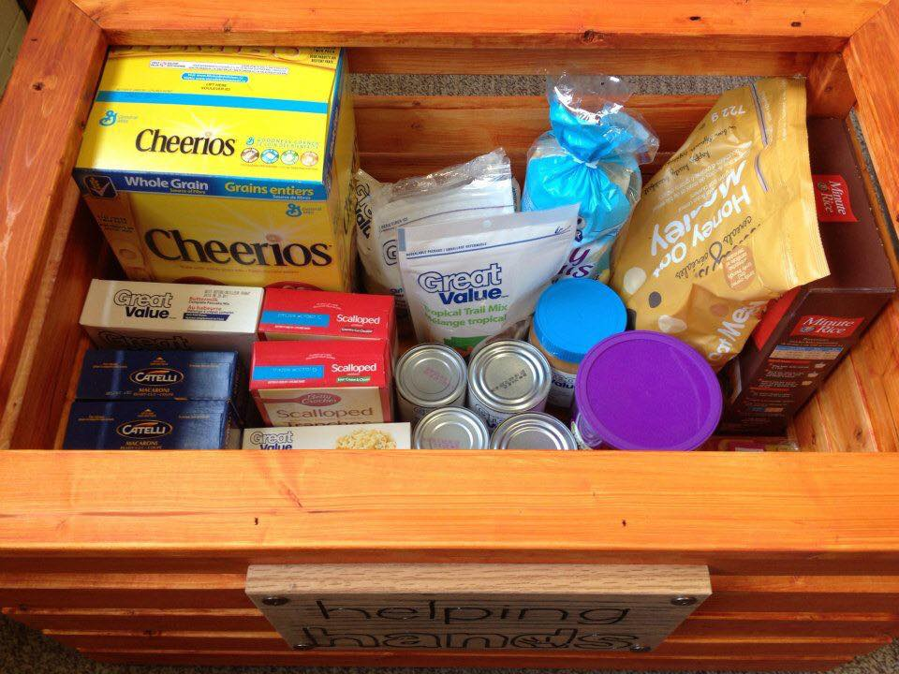

A community expression of love for God in worship cannot help but express itself in a community expression of love for our fellow human beings in actions and deeds of kindness and mercy. These two great commandments encompass everything that the Bible is about. Already, Niverville has a history whereby different groups and congregations have cross-pollinated in the mission of collaborative and co-operative social action. In addition to the Canadian Food Grains Bank, there is the ministry of Helping Hands which offers a hand up to families in need of help to put food on the table.

Slide 37
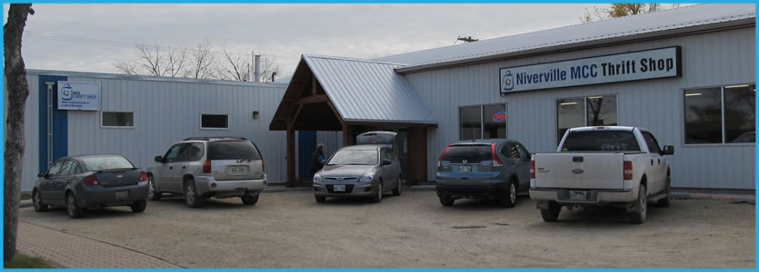
The Niverville Thrift Store is an initiative run by the Mennonite Central Committee that draws volunteers from a large cross-section of the community. The Niverville Thrift Store is a place where every purchase is a gift to the world! MCC Thrift Stores support the work of the Mennonite Central Committee in world-wide ministry of sharing God’s love and compassion with the most vulnerable and needy.

Slide 38

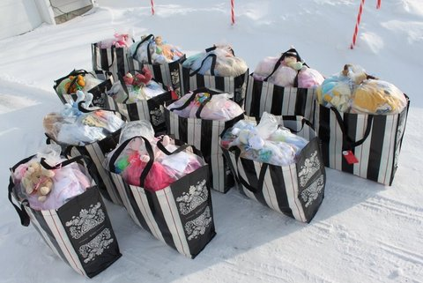
Then there is the ministry of Niverville Baby Layette Love which is basically a baby shower in a bag with 50 brand new items to help single mothers, mothers in need, immigrant mothers— mothers who choose to keep their babies to give them a chance at life. Many hundreds of these layettes have been given out freely and without partiality, regardless of the mother’s ethnicity, skin color or religious beliefs.

Slide 39
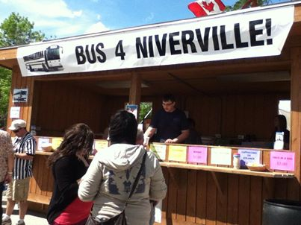
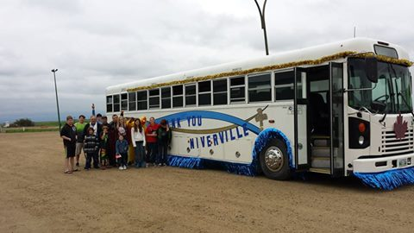
Then there is the Niverville Community Bus Project, which made a Community Bus possible because of the unity, the co-operation and the collaboration of people from several different congregations in Niverville. This bus is a charitable project that is making affordable transportation available for community projects such as youth groups, safe grad, seniors, local hockey team, Everyone Matters Family Street Party, Imagine and the MCC Grow Hope Project, GORP (Artel Farms).

Slide 40
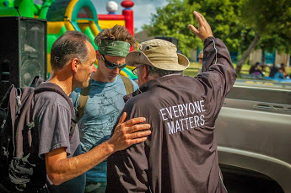
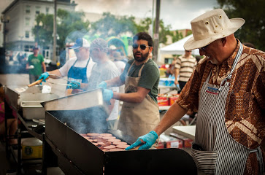
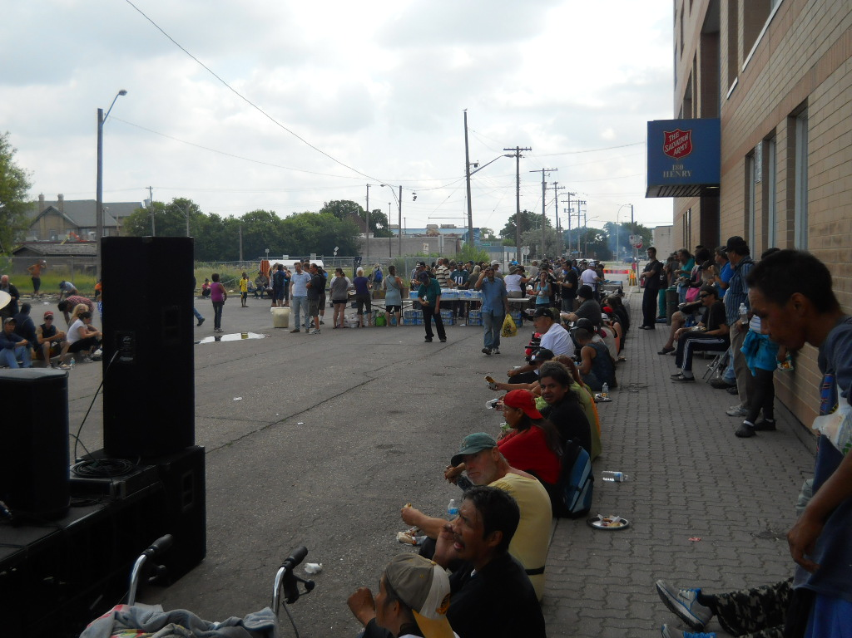
Between the years 2011 and 2017, some 50 volunteers, mainly from Niverville, sponsored and volunteered at the Everyone Matters Family Street Party in which some 500 to 600 street people were treated to a barbecue complete with fun activities for the family, worship music, a short message, and opportunity for prayer. Each year, one could sense that the skepticism of the street people was diminishing as they sensed the genuineness of the love expressed from Nivervilleans

Slide 41

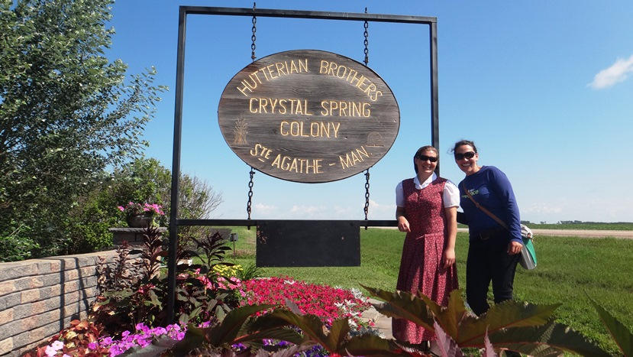
The Imagine Run has for many years brought the issue of mental depression and suicidal thinking out into the open where people can not only talk about it without condemnation, but they can build relationships with people of understanding. The opposite of addiction is connection. Our anabaptist friends from the Crystal Springs Hutterite Colony (just a few miles from Niverville) have been a huge support with this initiative.

Slide 42

There are at least three other present-day ministries in Niverville where believers from different congregations participate together in a co-operative and collaborative way. The first of these is the Niverville Personal Care Home where some of the churches have helped to finance the hiring of a part-time Chaplain, Darlene Dueck, to help meet the spiritual needs of the residents. Each of the eight congregations in Niverville take a turn every eight weeks to take a Sunday morning service at the PCH from 9:30 to 10:00 a.m., and others from the various congregations visit and minister to the lonely at both the PCH and the Niverville Credit Union Manor.

Slide 43

The Niverville Youth for Christ has been a point of light in the community of Niverville for over 30 years now, ever since 1988. This outreach to our local Youth has had a unifying affect in our community, with volunteers coming from the different congregations and spheres of influence in the community.
The Niverville YFC has faithfully hosted the Niverville Ministerial Meetings every month for many years now, and has generously served breakfast to these spiritual leaders every month.

Slide 44

Every August, the Church of Niverville unites in putting on a Vacation Bible School (VBS) which has connected in a deep way with both parents and children. This program has been a strong motivation in giving a sense of community togetherness and common purpose by investing in the next generation!

Slide 45

In addition to these inter-congregational initiatives, there are at least three other opportunities being given to the Church of Niverville wherein the only way that it can work is if we do mission together, and work co-operatively and collaboratively.
In September of 2019, there will be a new high school opening in Niverville, and Chris Cormie, Youth Pastor from Word of Life Mission Church has been asked to help with brief religious exercises prior to morning classes. He is well aware that the only way that this can work is by inter-congregational participation.

Slide 46

Open Doors Niverville is a private sponsorship group made up mainly of people from the Niverville Community Fellowship and from Maranatha Niverville that are working with the Mennonite Central Committee Refugee Program. They have been working for two years to bring a persecuted family from Pakistan (Moon and Schrish and their son Elijah) who are presently in Thailand to Niverville It now looks like this family could be in Niverville by this summer of 2019.

Slide 47

Plans are also in the works to see an inter-congregational and unified effort of the churches in Niverville to work co-operatively with the Lighthouse Mission in the core area of Winnipeg in sponsoring and volunteering for Friday evening Chili Nights to feed some 250 Street people. The new Operations Manager of the Lighthouse Mission, Beverly Ajtay, will be coming to Niverville to share the vision in late May, 2019, and already, people from at least three churches have expressed an interest in becoming involved with this outreach.

Slide 48

And so, in line with its historical connection to grain, there is evidence that as more people in Niverville die to selfishness and plant good seeds with the expectation of a harvest, that Niverville will fulfill its destiny to create a sense of home and belonging both inside and outside its borders in a multiplied way.

Slide 49


Slide 50


Slide 51

Together, we can make a difference! In this year of 2019, Niverville will be celebrating 50 years since it became an incorporated community, separate from the Rural Municipality of Hanover.

Slide 52
On Sunday, September 8, 2019, the congregations of the Church of Niverville will be holding a joint community service in conjunction with the Town of Niverville’s celebration of its 50th Anniversary. The service will be held at the Hespeler Park, the very park named after William Hespeler who financed and built the first circular grain elevator in Western Canada in this community 140 years ago! As the plaque on the stone in front of the sign states, “The character, prosperity and development of the Southeast, including the Town of Niverville, takes its inspiration from these courageous, hardworking people of faith.”

Slide 53


