Slide 1

Thinking Biblically about faith & doubt

Slide 2
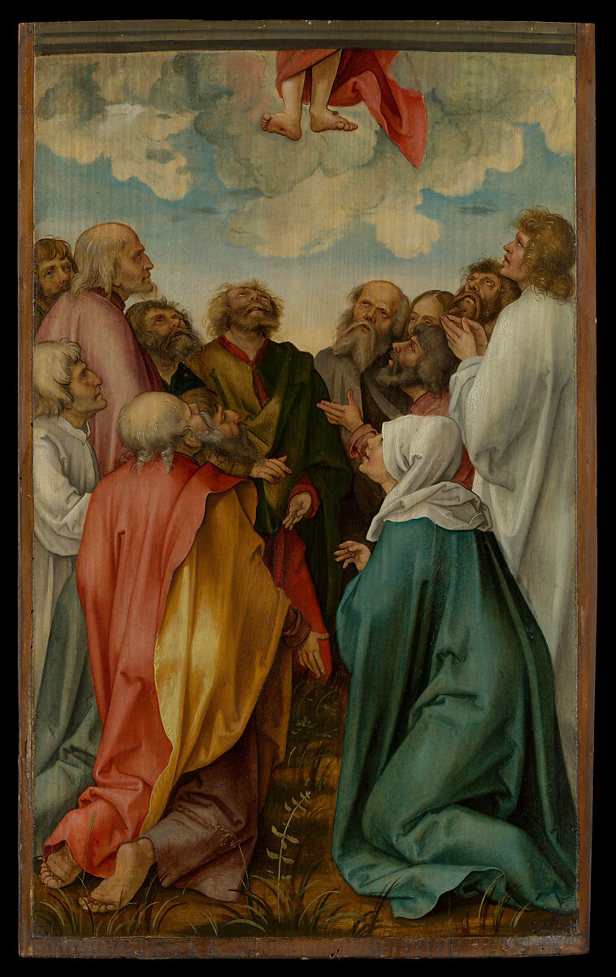
“The Ascension of Christ”
Hans Süss von Kulmbach
(1513)

Slide 3
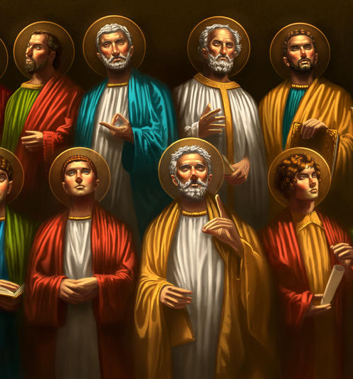
THE APOSTLES (MATT 28:16-17)
Now the eleven disciples went to Galilee, to the mountain to which Jesus had directed them. And when they saw him they worshiped him, but some doubted.

Slide 4
“I must not have faith because I struggle with doubt” that is a mistake

Slide 5
Mark 9:24
Faith is not the absence of doubt but the persistence of belief.
Immediately the father of the child cried out and said, “I believe; help my unbelief!”

Slide 6
Matthew 8:26
FAITH IS NOT ALWAYS STRONG: Our faith can be weak or “little”.
And he said to them,
“Why are you afraid, O you of little faith?”

Slide 7
Jude 3
Beloved, although I was very eager to write to you about our common salvation, I found it necessary to write appealing to you to contend for the faith that was once for all delivered to the saints.
The unbeliever you contend with the most is yourself. The person you persuade the most is yourself.

Slide 8
Faith is not the absence of doubt but the persistence of belief

Slide 9
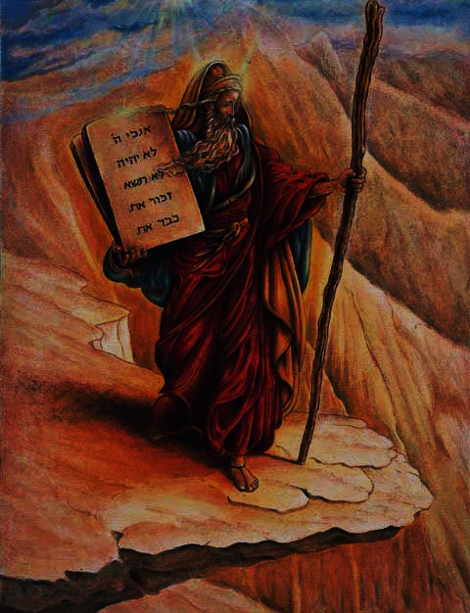
Heroes of the faith
& Times of doubt

Slide 10
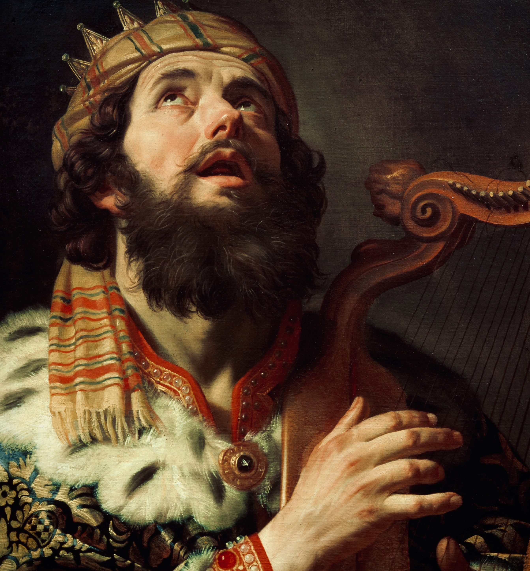
DAVID (PSALM 13:1)
How long, O Lord? Will you forget me forever?
How long will you hide your face from me?

Slide 11
David is not rebelling against God. He is longing for God. It is helpful to think of believer’s doubt as faith fighting for existence.

Slide 12
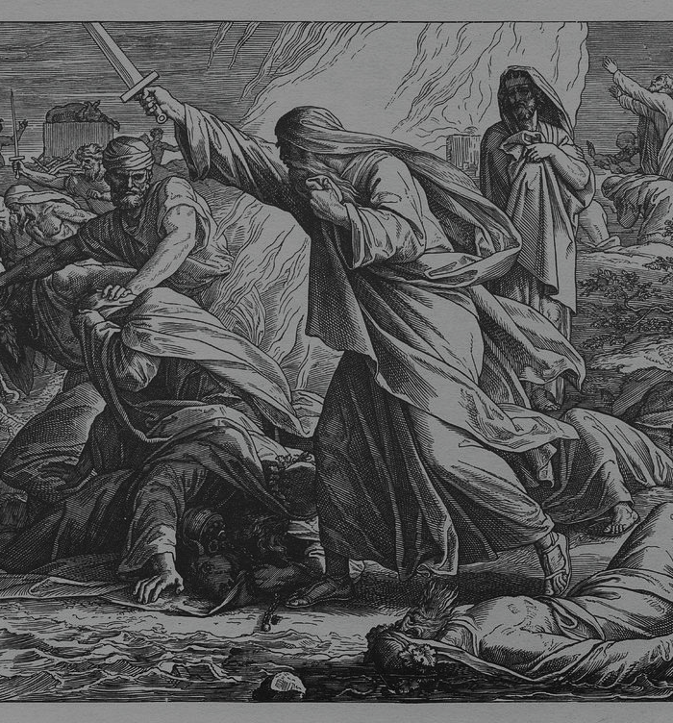
ELIJAH (1 KINGS 19:4)
But he himself went a day's journey into the wilderness and came and sat down under a broom tree. And he asked that he might die, saying, “It is enough; now, O Lord, take away my life, for I am no better than my fathers.”

Slide 13
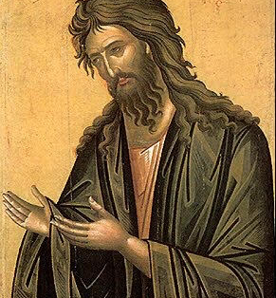
JOHN THE BAPTIST (MATT 11:3)
and said to him, “Are you the one who is to come, or shall we look for another?”

Slide 14
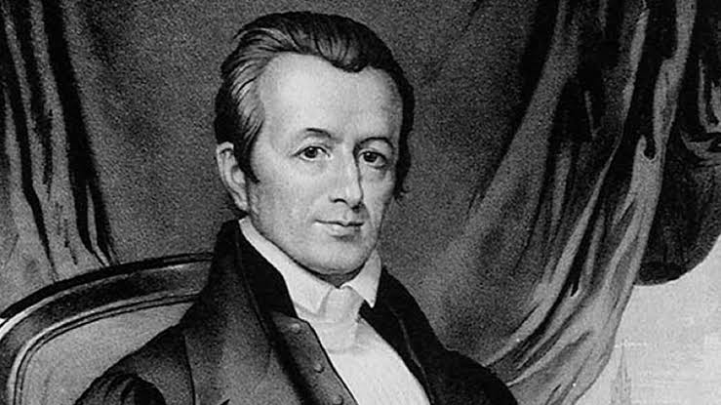
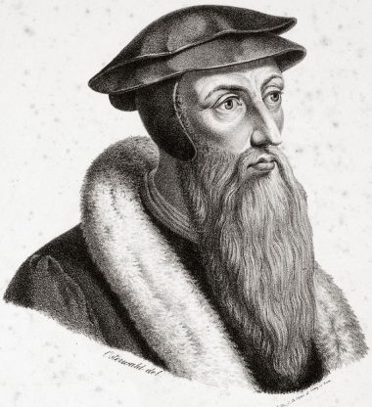
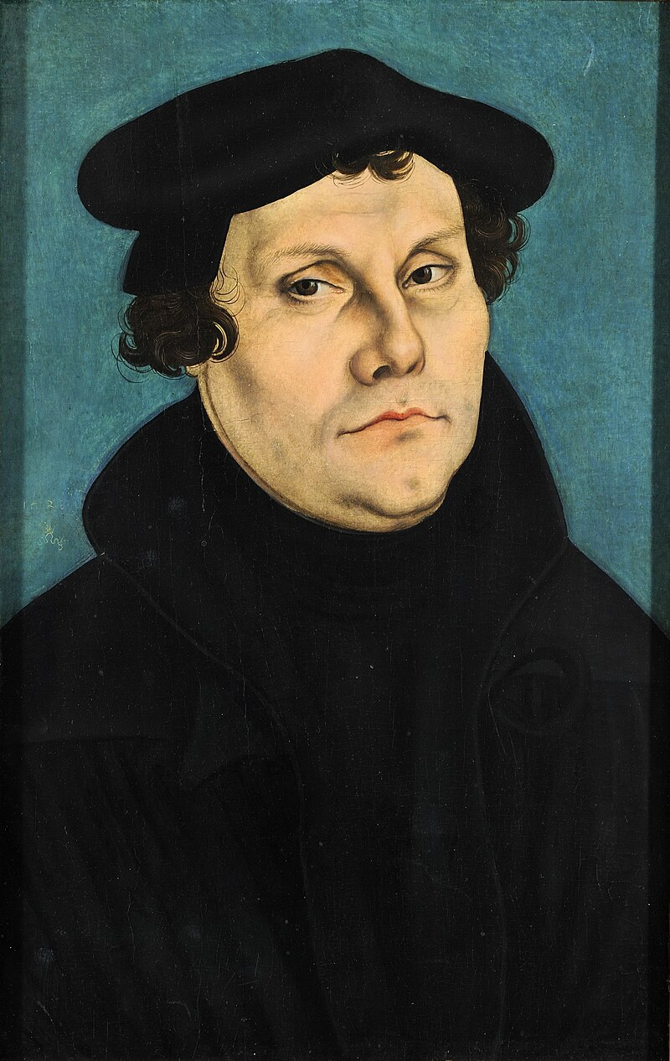
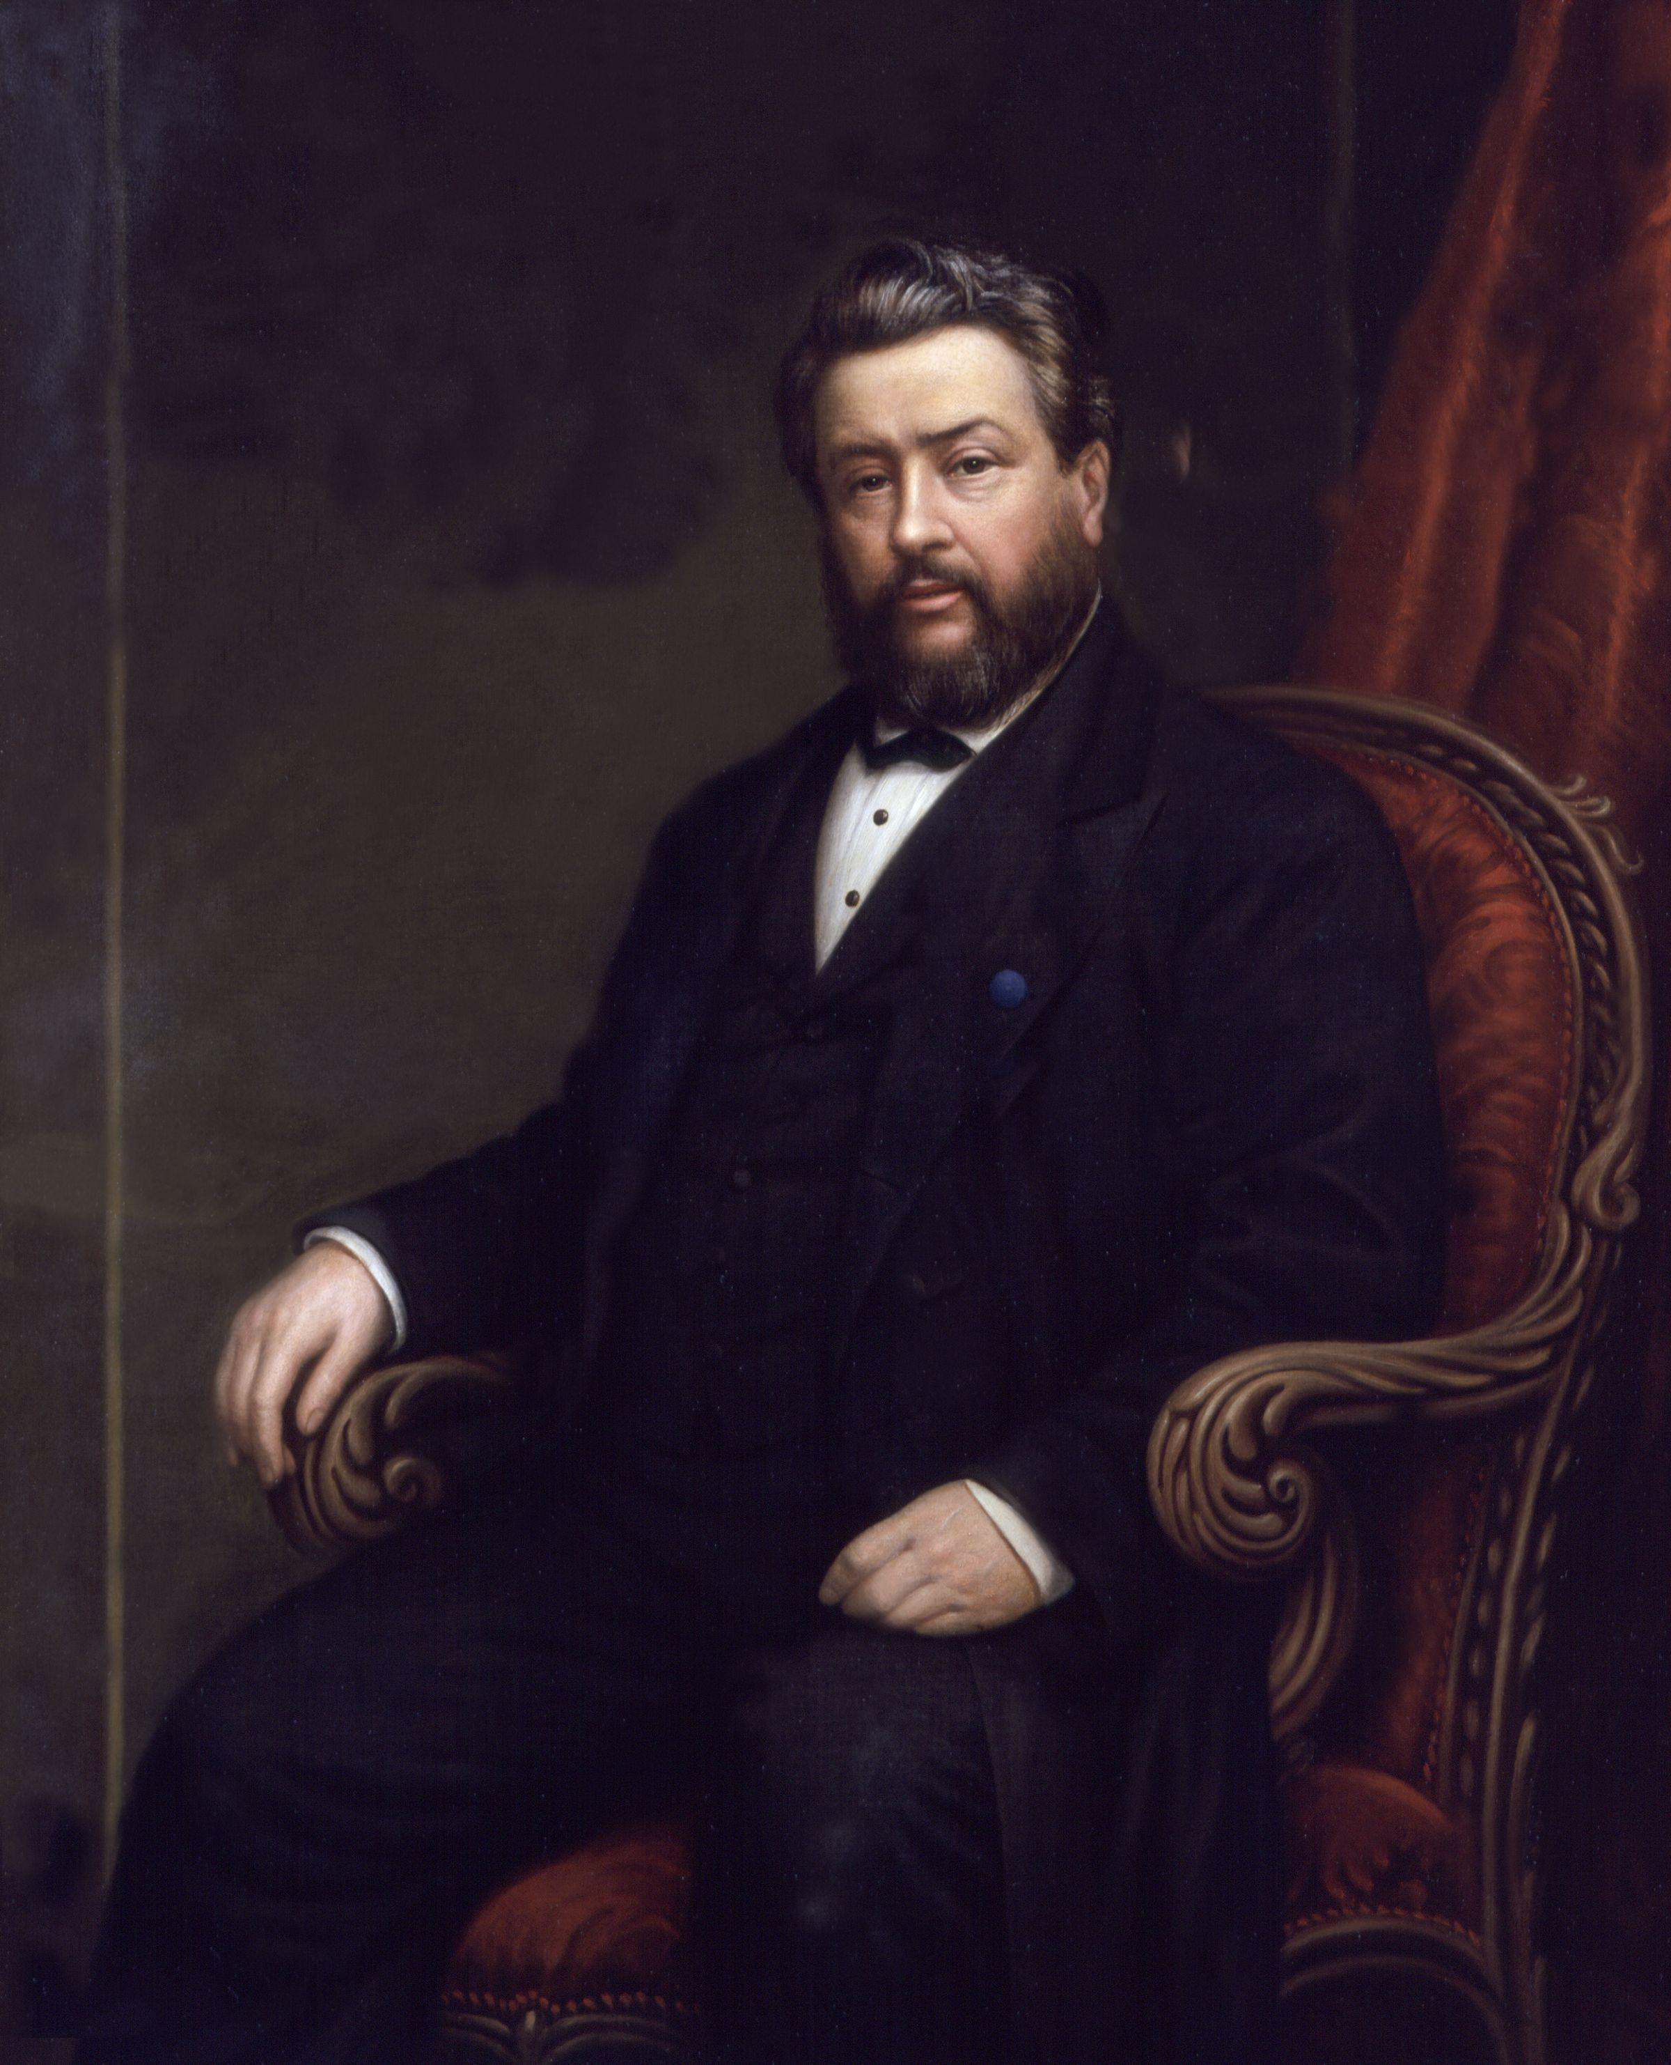
Christians who believe also doubt.

Slide 15
Martin Luther
“For more than a week I was close to the gates of death and hell. I trembled in all my members. Christ was wholly lost. I was shaken by desperation and blasphemy of God.’”

Slide 16
Anfechtung: Spiritual despair due to an inability to trust God’s goodness.

Slide 17
John Calvin
“Surely, while we teach that faith ought to be certain and assured, we cannot imagine any certainty that is not tinged with doubt, or any assurance that is not assailed by some anxiety.”

Slide 18
Adoniram Judson
“I feel utter spiritual desolation. God is the great unknown. I believe in Him, but I find Him not.”

Slide 19
Charles Spurgeon
“I think, when a man says, ‘I never doubt,’ it is quite time for us to doubt him, it is quite time for us to begin to say, ‘Ah, poor soul, I am afraid you are not on the road at all, for if you were, you would see so many things in yourself, and so much glory in Christ more than you deserve, that you would be so much ashamed of yourself, as even to say, 'It is too good to be true.'“

Slide 20
Charles Spurgeon
“I think, when a man says, ‘I never doubt,’ it is quite time for us to doubt him, it is quite time for us to begin to say, ‘Ah, poor soul, I am afraid you are not on the road at all, for if you were, you would see so many things in yourself, and so much glory in Christ more than you deserve, that you would be so much ashamed of yourself, as even to say, 'It is too good to be true.'“

Slide 21
DIFFERENT KINDS OF DOUBT
Intellectual Doubt
Experiential Doubt
Mystery Doubt
Sin Induced Doubt

Slide 22
DOUBT IS NOT A VIRTUE
We are commanded to believe and not doubt.
Beware of any teacher or “Christian” movement that glorifies unbelief.
John 20:27
James 1:6
Romans 14:23

Slide 23
How do we deal with doubt?

Slide 24
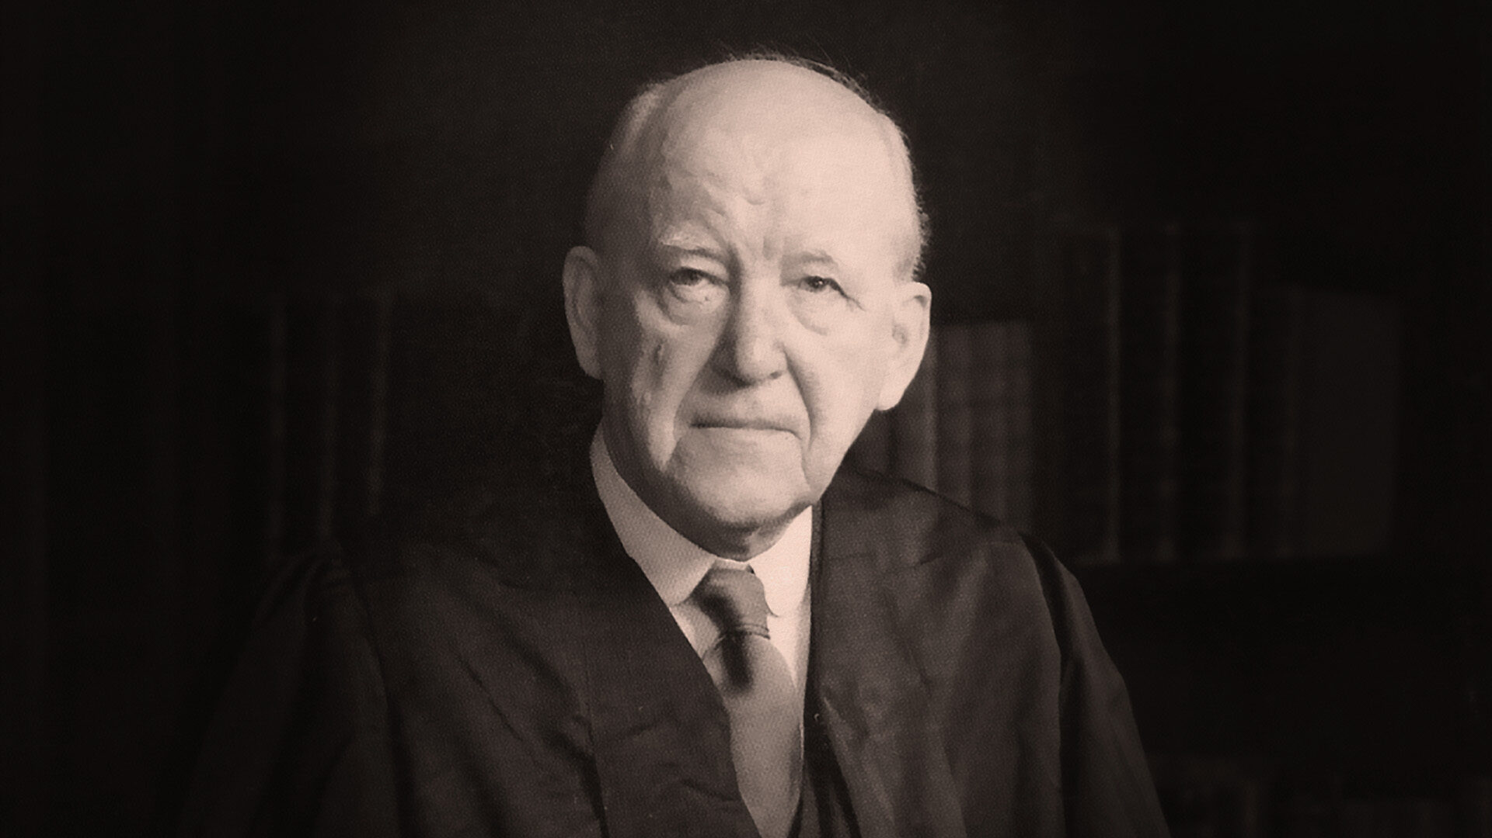
    Faith is a refusal to panic. Faith says: `I am not going to be controlled by these circumstances- I am in control’. So you take charge of yourself, and pull yourself up, you control yourself. You do not let yourself go, you assert yourself.
    Martin Lloyd-Jones, Spiritual Depression, Its Causes and Cures (1965).

Slide 25
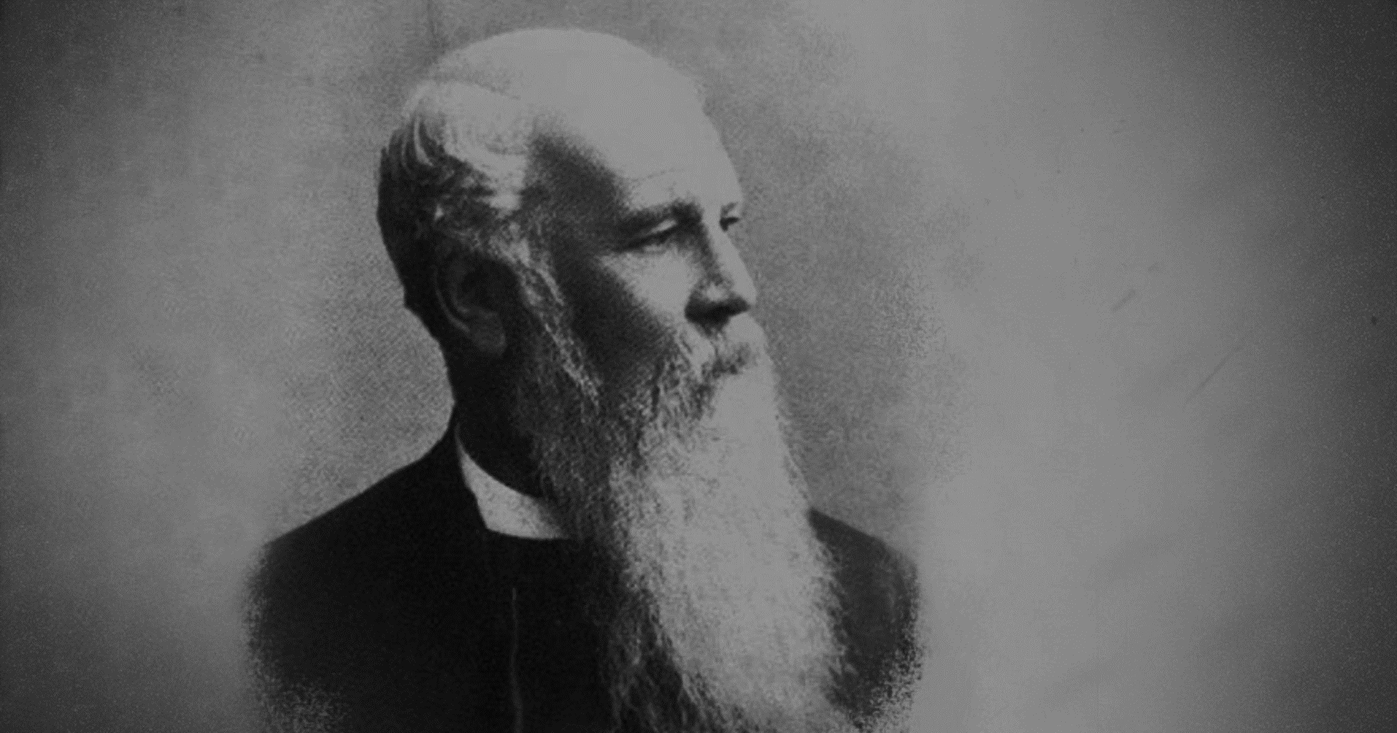
J.C. Ryle in
The Unchanging Christ (1868)
We bid you take comfort, and remember that Christ is still the same: he called you and gave you the witness of the Spirit, and he will not forsake you. You may waver and tremble: go forward in faith, and He will support you.

Slide 26
DAVID (PSALM 13:5-6)
But I have trusted in your steadfast love;
my heart shall rejoice in your salvation.
I will sing to the Lord,
because he has dealt bountifully with me.

Slide 27
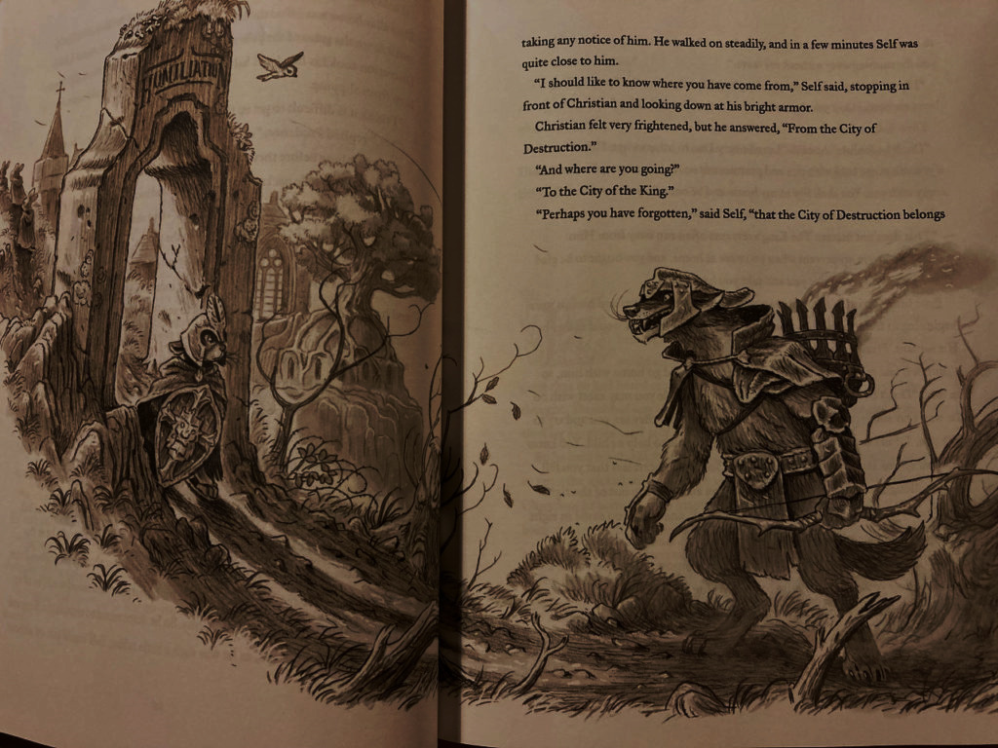
      “What a fool am I, thus to lie in a stinking dungeon, when I may as well walk at liberty? I have a key in my bosom called Promise that will (I am persuaded) open any lock in Doubting Castle.“
      Pilgrim’s Progress, Part 1, Section 8

Slide 28
God’s word is the key to faith & personal freedom.
With it you are covered in armor.
Without it you don’t stand a chance.
Are you armoring yourself daily?

Slide 29
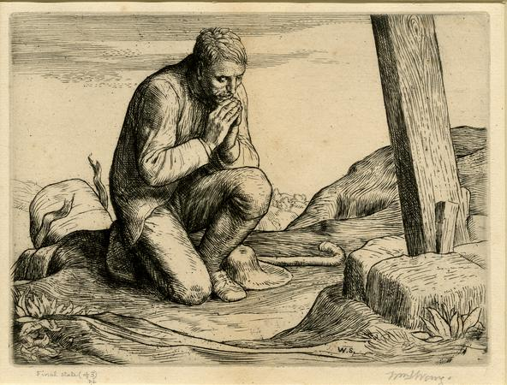
DEALING WITH DOUBT
Confess it.
Endure it.
Address it.
Share it.

Slide 30
TWO VERSES THAT HAVE HELPED ME DEAL WITH DOUBT.

Slide 31
We do not know what to do, but our eyes are on you.
2 Chronicles 20:12

Slide 32
“The secret things belong to the Lord our God, but the things that are revealed belong to us and to our children forever, that we may do all the words of this law.
Deuteronomy 29:29

Slide 33
TWO reasons god allows us to experience doubt.

Slide 34
God uses doubt to settle faith.
“Nothing is so certain as that which is certain after doubts. Shaking settles and roots.”
― Richard Sibbes,
The Bruised Reed (1630)

Slide 35
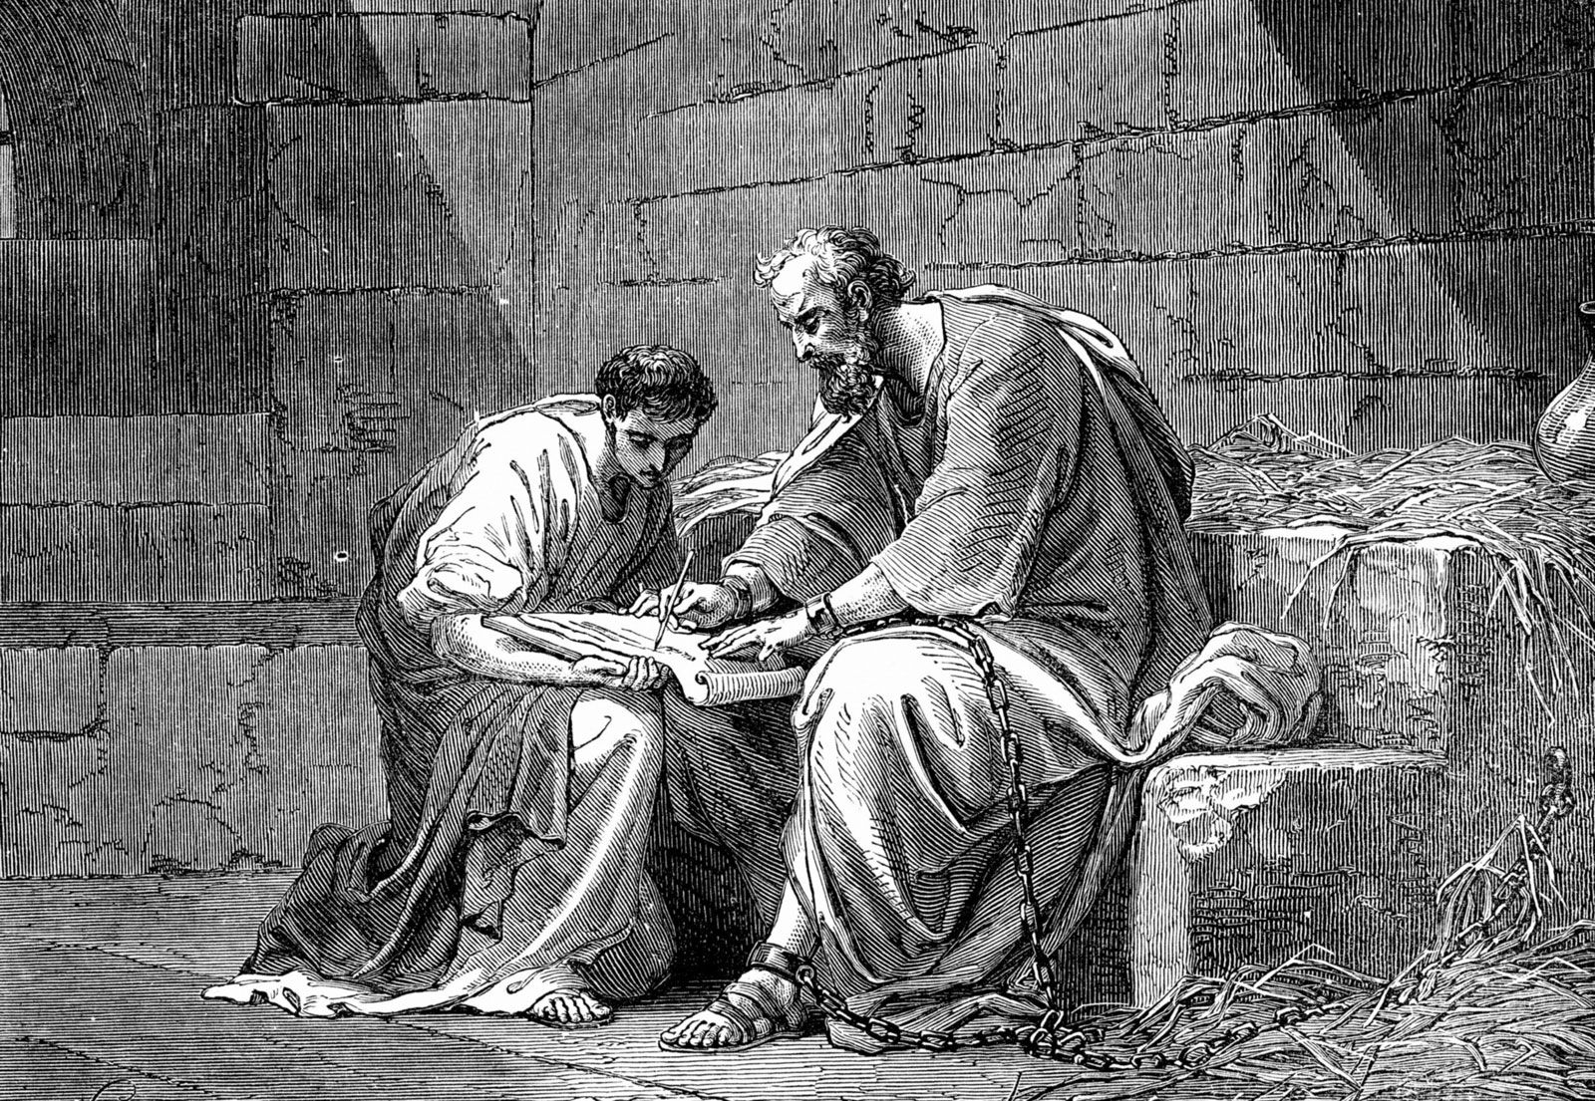
God comforts us to comfort others.
³ Blessed be the God and Father of our Lord Jesus Christ, the Father of mercies and God of all comfort, ⁴ who comforts us in all our affliction, so that we may be able to comfort those who are in any affliction, with the comfort with which we ourselves are comforted by God.
2 Corinthians 1:3-4

Slide 36
adamgroza@gs.edu

