Slide 1
THANKS
LIVING
Learn to Live Thankfully

Slide 2
HOW WAS YOUR THANKSGIVING?

Slide 3
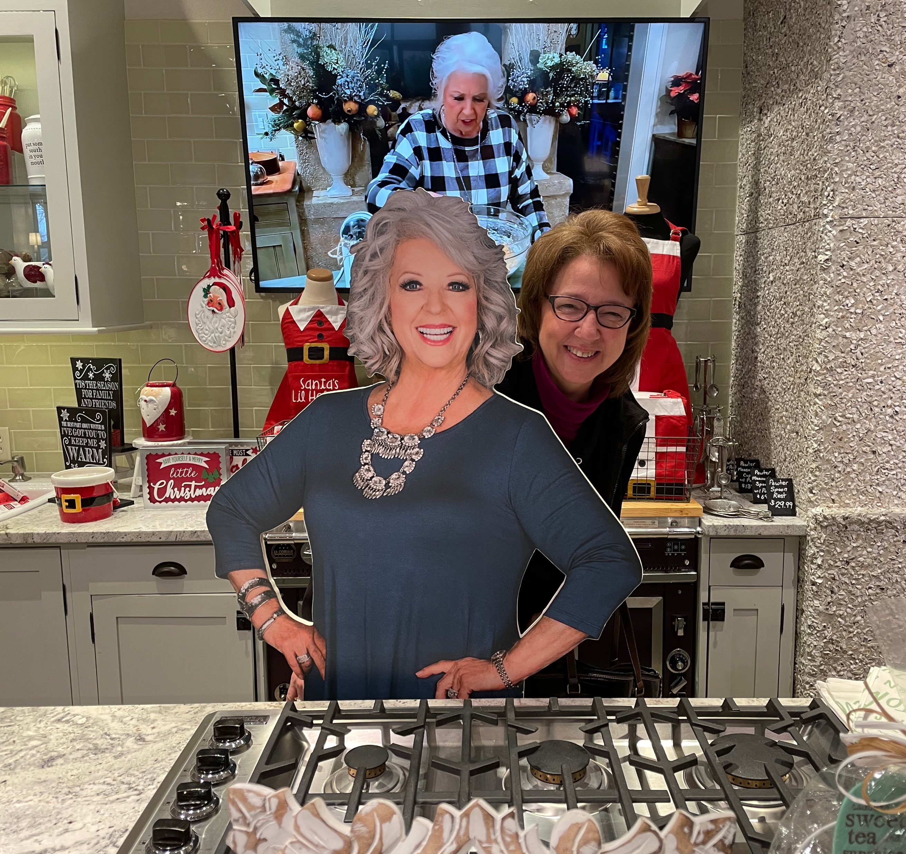
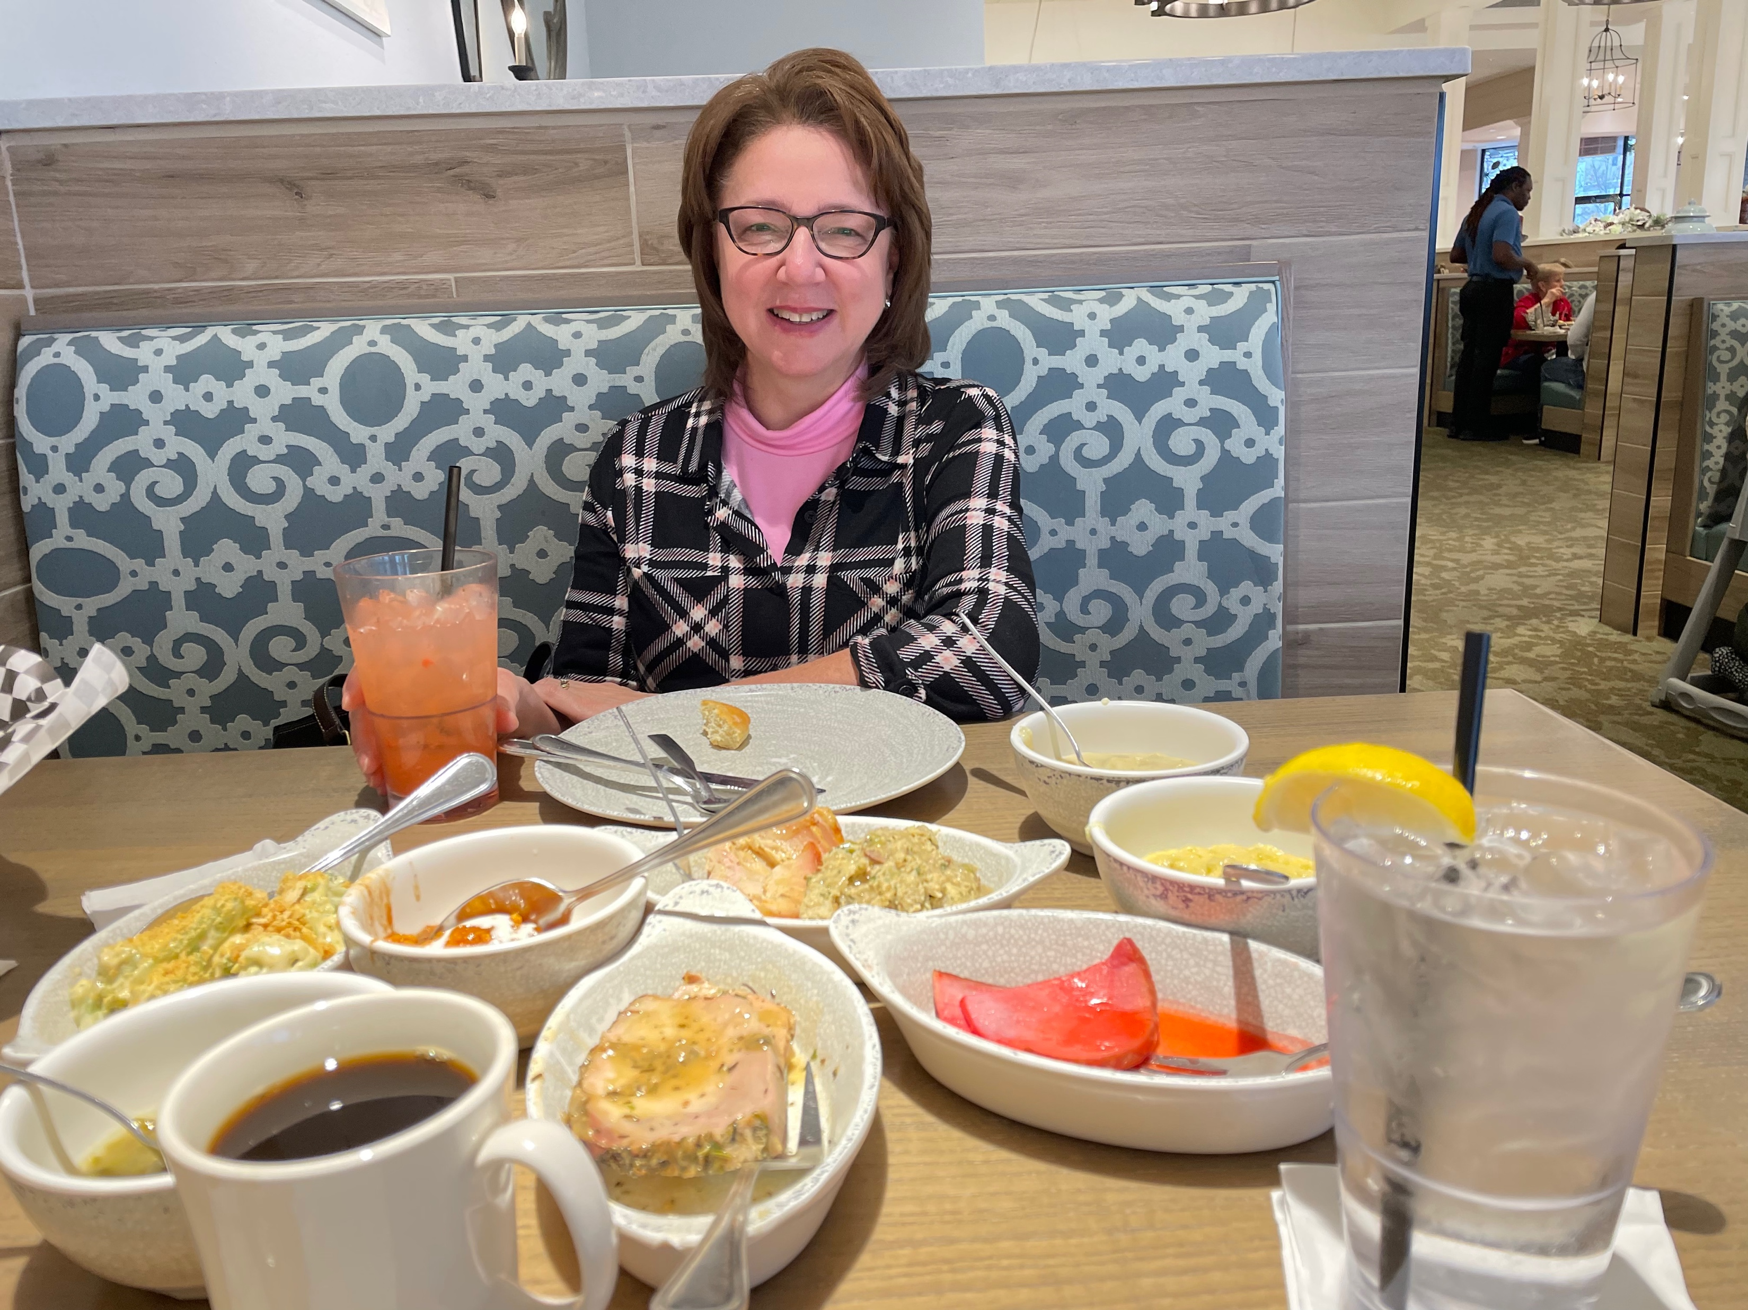
HOW WAS YOUR THANKSGIVING?

Slide 4
Are you moving from
Thanksgiving as a holiday to
ThanksLiving as a holy habit?

Slide 5
THANKS
LIVING
How Can I Be More Thankful?
REMEMBER to be thankful for common grace gifts but even more so for the saving grace Giver.

Slide 6
THANKS
LIVING
How Can I Be More Thankful?
RESOLVE the tension between changing circumstances and our unchanging God.
“Whom have I in heaven but you? And there is nothing on earth that I desire besides you. My flesh and my heart may fail, but God is the strength of my heart and my portion forever.”
Psalm 73:25–26

Slide 7
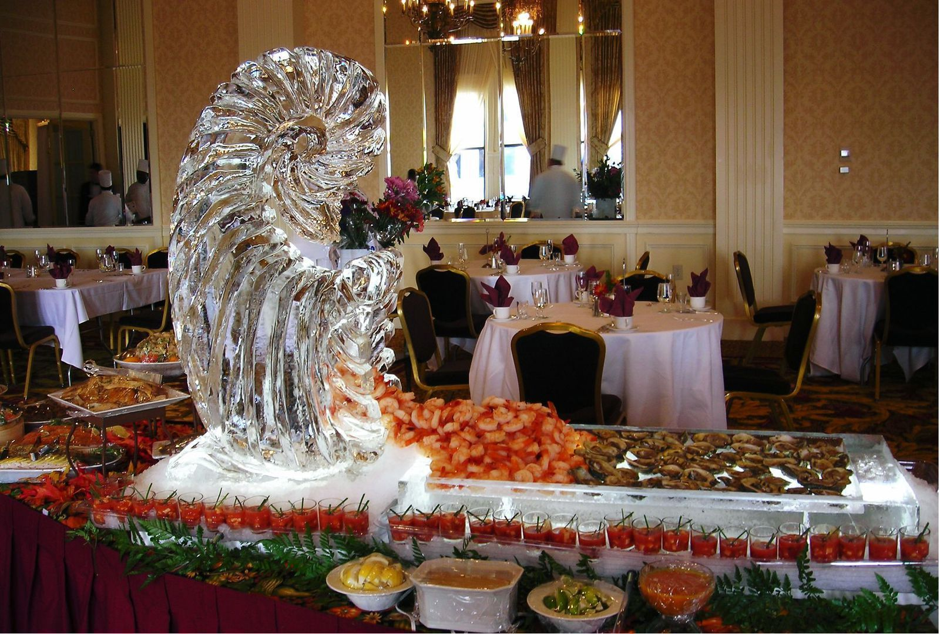
THANKS
LIVING
How Can I Be More Thankful?
REALIGN your living with Christ's lordship. Colossians 2:6-7

Slide 8
THANKS
LIVING
Paul’s “Holy Day” Recipe for
Overflowing with ThanksLiving
The secret recipe is to realign your living with Christ's lordship: "Just as...so continue..."!

Slide 9
THANKS
LIVING
Paul’s “Holy Day” Recipe for Overflowing with ThanksLiving
Embrace SURRENDERED Living.
Just as you received Jesus Christ as the Lord,
so continue to live under His Lordship on a daily basis!

Slide 10
Have you RECEIVED Jesus Christ the Lord?

Slide 11
“Christ Jesus the Lord” means Jesus is the Christ who
is the LORD over all!
Colossians 1:15-20; 2:9-10

Slide 12
Salvation is a free gift from the Person who is
BOTH Savior AND Lord.
Your salvation is secure and sure by WHO Jesus is and WHAT He has DONE for you, is DOING for you,
and has yet to DO for you!

Slide 13
Therefore, the rest of your life should overflow with one big: "THANK YOU!"

Slide 14
If so, continue to LIVE under His lordship
on a daily basis.

Slide 15
THANKS
LIVING
Paul’s “Holy Day” Recipe for Overflowing with ThanksLiving
Experience SPIRITUAL Growth.
Just as you have been rooted in Christ's Lordship,
so continue to be built up in His Lordship!

Slide 16
Has God firmly ROOTED you in Jesus Christ
the Lord?

Slide 17
Has God firmly ROOTED you in Jesus Christ
the Lord?
The Lordship of Jesus Christ Is Our SOURCE of Life
and STABILITY in Life's Storms!
Colossians 1:23; 2:9-10

Slide 18
If so, continue being BUILT UP in His Lordship
on a daily basis.

Slide 19
If God is the one building us up in Christ's Lordship,
what tools does He use?
The SPIRIT of God
The PEOPLE
of God
The WORD of God

Slide 20
If I am to cooperate with God in this building project,
how did I do in 2022?
The SPIRIT of God
The PEOPLE
of God
The WORD of God

Slide 21
THANKS
LIVING
Paul’s “Holy Day” Recipe for Overflowing with ThanksLiving
Establish STRONG Convictions.
Just as you were taught gospel truth,
so continue to be established in this gospel truth!

Slide 22
Have you been TAUGHT the gospel truth
about Jesus Christ the Lord?

Slide 23
If so, continue to be ESTABLISHED in the gospel truth about His Lordship on a daily basis

Slide 24
People Who Are Firm in the Faith...
1. Discover sound doctrine IN the Bible.
2. Develop strong convictions FROM the Bible.
3. Discern false teaching WITH the Bible.

Slide 25
THANKS
LIVING
Paul's "Holy Day" Recipe Is to Realign Your Living
with Christ's Lordship:
Embrace Surrendered Living Under Him,
Experience Spiritual Growth in Him,
Establish Spiritual Convictions About Him,
and You Will Be a Cornucopia Overflowing with ThanksLiving!

Slide 26

THANKS
LIVING
Learn to Live Thankfully
New Life Class | 9:30 AM | Multipurpose Room

