Slide 1
Sharing our faith through
Community action
Plan Your next Community initiative
Presented to
Mid-Atlantic Episcopal district

Slide 2


Scriptural basis for Community action
paraphrase
One of the purest and most undefiled demonstrations of the gospel is to move towards hard places and broken people, not away from them.

Slide 3
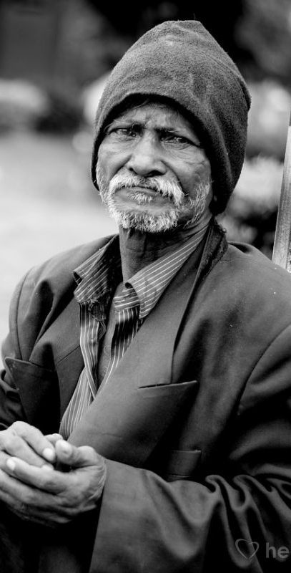
Scriptural basis for
Community action
Matthew 25:37-40 NIV
37 “Then the righteous will answer him, ‘Lord, when did we see you hungry and feed you, or thirsty and give you something to drink? 38 When did we see you a stranger and invite you in, or needing clothes and clothe you? 39 When did we see you sick or in prison and go to visit you?’40 “The King will reply, ‘Truly I tell you, whatever you did for one of the least of these brothers and sisters of mine, you did for me.’

Slide 4
Community action Planning process
Pray – pray throughout the process
Engage your board/s
Define your area
Assess your area
Consider your skills & resources
Determine your target

Slide 5
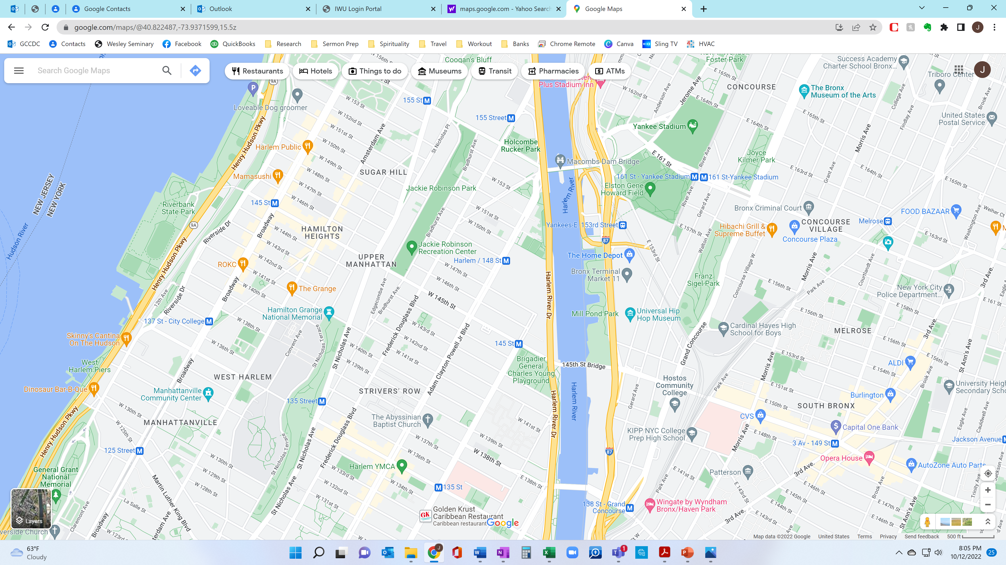

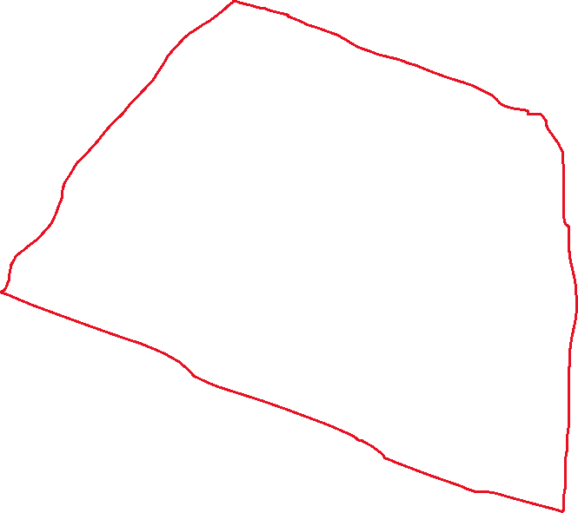
Define your geographical area of impact?
What is your parish?
Large enough to mean something
Small enough to impact
Prayer walks

Slide 6
Assess your area
Who is in your parish? Demographics
  Businesses/entities
    Companies (Large & small)
    Hospitals
    schools
    Non-profits
    Government agencies
    Other churches
  Residents
    Owners (Individuals & major property holders
    renters
Who comes into your parish & from where?
  Church goers
  Shoppers
  workers

Slide 7
Assess your skills & resources
What skills are in your church?
  Preach on Matthew 25:37-40
  Do survey following sermon before benediction
    List your skill sets
    List your interests
    What should the church be doing in the community
What skills are in your community?
  Ask congregation
  Walk the community
Who are community leaders/politicians?
What funding is coming into area?
Who are potential collaborators/partners?

Slide 8
Determine your action
What is God calling us to be and do?
How will we practice Christian community in our corporate life?
With regard to the physical space, how do we
  Repurpose
  Reimagine
  Redefine
Strategically opportunistic
  Challenges
  Crises

Slide 9
outcomes
PARTNERED WITH A SCHOOL – started with a class
LAUNCHED A WEEKLY FOOD DISTRIBUTION
  Amish organization
  Share our strength
  Church resources
LICENSED SCHOOL AGED CHILDCARE
  Free summer program
  Potential afterschool
  Potential daycare
New idea: CRISIS HOMELESS SHELTER

Slide 10
Rev. Julius Walls, Jr.
Chief Operating Officer
JWalls@AMEZion.org
704-688-2560

