Slide 1
“The Black Church: Opportunities for Sharing Our Faith”
Bishop W. Darin Moore, Presenter
Mid-Atlantic Episcopal District
of the AME Zion Church
  LEADERSHIP TRAINING INSTITUTE
THURSDAY OCTOBER 13, 2022
Westfield marriott hotel and conference center ~ Chantilly, VA

Slide 2
“And I tell you, you are Peter, and on this rock I will build my church, and the gates of Hades will not prevail against it.” - Matthew 16:18
The Church is GOD’s idea!
THE CHURCH is The Body of Christ, through worship, witness, and work, connecting people to Jesus and growing together to become like Christ.
The Church is NOT DYING, it’s SHIFTING.

Slide 3

A. OUR MISSION IS THE GREAT COMMISSION
And Jesus came and said to them, “All authority in heaven and on earth has been given to me. Go therefore and make disciples of all nations, baptizing them in the name of the Father and of the Son and of the Holy Spirit, teaching them to observe all that I have commanded you. And behold, I am with you always, to the end of the age.” ~ Matthew 28: 18 - 20
* Are we authentic in our desire to connect with people?
*Have we lost (or never had) a zeal to spread the Gospel?
Are we clear on the basic truths of the Christian Faith?
*Are we intentional in training our members to invite and disciple new believers?

Slide 4

B. OUR MOTIVATION IS THE GREAT COMMANDMENT
“Teacher, which commandment in the law is the greatest?” He said to him, “ ‘You shall love the Lord your God with all your heart and with all your soul and with all your mind.’ This is the greatest and first commandment. And a second is like it: ‘You shall love your neighbor as yourself.’ On these two commandments hang all the Law and the Prophets.”” ~ Matthew 22: 36 - 40
*Do we truly believe that a relationship with Jesus Christ is the most important factor in our lives?
*Are we convinced that everyone needs to experience the love of Jesus and new life in Him?
*Are we passionate about sharing the Gospel with our neighbors (our family, community, world)?

Slide 5
C. OUR METHOD IS GREAT COMMUNICATION
“In the presence of God and of Christ Jesus, who is to judge the living and the dead, and in view of his appearing and his kingdom, I solemnly urge you: 2 proclaim the message; be persistent whether the time is favorable or unfavorable; convince, rebuke, and encourage with the utmost patience in teaching. 3 For the time is coming when people will not put up with sound teaching, but, having their ears tickled, they will accumulate for themselves teachers to suit their own desires 4 and will turn away from listening to the truth and wander away to myths. 5 As for you, be sober in everything, endure suffering, do the work of an evangelist, carry out your ministry fully.”~ 2 Timothy 4: 1 - 5
*Do we share our faith as people who unapologetically love GOD?
*Are we empowered by the Holy Spirit?
*Is our message rooted in the Holy Scriptures?
*Do we truly have a heart for the people in our community?

Slide 6

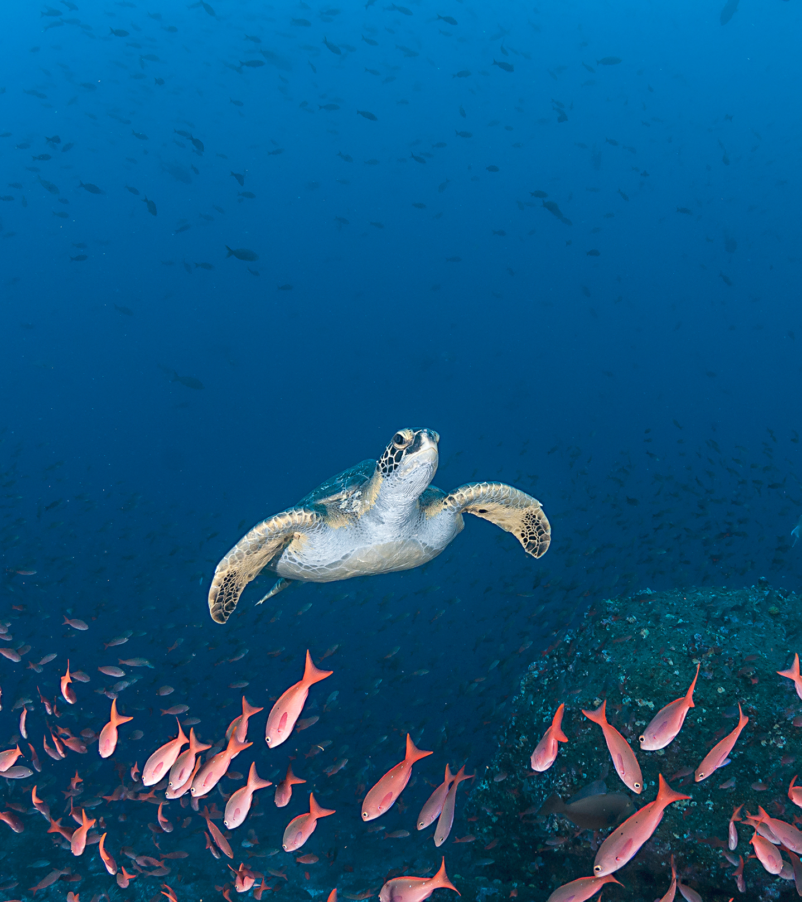
EVANGELISM AND TECHNOLOGY
PAX ROMANA - EARLY CHURCH EXPANSION
GUTENBURG BIBLE - PROTESTANT REFORMATION
USA INTERSTATE HIGHWAY SYSTEM - SUBURBAN CHURCH GROWTH
RADIO AND TV - GLOBAL EVANGELISM
INTERNET, SOCIAL MEDIA, AND THE METAVERSE - ???

Slide 7
“A Contagious Church or A ‘COVID Congregation’?”
“Day by day, as they spent much time together in the temple, they broke bread at home and ate their food with glad and generous hearts, praising God and having the goodwill of all the people. And day by day the Lord added to their number those who were being saved.” - Acts 2: 46-47
> RADICAL HOSPITALITY OR A COMPROMISED IMMUNE SYSTEM
> ENTHUSIASTIC WORSHIP OR A STRUGGLE TO BREATHE
> CONTAGIOUS COMMITMENT TO COMMUNITY OR A VIRIUS OF APATHY
> INTENTIONAL AND CONSISTENT INVITERS OR QUARANTINED INWARD FOCUSED MEMBERS

