Slide 1
Sharing Faith in a Skeptical Culture
Mid-Atlantic Episcopal Conference
October 13, 2022
Dr. Lance Watson

Slide 2
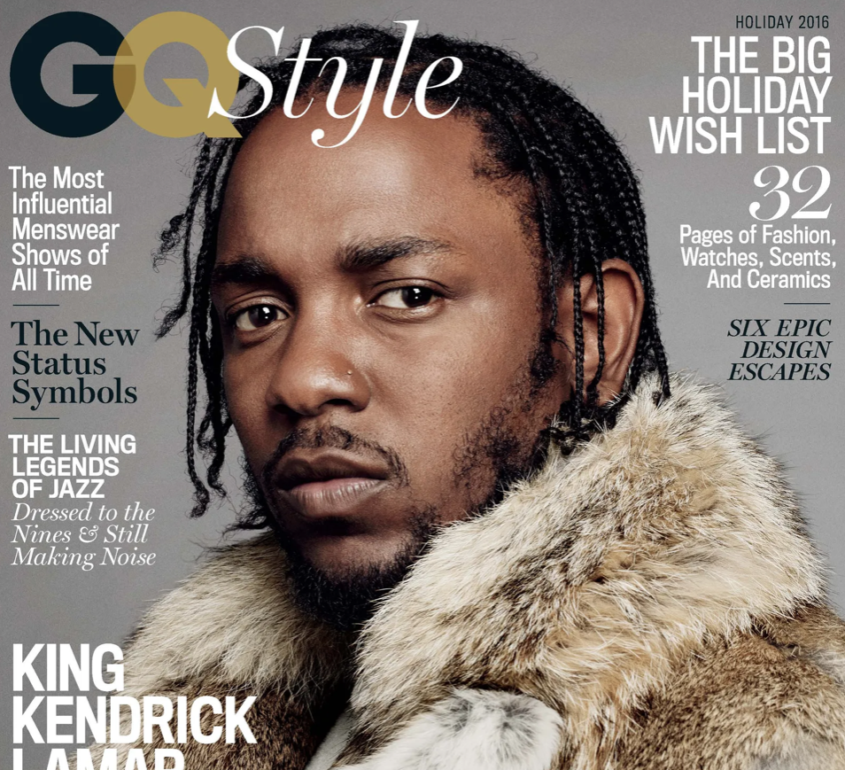
21 Books You Don’t Have to Read
#12: THE BIBLE

Slide 3


Slide 4


Slide 5
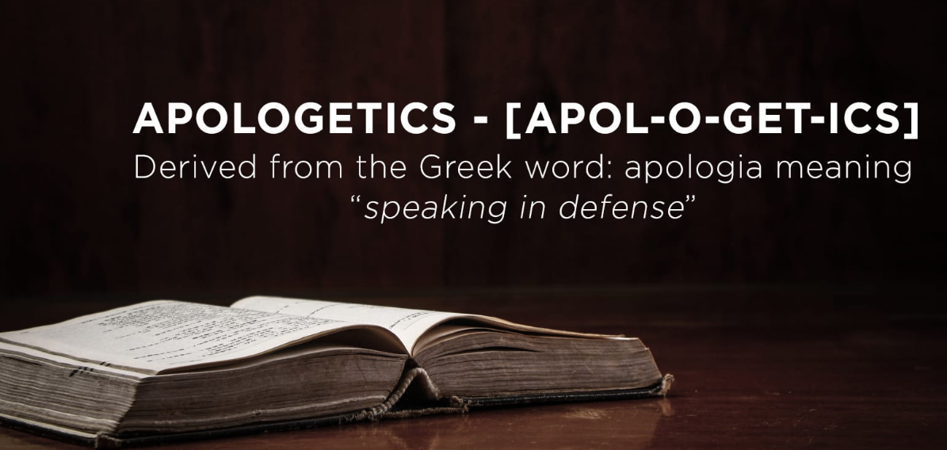

Slide 6
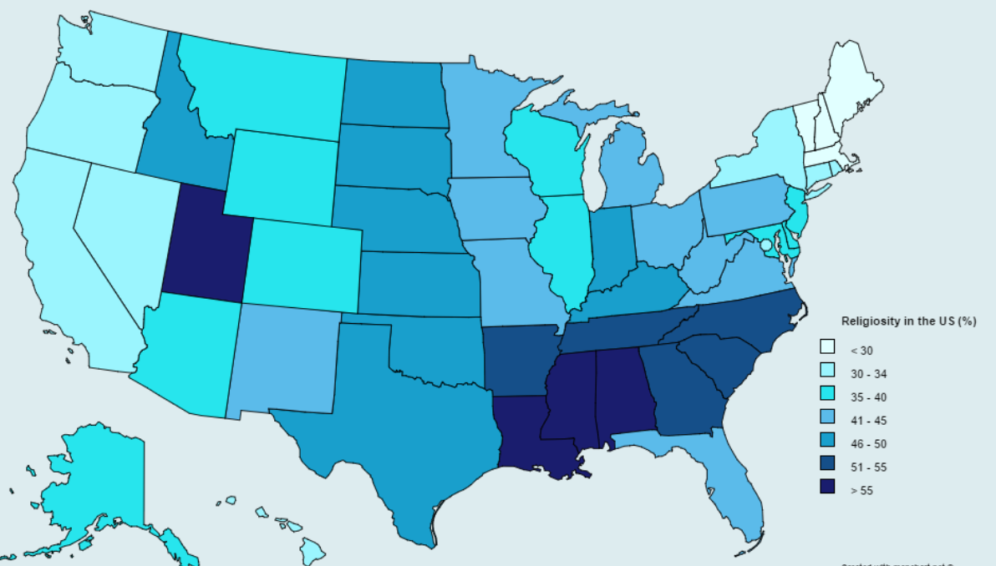

Slide 7
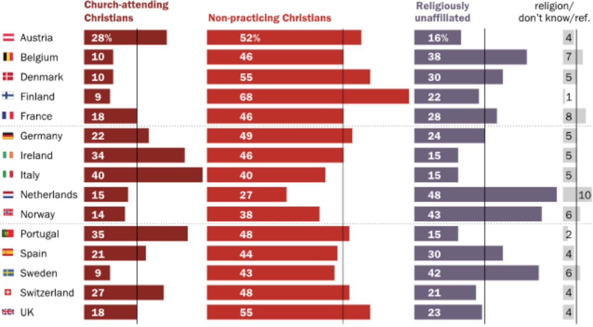

Slide 8
Practicing Christians identify as Christian, agree strongly that faith is very important in their lives and have attended church within the past month.
Non-practicing Christians are self-identified Christians who do not qualify as practicing.
Non-Christians are U.S. adults who do not identify as Christian.

Slide 9
ONE IN FOUR AMERICANS ARE PRACTICING CHRISTIANS

Slide 10
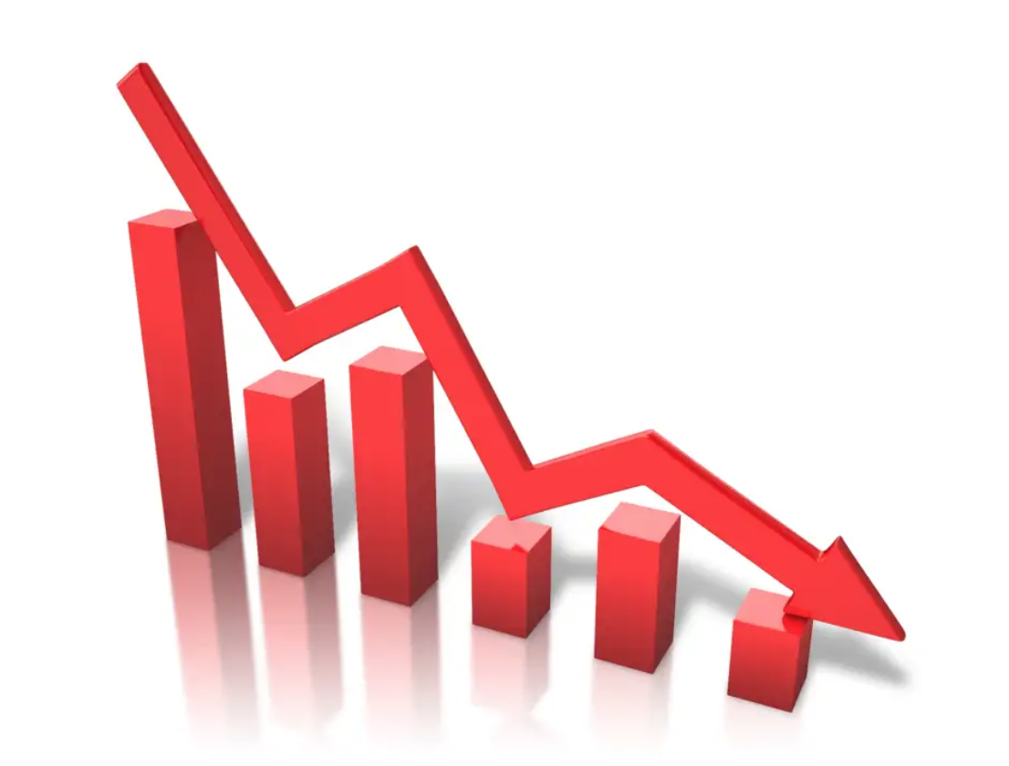

Slide 11


Slide 12


Slide 13


Slide 14
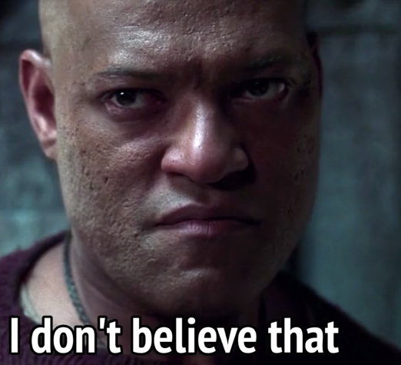

Slide 15
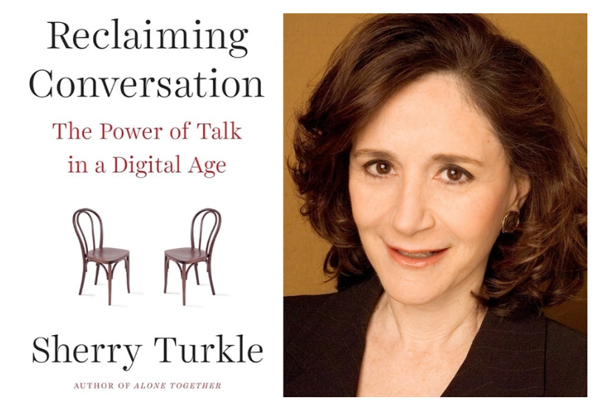

Slide 16


Slide 17
God loves each of us as if there were only one of us.
-- Augustine

Slide 18
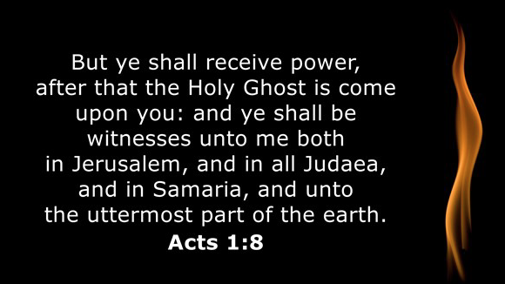

Slide 19
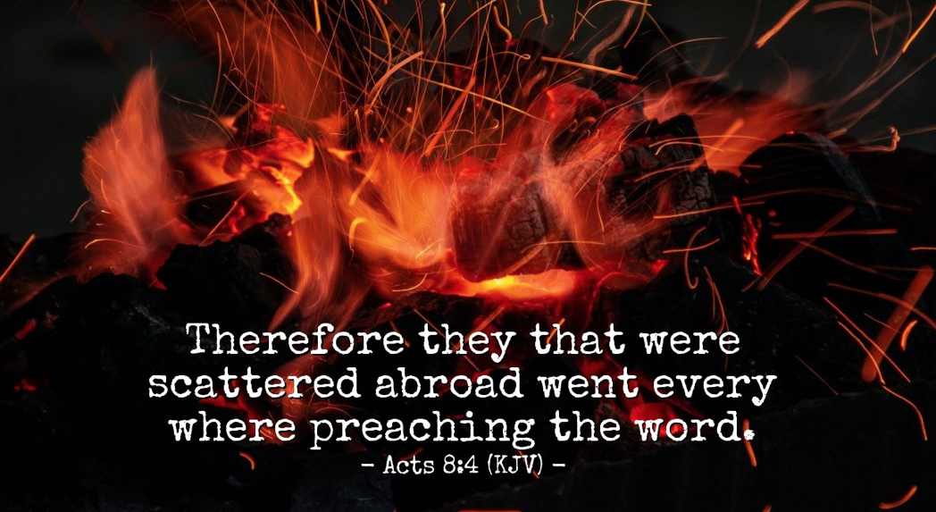

Slide 20
EVANGELISTIC UNFRUITFULNESS

Slide 21
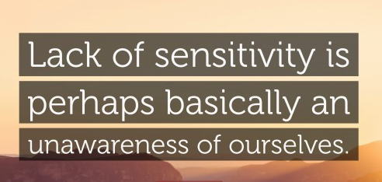

Slide 22


Slide 23
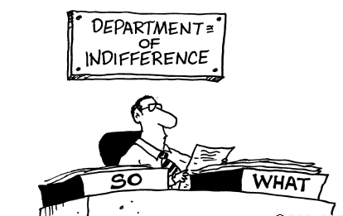

Slide 24
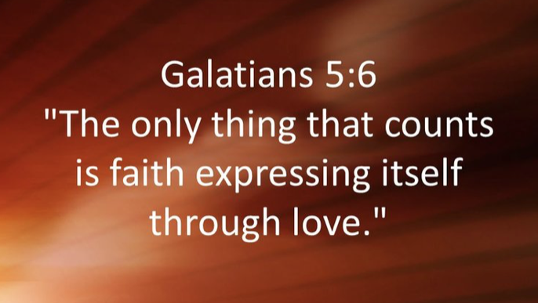

Slide 25
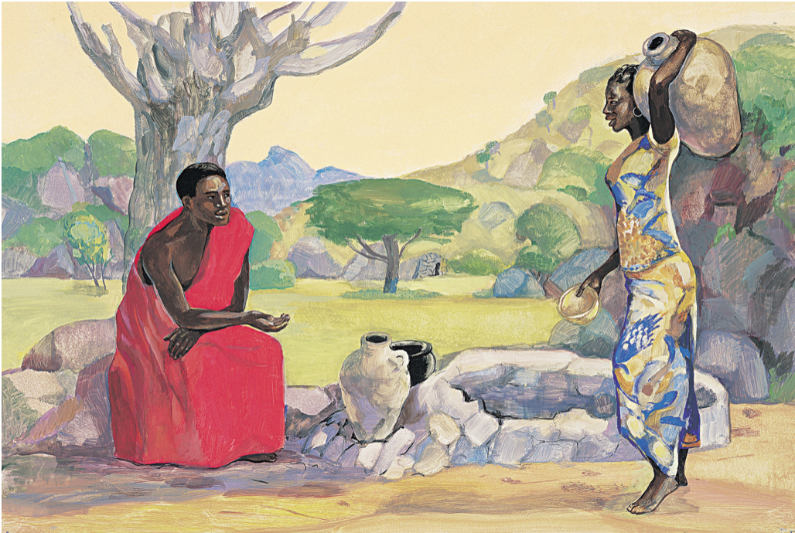

Slide 26
WHY BE PUBLIC WITH OUR FAITH?

Slide 27


Slide 28


Slide 29


Slide 30
HOW DO WE SHARE OUR FAITH IN A SKEPTICAL CULTURE?

Slide 31


Slide 32


Slide 33


Slide 34


Slide 35
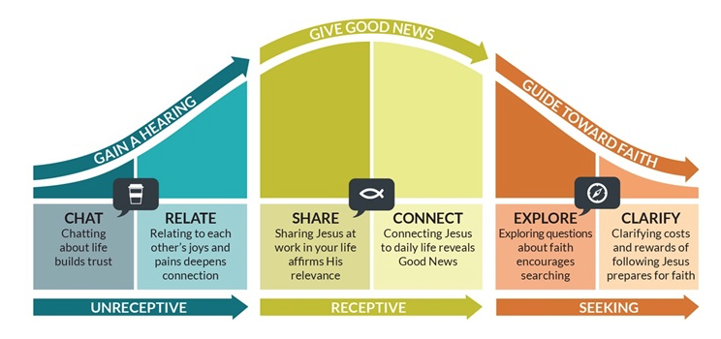

Slide 36


Slide 37


Slide 38


Slide 39
Public faith is about authentic relationships and getting out of our own social and spiritual comfort zones.
Ultimately, public faith is trusting the Holy Spirit to do the evangelistic work through us in our relationships.
While many of us identify as secluded or private, our prayer and desire is that we all become more public with our faith.

Slide 40
