Slide 1
Public service loan forgiveness (pslf) program

Slide 2
Targeted Student Loan relief
The department has approved nearly $36 Billion in debt cancellation for almost 1.7 million borrowers
Nearly $13 billion for over 211,000 public servants through improvements to PSLF;
Over $9.1 billion for more than 425,000 borrowers who have a total and permanent disability;
$14.5 billion for 1.1 million borrowers whose institutions took advantage of them through discharges related to borrower defense and school closures.

Slide 3





PSLF Basics
120 qualifying payments…
While working for a qualifying employer
Forgiven amount is not taxable income
…on Direct Loans…
…when applying for and receiving PSLF

Slide 4


Temporary Expanded PSLF
Provides loan forgiveness to those who do not qualify for PSLF only because some or all their qualifying payments were made on non-qualifying plans
Extended and Graduated, if:
  In the 12 months before applying for TEPLSF, the borrower paid at least the amount they would have paid under an IDR plan
Alternative

Slide 5
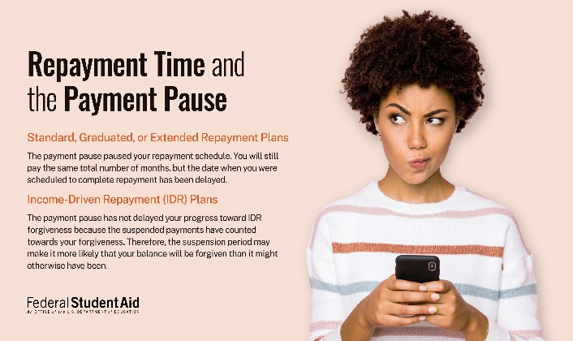
COVID-19 Flexibilities
StudentAid.gov/Coronavirus
Loans in forbearance due to the payment pause are eligible for PSLF and TEPSLF
Borrowers do not have to be in an eligible repayment plan if they are in forbearance due to the payment pause
Borrowers need to submit a PSLF form to receive PSLF credit for any time during the payment pause
Notes:
Updated 5-17-22

Slide 6



LIMITED PSLF WAIVER
On Oct. 6, 2021, the U.S. Department of Education (ED) announced a change to Public Service Loan Forgiveness (PSLF) program rules for a limited time.
Borrowers may receive credit for past periods of repayment that would otherwise not qualify for PSLF. Under the new, temporary rules, any prior period of repayment will count as a qualifying payment, regardless of loan program, repayment plan, or whether the payment was made in full or on time. You continue to need qualifying employment.
This change applies to student loan borrowers with Direct Loans, those who have already consolidated into the Direct Loan Program, and those who consolidate into the Direct Loan Program by Oct. 31, 2022.
17

Slide 7
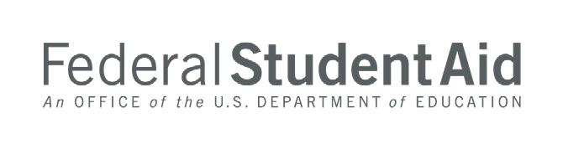
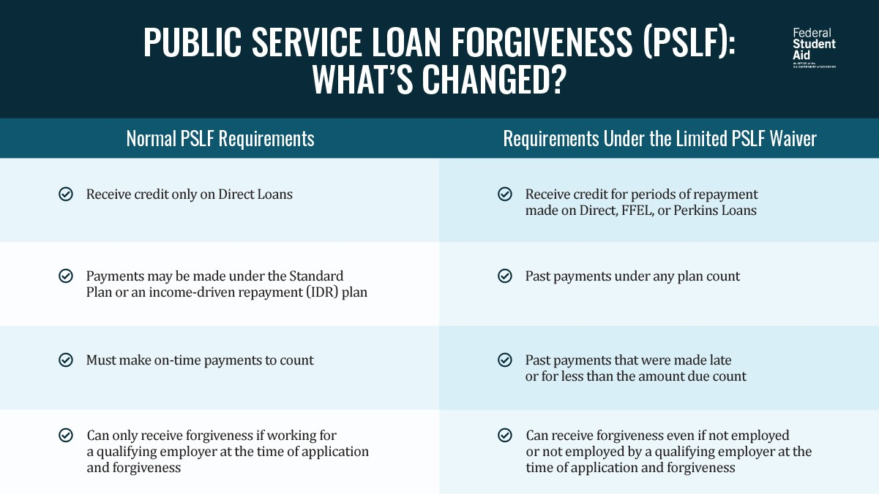
PSLF VS LIMITED WAIVER

Slide 8



PSLF Limited Waiver: Borrower groups
StudentAid.gov/PSLFWaiver
If You only borrowed direct loans…
If you previously consolidated into Direct Loan(s)
If you still have FFEL or Perkins Loans…
File a PSLF Form for each eligible employer you had since you borrowed the loan (or since Oct. 1, 2007, whichever is later)
File a PSLF Form for each eligible employer you had since you borrowed any loans underlying the Direct Consolidation Loan (or since Oct. 1, 2007, whichever is later)
Consolidate your loans into the Direct Loan Program and file a PSLF Form for each eligible employer since you borrowed the loans you are consolidating (or since Oct. 1, 2007, whichever is later)

Slide 9

TO TAKE ADVANTAGE OF THE WAIVER:
Confirm your employer is qualified.
Consolidate your loans if you need to.
Submit your PSLF form(s).
By Oct. 31, 2022

Slide 10

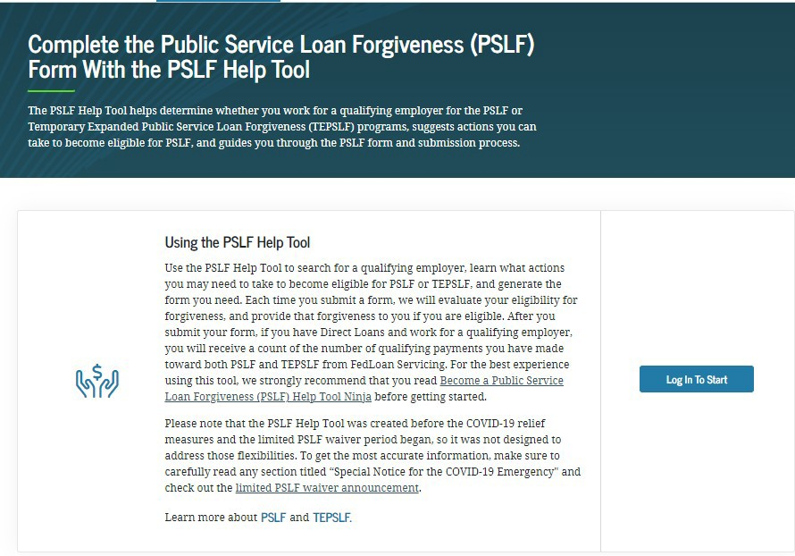
PSLF HELP TOOL
URL: StudentAid.gov/PSLF
24

Slide 11

PSLF Help Tool
StudentAid.gov/pslf
SECTIONS OF THE HELP TOOL
Employment History Loan Tips
Application Details Personal Information
Review & Save
WHAT YOU NEED
Your FSA ID to Log-In
Employer Identification Number (EIN) Or recent Employer W-2

Slide 12



PSLF INFORMATION AND RESOURCES
LIMITED PSLF WAIVER
PSLF HELP TOOL
StudentAid.gov/pslfwaiver
StudentAid.gov/pslf
WHAT TO DO WITH YOUR PSLF FORM
GENERAL PSLF INFORMATION
StudentAid.gov/publicservice
Beginning July 1, submit your PSLF forms to MOHELA:
Make sure to review the FAQs!
Beginning July 1, 2022, all new PSLF form submissions go to MOHELA.
Mail to: U.S. Department of Education, MOHELA, 633 Spirit Drive, Chesterfield, MO 63005-1243.
Fax to: 866-222-7060.
Upload to: mohela.com/uploadDocument
if MOHELA is already your servicer.
46

Slide 13
Biden- Harris One time Debt relief

Slide 14
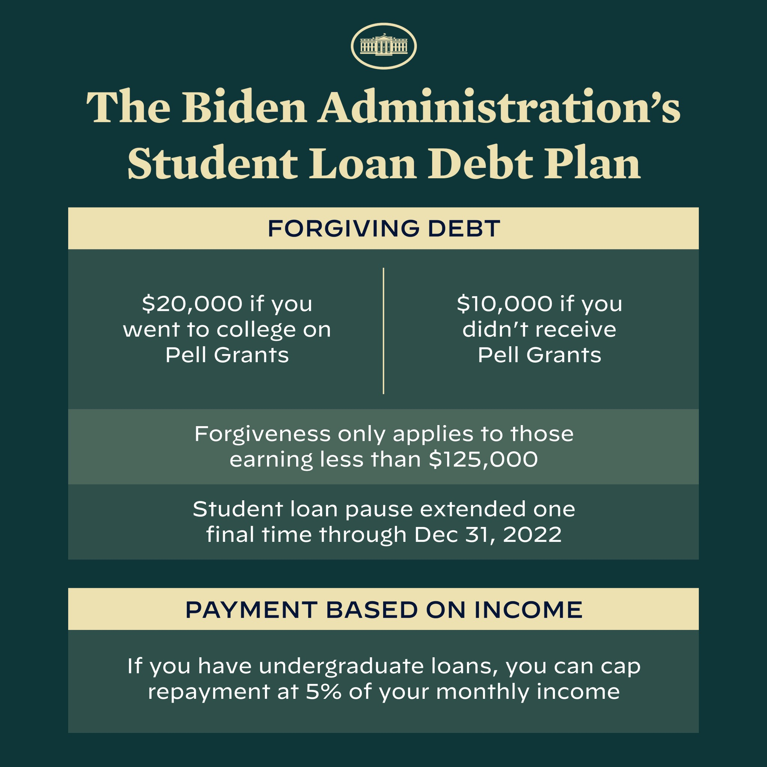
Targeted Student Loan relief
URL: StudentAid.gov/debtrelief
Notes:
- Updated as of 5-20-22

Slide 15
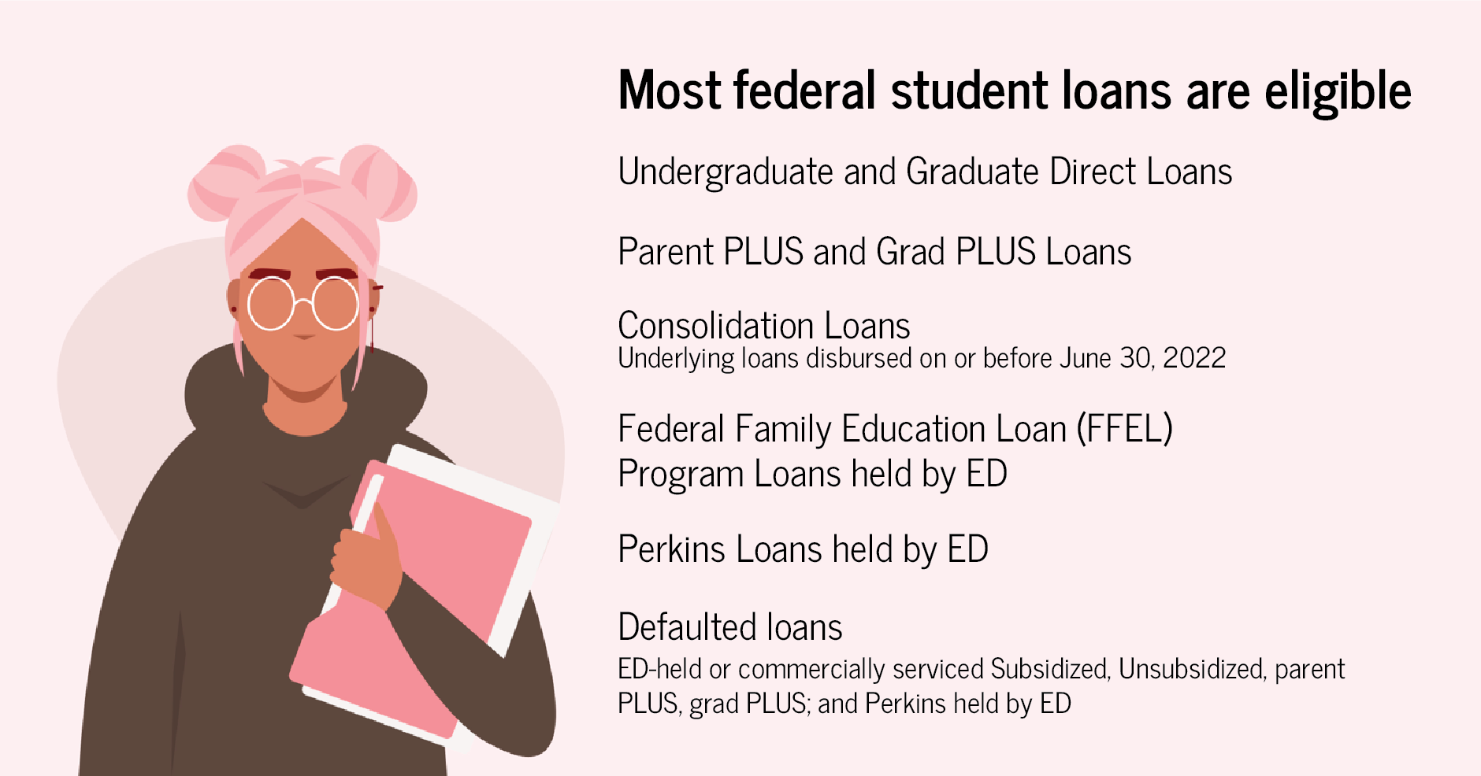
Eligible loans

Slide 16
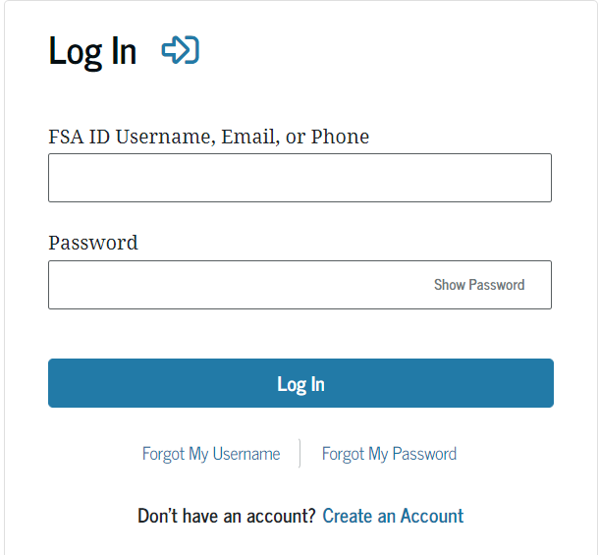
How to Prepare
Borrowers can prepare by confirming their contact information is up to date.
Log in to your account on StudentAid.gov
Contact your servicer and make sure your current contact information is up to date.
Sign up for updates on the Department of Education Subscription page. You can do so at www.ed.gov/subscriptions

Slide 17

APPLICATION DETAILS
The application will be available online this month, October 2022.
Borrowers will complete a few short questions confirming their basic information, and to attest that they fall below the income threshold.
No additional documentation will be needed to apply. Borrowers will receive a confirmation email upon submission.
Borrowers are encouraged to apply by mid-November in order to receive relief before the payment pause expires.
The Department of Education will continue to process applications as they are received, and you'll have until December 31, 2023, to submit your application.

Slide 18
Debt Forgiveness INFORMATION AND RESOURCES
DEPARTMENT OF EDUCATION SUBSCRIPTION PAGE
www.ed.gov/subscriptions
GENERAL DEBT RELIEF INFORMATION
CONTACT YOUR SERVICER
studentaid.gov/debt-relief-announcement
https://studentaid.gov/app/additionalInformation.action
Make sure to review the FAQs!
46

Slide 19
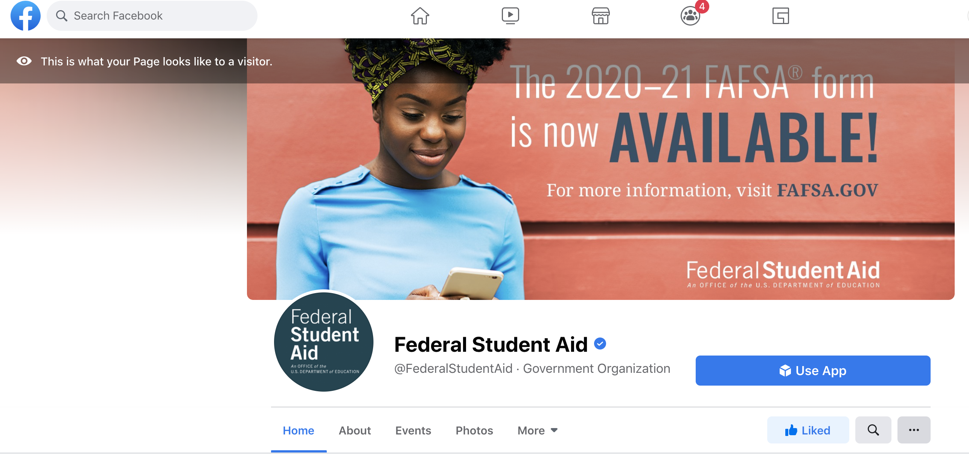
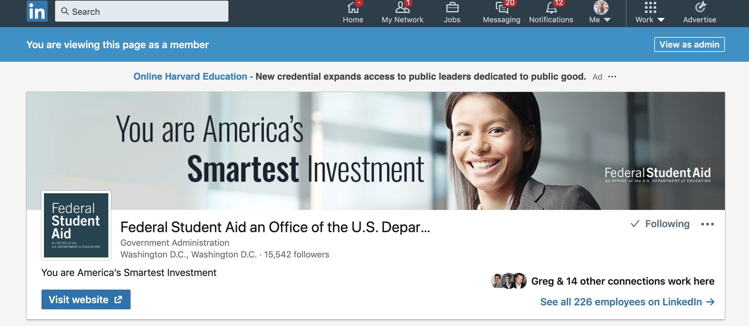
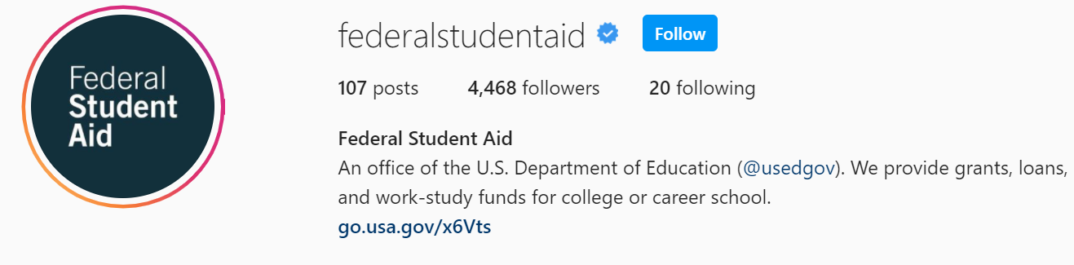
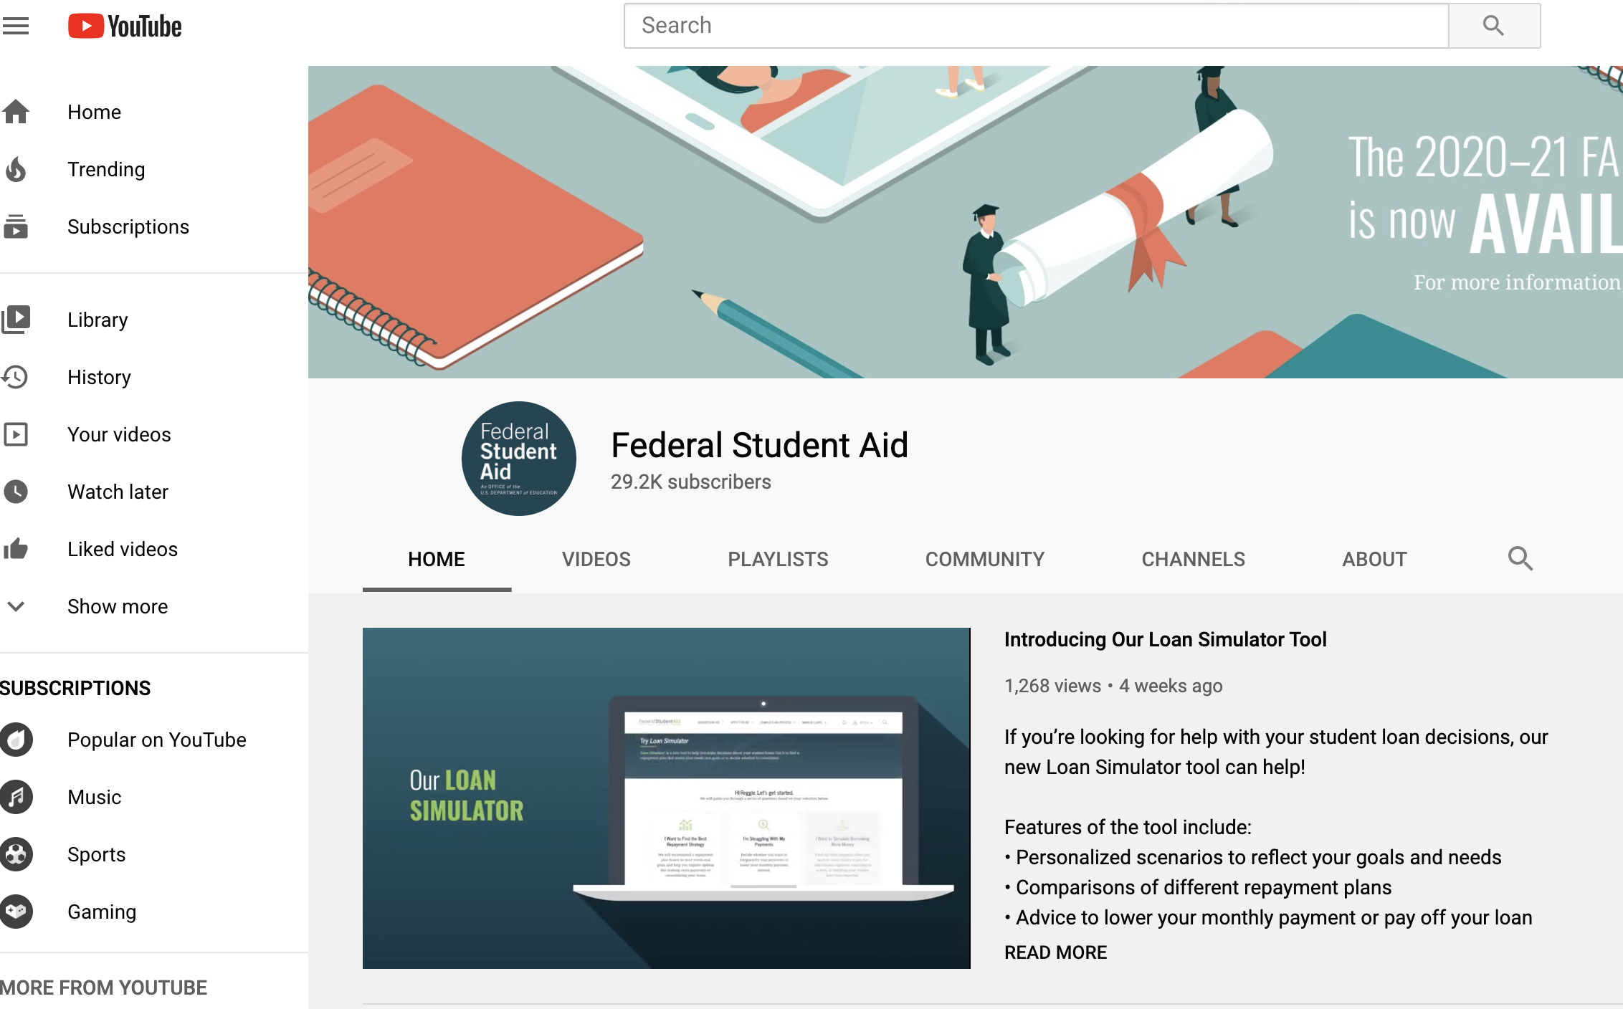
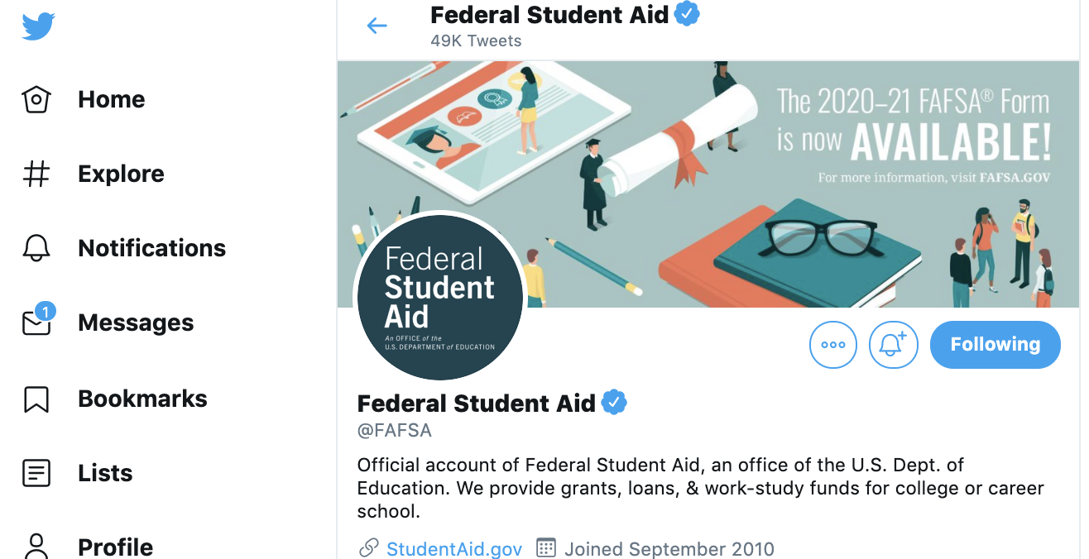


FSA’s Channels
Facebook: @FederalStudentAid
Linkedin: @FederalStudentAid
Instagram: @federalstudentaid
Twitter: @fafsa
YouTube: @FederalStudentAid
1-800-4FED-AID
1-800-433-3243
Notes:
In the blue box you’ll see our followers numbers for each platform

