Slide 1

Four Ways Faith Marks a Generation
The Generational Baton:
Your faith is the present, living reality of future things.

Slide 2

What is faith?
Catholic Answer
Explicit Faith – knows its object
Implicit Faith – uncomprehending assent
Arminius’ Answer
A person’s contribution
Photo by Raechel Romero on Unsplash

Slide 3
What is faith?
Liberalism’s Answer
A sense of contented harmony with the Infinite through Christ
A fixed resolve to follow Christ’s teaching
An optimistic confidence in the friendliness of the universe
A “yes” to vague content
Photo by Raechel Romero on Unsplash

Slide 4
What is faith?
Reformed Protestant Answer
A personal trust and confidence in God’s mercy through Christ: that it is not a meritorious work, but rather an appropriating instrument, an empty hand outstretched to receive the free gift of God’s righteousness in Christ; that faith is God-given and is itself the animating principle from which love and good works spontaneously spring; and that communion with God means not an exotic rapture of mystical ecstasy but just faith’s everyday commerce with the Savior.
Photo by Raechel Romero on Unsplash

Slide 5

Hebrews 11:1
Faith
Is
Reality/Existence OR Assurance
Evidence/Proof OR Conviction
Photo by Billy Pasco on Unsplash

Slide 6

Bible Idea to Timeless Truth
Early Christian preaching to believers facing dangerous adversity aimed to encourage present faith by tying it to future realities.
Connection: Faith and Hope
Faith bridges the present and the future for living trust in God’s promises.
Photo by Ron Smith on Unsplash

Slide 7
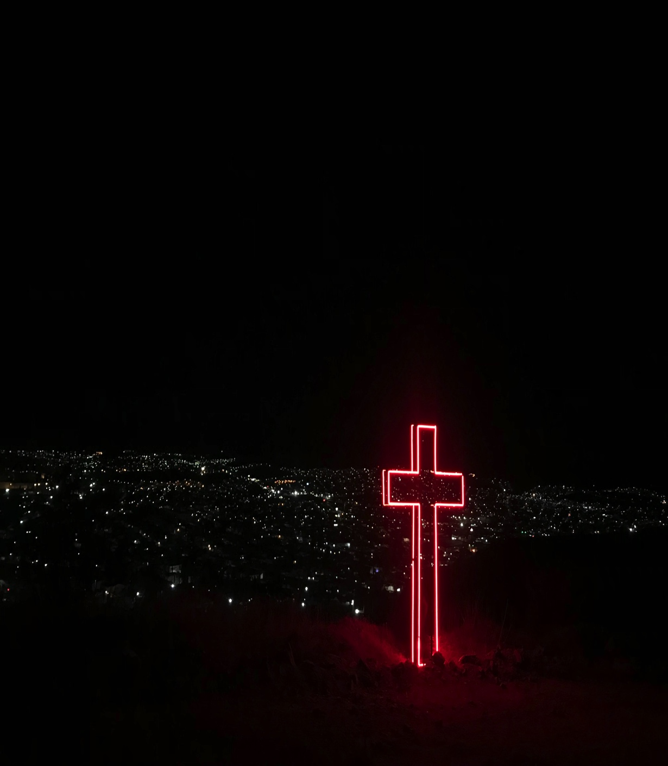
Anticipate the certainty of the future today.
Faith is the generational baton.
Anchor today in tomorrow.
Invite elders to tell tales of faith.
Train for faith before works.
Hold a Christian worldview.
Photo by Diana Vargas on Unsplash

Slide 8
Four Ways Faith Marks a Generation
The Generational Baton:
Your faith is the present, living reality of future things.

