Slide 1
Council on Finance & Administration
Phil Potter, President
Annual Conference
October 26, 2021

Slide 2
Agenda
CFA Contingency Planning: A Must in 2022 and Beyond
Review the 2022 Budget Proposal
CFA Recommendations to Annual Conference

Slide 3
Contingency Planning is Essential
For the next 12-24 months, the Conference is facing unknown and cascading levels of risk and liability.
  Boy Scout Bankruptcy
  Court Actions
  Local Church Disaffiliations
Local churches continue to operate under the COVID-19 constraints.
Contingency Planning is essential as we approach the 2022 budget.
But this is nothing new! Our experience in 2019, 2020, and 2021 reveals that contingency planning is already part of the standard operation in managing the Conference budget.

Slide 4
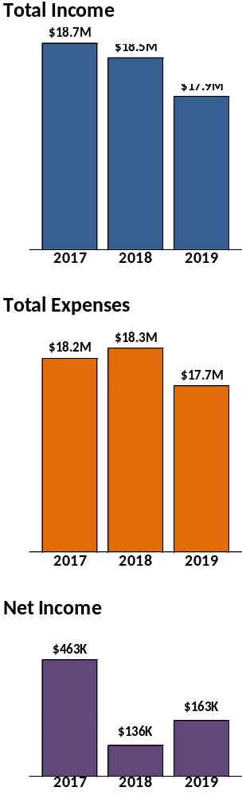
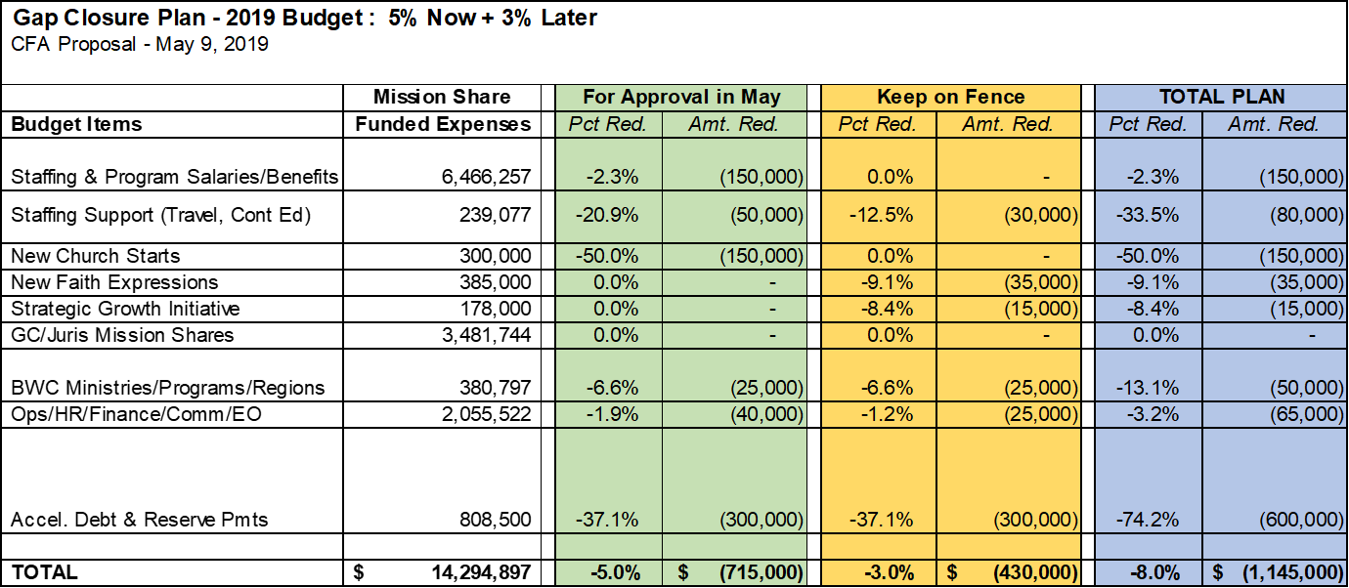
2019 Contingency Planning
The Special Session of the General Conference was held in February 2019.
Starting in February, the mission share giving fell behind budget and reached a shortfall of $810,000 by November before slightly recovering in December.
The CFA approved a $715,000 spending reduction plan in May 2019.
The early steps to reduce spending kept total expenses less than the total income by $163,000.

Slide 5
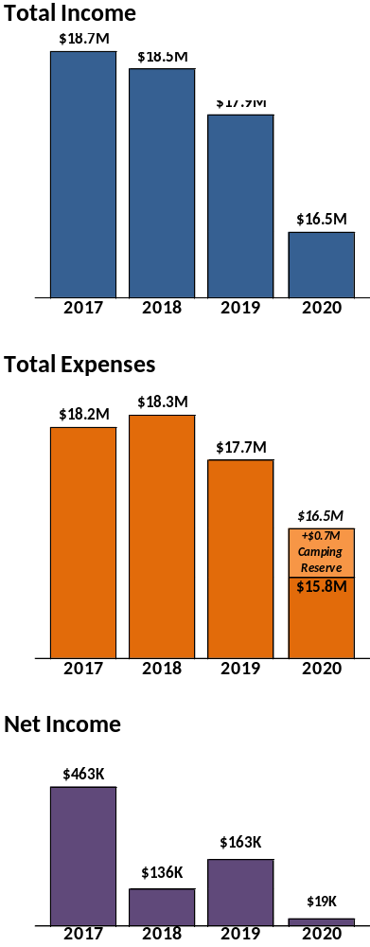
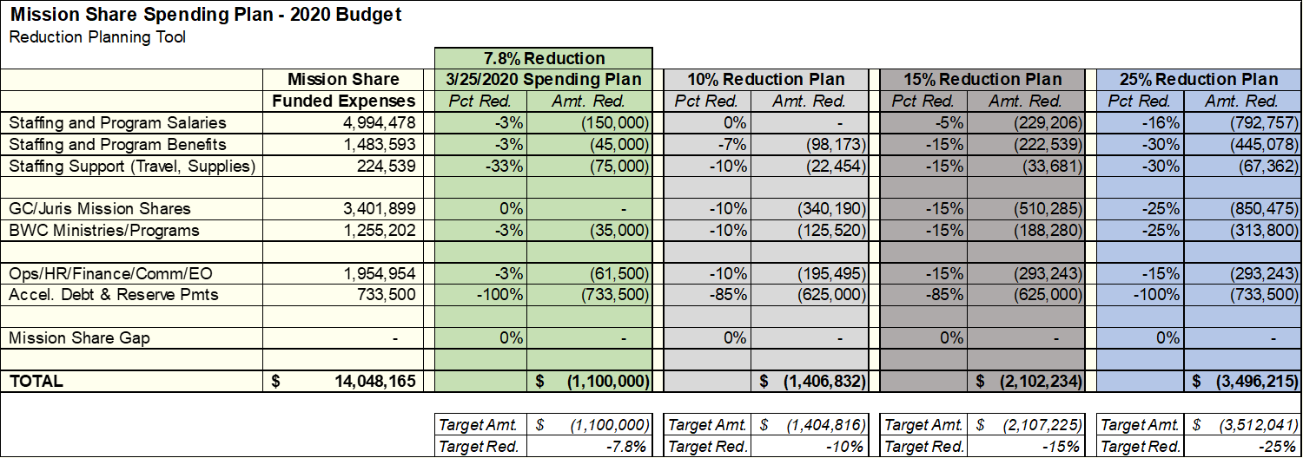
2020 Contingency Planning
The pandemic shuttered churches in February 2020.
The CFA approved a $1.1M spending reduction plan in March 2020.
The spending reduction plan was increased to $1.6M in June 2020.
We finished the year with expenses $2.8M (15%) less than budget.
The multiple steps to reduce spending kept total expenses less than the total income by $19,000 and it also established a camping reserve of $700,000 to enable camps to fully open in 2021.

Slide 6
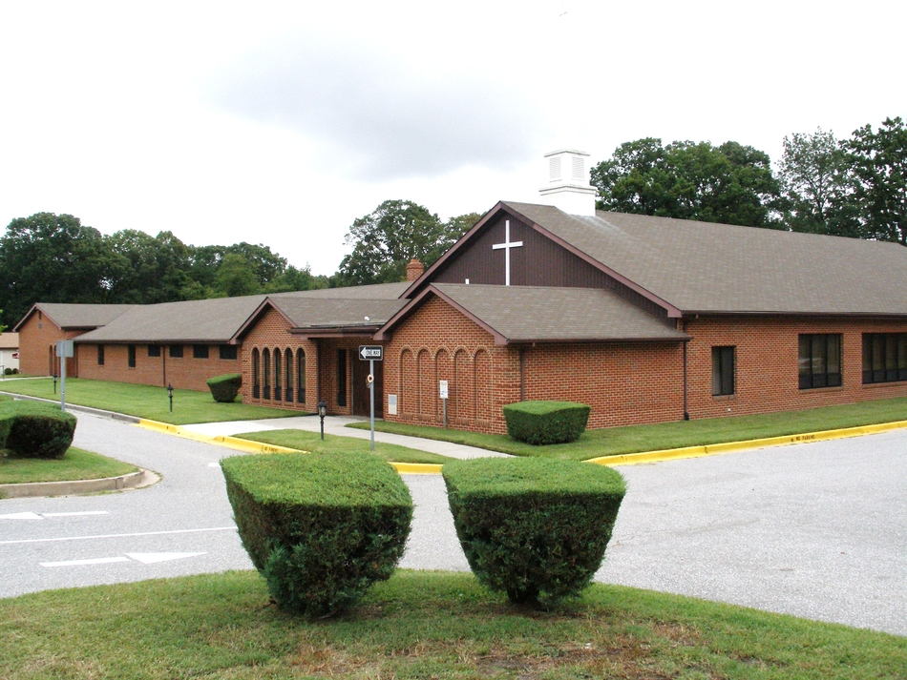

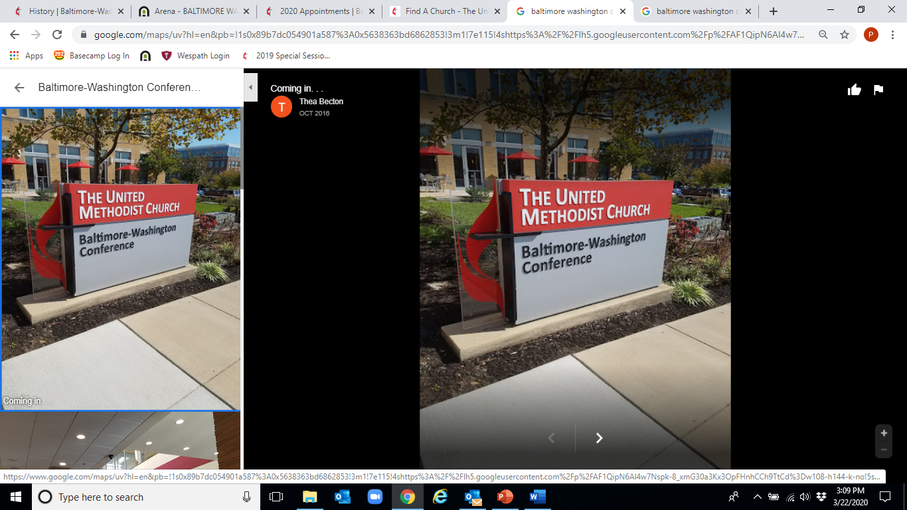
2020 Contingency Planning Included
Over $12M of Local Church Support
PPP1 Grants = $6,000,000; PPP2 = ?
2020 Budgeted Grants = $1,100,000
Small Church Grants = $500,000
Relief Grants = $615,000+
Encourage Gov’t Check Donations
PPP1 Grants = $1,200,000
PPP2 = Did not qualify
3-month waiver
Direct Benefit Billing
= $2,600,000
32 Local Church Loans –
3-month deferral with no interest
“Do Your Best” Mission Shares in 2020
= $1,300,000 (9%) less than budget

Slide 7
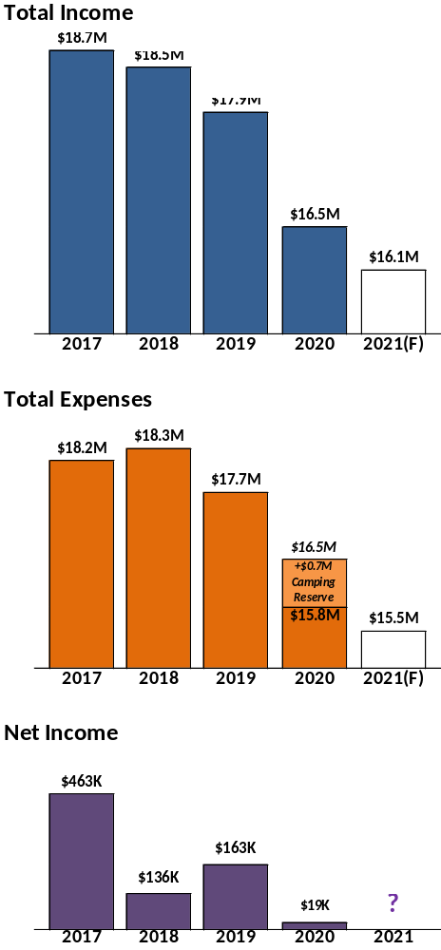
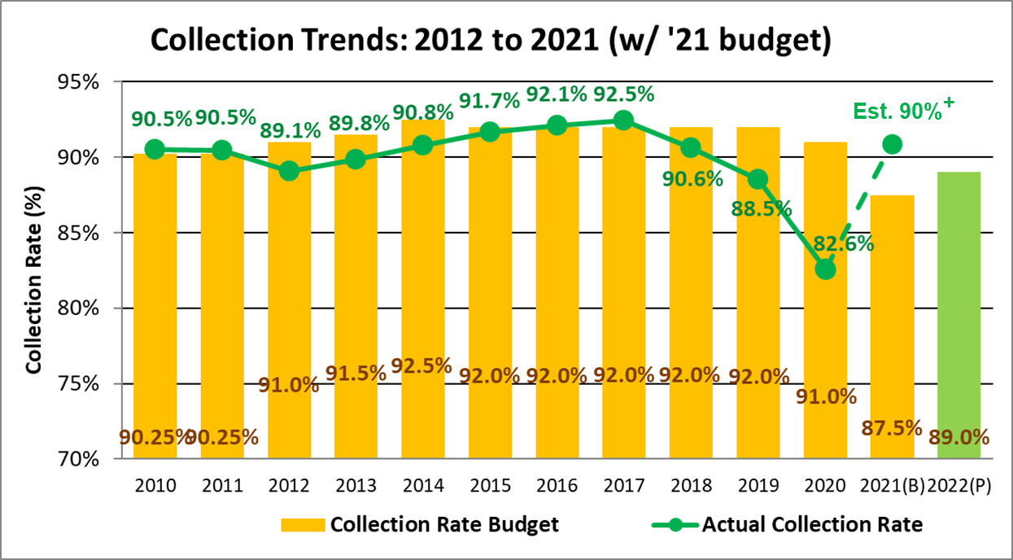
2021 Contingency Planning
Mission share giving is strong this year and appears to be returning to a collection rate slightly higher than 90%.
But the CFA is still managing an expected $700K camping loss.
The COVID expense controls have remained in place in 2021. Expenses are currently 18% less than budget.
The focus on expense control this year is ensuring the Conference budget survives the lowest total income in at least 20 years.

Slide 8
Status of CFA & Trustee Reserves
Designated CFA Reserves
15% Budget Reserve $ 2.0M
Mortgage Payoff Reserve $ 1.3M
Camping COVID Relief $ 0.7M
Local Church COVID Relief $ 0.2M
Legal Reserve Fund $ 0.2M
Other Designated $ 0.2M
Undesignated CFA Reserves $ 0.1M
TOTAL CFA RESERVES $4.6M
Designated Trustee Reserves
Sale of Closed Churches $ 5.4M
Parsonage Reserve $ 0.6M
Building Reserve $ 0.9M
TOTAL TRUSTEE RESERVES $ 6.9M

Slide 9
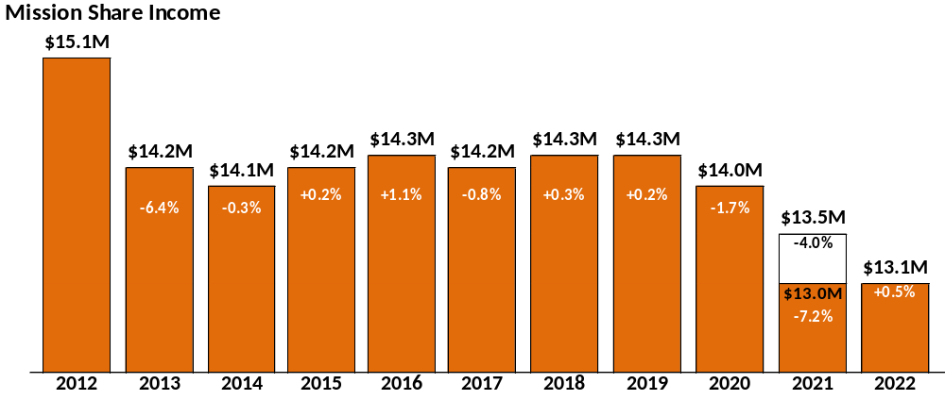
Contingency Planning in the Future
The CFA is in the process of reducing the mission share budget from $14M in 2019 to $12M by 2024 or 2025. This objective prepares the Conference budget to reflect anticipated disaffiliations of local churches in the coming years. The proposed 2022 budget of $13.1M is nearly halfway towards that objective.
The 2022 budget pays off the Conference debt and a saving of $675,000/year will be realized in 2023 and beyond.

Slide 10
Contingency Planning Highlights
BWC has operated during the last 3 years without pulling on reserves.
Significant relief has been provided to local churches during a very challenging time.
Sufficient reserves have been established that are flexible to meet the unknown financial challenges in the future.
There is a plan for the mission share budget that anticipates the potential impact of future disaffiliations.

Slide 11
2022 Budget Proposal

Slide 12
CFA Recommendations
Proposed 2022 budget = $18,145,697 with Mission Shares = $13,104,912
Proposed 2022 Benevolence Factor = 17.55% (unchanged)
Proposed 3-year average for Mission Share Base (2018 – 2020)*
* Not Standard per BWC Policies and Procedures, Proposed for 2022 Budget Only.
Combined Apportionment Budget Ratio Statement:
33% World Service
67% Conference and General Church Benevolences
Independent Auditors for 2021 - Ellin & Tucker
Close 2021 books on January 11, 2022
Grant authority to CFA, in consultation with the Bishop and the Cabinet, to act on financial matters between sessions of the Annual Conference

Slide 13
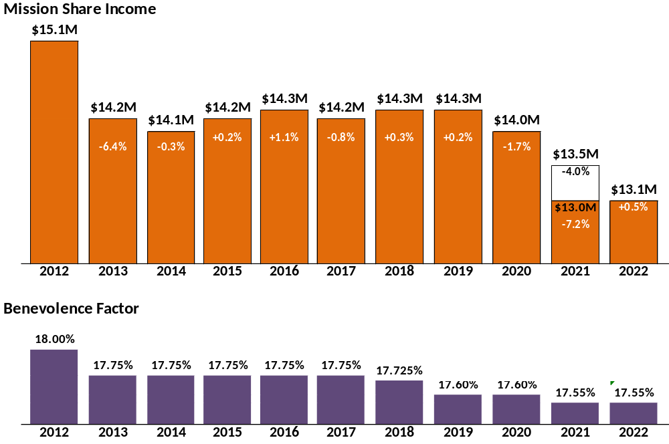
Historic Trends
Mission Share Income and Benevolence Factor
The original 2021 budget proposal set the mission shares at $13.5M.
The pandemic caused a recast to $13.0M as expenses were cut to meet budget.
The 2022 budget institutes these expense cuts into a $13.1M budget.
CFA projects a $12M budget in 2024 or 2025 as the BWC debt is retired.

Slide 14
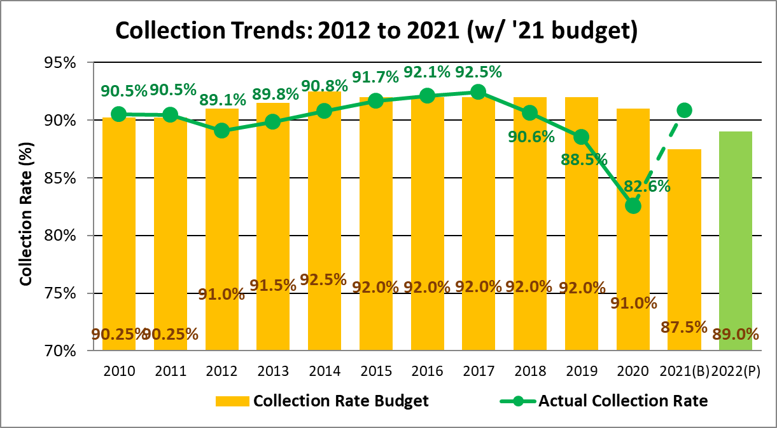
Historic Collection Rates
Budget vs. Actual
The reduced collection rate of 82.6% in 2020 resulted in a $1.2M mission share shortfall as churches were asked to “do your best” during the pandemic.
2021 results are forecast to be better than a 90% collection rate vs. the budget of 87.5%.
The 2021 performance gives CFA confidence to set the 2022 budget at a collection rate of 89.0%.
Est. 90%⁺

Slide 15
Why Use a 3-Year Average of Expenses in the 2022 Mission Share Formula?
Factors that impacted the actual expenses in 2020
  PPP funding received No PPP funding received
  State funding received No State funding received
  Draws on endowed reserves No draws on reserves
  Employees applied for unemployment Kept employees on payroll
  Reduced staff Did not reduce staff
  Reduced staff’s pay Did not reduce staff’s pay
  Worship held online Worship held in person
  Closed the preschool Kept the preschool open
Factors that impacted the reported expenses in 2020
  BWC 2020 Statistical Reports: $6M of PPP funding on the 2020 stats
  Small Business Administration Database: $11M of PPP to BWC churches plus $2M to preschools
  Conclusion: Statistical reports for some churches did not include PPP paid expenses

Slide 16
CFA Conclusion
The 2020 expense statistics were so greatly influenced by the pandemic that they are, by themselves, an inadequate measure for fairly distributing the mission shares for the 2022 budget.
The Council believes the best solution is to use of a 3-year average of the expenses that include 2018, 2019, and 2020 in the mission share base calculation.
This averaging will provide a stabilizing element to the distribution so that the extremes involved with the 2020 expense changes do not create a list of “1-year winners” and “1-year losers”. It also recognizes some impact from the 2020 expense reductions.
We believe this is the fair way to proceed and it is the intent of the Council that we return to the standard mission share formula for the next budget cycle.
  (Note: The Conference dealt with a statistical data issue in 2009 by adopting a 1-year change to the mission share formula as part of that year’s budget approval process.)

Slide 17
Comparison of
Mission Share Base Calculations
Two Methods to Calculate the
Mission Share Base
2020 Stats
Mission Share
Base
2022 Budget
Benevolence
Factor
2022 Budget
Collection
Rate
2022 Budget
Mission Share
Income
X
X
=
3-Year Average (2018-2020) $ 83.9M X 17.550% X 89.0% = $ 13.1M
1-Year Standard Calc (2020) $ 79.1M X 17.550% X 89.0% = $ 12.4M
Local Church Example
Local Church Mission Share Base
Local Church Mission Share
$ 113,960 X 17.550% = $ 20,000
Mission Share
Base Trends
2019 $84.9M
2018 $87.7M
2017 $88.3M
$87.4M
2015 $87.1M
2014 $87.8M
2013 $86.8M
Reference: Mission Share Base Calculation
Includes: Pastor’s Compensation and Housing Allowance
Pastor’s Reimbursements
Church Staff and Benefits
Church Program
Church Operating Expenses
Does Not Include:
Pastor’s Pension and Benefits
Mission Giving
Capital Expenditures

Slide 18
2022 Budget Highlights
Institutes the lower expense spending of $13M that was implemented during the pandemic spending reductions. Note: 2020 mission share budget was $14M.
Supports the payoff of BWC debt by Qtr 3, 2022 which is necessary to enable further reductions in the mission share budget towards $12M.
Implements the sharing of Episcopal Office expenses between the Pen-Del and BWC Conferences.
Staff Salaries are increased 2.5% following the 2021 salary freeze.
Reduces current staffing level from 63.5 to 62.5 Full-time Equivalents (FTE).
  Historic View: 2016 - 67.0 FTE
  2012 - 72.8 FTE

Slide 19
2022 Budget Highlights
General Church Apportionments are assumed to remain at $3.0M pending the final budget from the General Conference Session.
Unified Funding Task Force is reallocating existing grant funding as areas are refined for the current needs. Total funding remains the same at $1,063,000.
Funding of Unified Funding Task Force grants from Trustee closed church sales reserves was increased from $250,000 to $415,000.
We Rise United and NEJ Call to Action funding is increased from $37,000 to $87,000.
Building Reserve Payments returned to the full amount of $108,500.
Legal expenses increased from $160,000 to $185,000.

Slide 20
CFA Recommendations
Proposed 2022 budget = $18,145,697 with Mission Shares = $13,104,912
Proposed 2022 Benevolence Factor = 17.55% (unchanged)
Proposed 3-year average for Mission Share Base (2018 – 2020)
Combined Apportionment Budget Ratio Statement:
33% World Service
67% Conference and General Church Benevolences
Independent Auditors for 2021 - Ellin & Tucker
Close 2021 books on January 11, 2022
Grant authority to CFA, in consultation with the Bishop and the Cabinet, to act on financial matters between sessions of the Annual Conference

Slide 21
Thank you

