Slide 1
Family Ministries
Erica Benjamin
Director of Children’s Ministries
Severna Park UMC
Ebenjamin@SevernaParkUMC.org

Slide 2
Deuteronomy 6:4-9
Hear, O Israel: The Lord is our God, the Lord alone. You shall love the Lord your God with all your heart, and with all your soul, and with all your might. Keep these words that I am commanding you today in your heart. Recite them to your children and talk about them when you are at home and when you are away, when you lie down and when you rise. Bind them as a sign on your hand, fix them as an emblem on your forehead, and write them on the doorposts of your house and on your gates.

Slide 3
Discussion at Table
  When historians look back at the 21st century, what do you think they will say about families in America? What would they say about children?
  If there were a historical case study on your family, what would they say are your priorities based on archeological remains (writings, all your stuff, the layout of your house, the use of your time)? Think about those who live in your home now and your extended family.
  What are the obligations of a parent? What are the obligations of a Christian parent?
  What are your hopes and dreams for your children? How can you be intentional about spiritual parenting?
  (Edit this for groups at your church: parents, grandparents, committees.)

Slide 4
Children in Scripture and History
Old Testament Jewish Tradition
Children are God’s blessing
Part of God’s purpose- “be fruitful and multiply”
Faith passed down through generations- Abraham
Key in building a great nation
Sign of God’s covenant- circumcision
Teaching & discipline important
Greco Roman Times
Loved and valued
Important for economic, culture, military survival
Entertainment
Immature- could not reason
Potential is in future
Fathers are in charge
Exposure- esp. females
Slaves and prostitues

Slide 5
Children in Scripture and History
Scripture
Deuteronomy 6:4-7
  The Shema
Mark 10:3-6, Matthew 19:13-15, Luke 18:15-17
  Becoming Like a Child
Mark 9:33-37, Matthew 18:1-2, 4-7, Luke 9:46-48
  The Greatest
Colossians 3:20-21, Ephesians 6:1-4
  Obedience & Obligation
History
John Wesley
Chrysostom
Reformers: Schleiermacher, Bushnell
Calvin
Troublesome Texts
Deuteronomy 21:18-21
Mark 10:28-31
Matthew 10:34-39

Slide 6
Faith Practices
  Faith Talks- planned discussions about scripture
  God Sightings- unplanned, observations, making connections to scripture
  Get a good Bible(s)

Slide 7
Prayers
  Pray for your child
  Pray with your child
  Lead prayer
  Let your child lead prayer
  Encourage your child to pray for you!
  Morning prayer & evening prayer
  Meal time prayer
  Silent prayer
  Coloring prayers
  The Lord’s Prayer

Slide 8
Faith Routines
  Preschool Routine
    Bath Time
    Story Time
    Prayer Time
  Elementary Routine
    Dinner Time
    3or 4 Times a Week
    Prayer
    Talk Together

Slide 9
Faith Practices and Routines
  Sabbath as a family
  Play as a family
  Be child-like (Mark 10:13-16), be non-productive, create
  Encounter God

Slide 10
Blessings
Our kids grow up in a world of criticism. How great would it be for us to bless them every day? I will just be a little transparent. Sometimes I wonder if I am 70% criticism as a parent and only 30% blessing. Here is what I mean. It is really easy to criticize. You left your shoes out. Your voice is too loud. Stop hitting your sister. Don’t use my toothbrush…you get the idea.
What if I blessed at least as much or more than I criticize? Would my kids grow up to be much different kids? Let’s make a pact, you and me. Let’s bless our kids. Here is one way you could be really intentional about it.
Tuck your kids in bed whether they are 2 or 17. Pray with them at the end of the day before they sleep and then take a bold step. Bless them. Put your hands on their head or their back or hold their hands and bless them. Use Scripture as the model for blessing. –Haynes
“May the Lord bless you and keep you. May the Lord make His face shine on you and be gracious unto you. May the Lord lift up His countenance upon you and give you peace. Amen!” -Numbers 6:24-26.

Slide 11
Milestones
  Opportunities to Connect or Reconnect with Families and Guide them in their Faith
  Baptism
    1st connection
    Copy of booklet
    Faith box, remembering your baptism, celebrate
  3rd Grade Bibles
    Reading Scripture Together
    Liturgy & Worship
  Confirmation
    Mentors
    Liturgy & Worship
  Letters to children about your hopes as they grow in faith

Slide 12
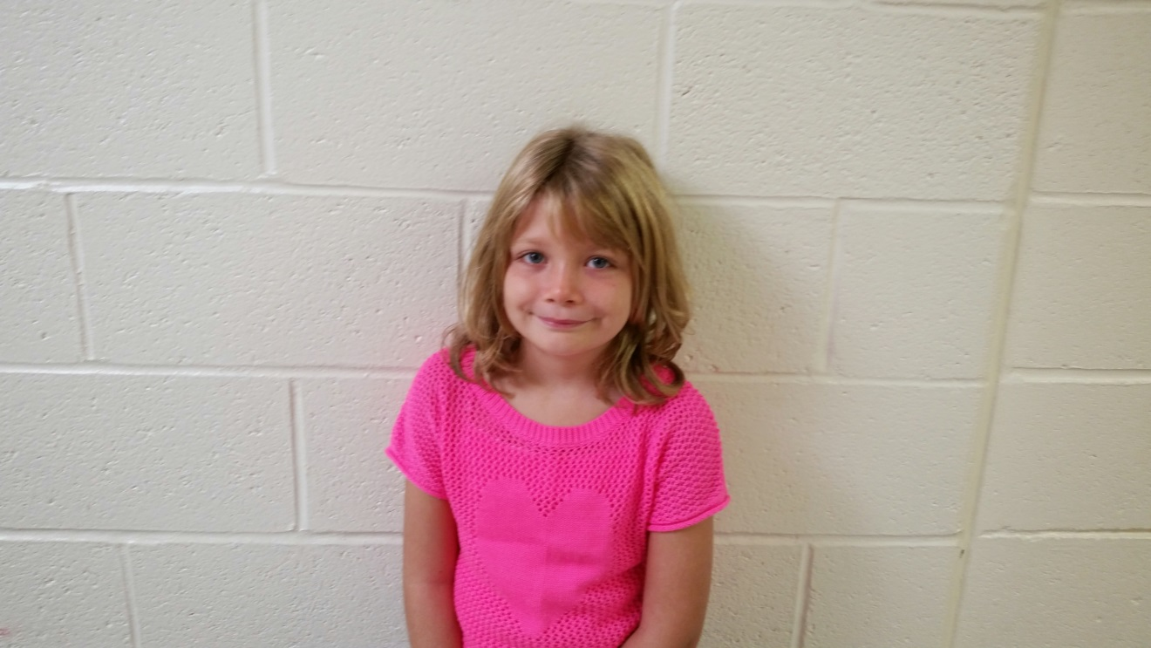
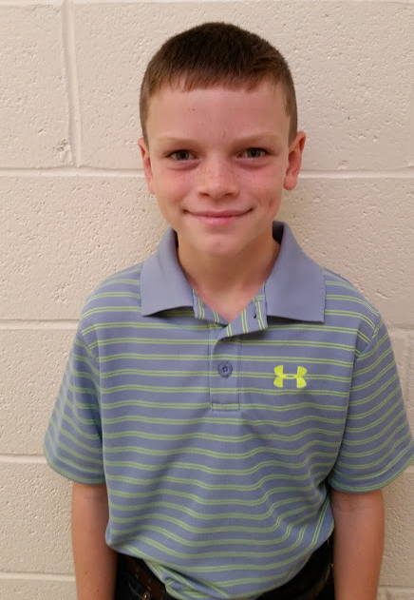
Spencer Chase Bierdeman
As you love God’s Word, may you have great peace and never stumble.
Psalm 119:65

Slide 13
Special Events
  Movie Nights
  Fall Festival
  Advent- Carols, Cookies, Crafts
  Lent- Egg Hunts
  Table Talks
  Intergenerational Class

Slide 14
Support Groups
Groups
Moms Groups
Grand parenting Groups
Young Family
Single Parents
Grieving Families
Curriculum Ideas
Convergence
Momastery
Moms Connect
MOPS

Slide 15
Resources
The Fall of Freddie the Leaf by Leo Buscaglia
  Seamless Faith by Traci Smith
  A Family Journey with Jesus through Lent by Angela Burrin
  Grand Days by Group Publishing
  Lord, Bless My Child by William & Nancie Carmichael
  Family Faith Celebration: Milestone Kits: Baby Blessing, Faith Commitment, First Bible by Group Publishing
  The Child in Christian Thought edited by Marcia J. Bunge

Slide 16
Resources
The Bible Uncensored, Children’s Ministry Magazine, April 2012, http://childrensministry.com/articles/the-bible-uncensored/
Beyond Noah’s Ark by Susan Garrett http://www.baylor.edu/ifl/christianreflection/childrenarticlegarrett.pdf
Practicing Our Faith at Home by Susan Briehl http://practicingourfaith.org/pdf/Practicing%20Our%20Faith%20at%20Home.pdf
31 Ways to Pray for Children by Bob Hosteltler https://finneyschool.org/LinkClick.aspx?fileticket=gsN6bSF_Elc%3D&tabid=289&mid=916
Practicing Examen with Children by Kimbrelee Conway Ireton http://www.kimberleeconwayireton.net/wp-content/uploads/2009/06/Practicing-the-Examen-with-Children.pdf
Bless your Kids Everyday by Brian Haynes, November 14, 2008 https://brianhaynes.org/2008/11/14/bless-your-kids-every-day/
Development Through the Lifespan http://www.umcdiscipleship.org/resources/development-through-the-life-span

