Slide 1
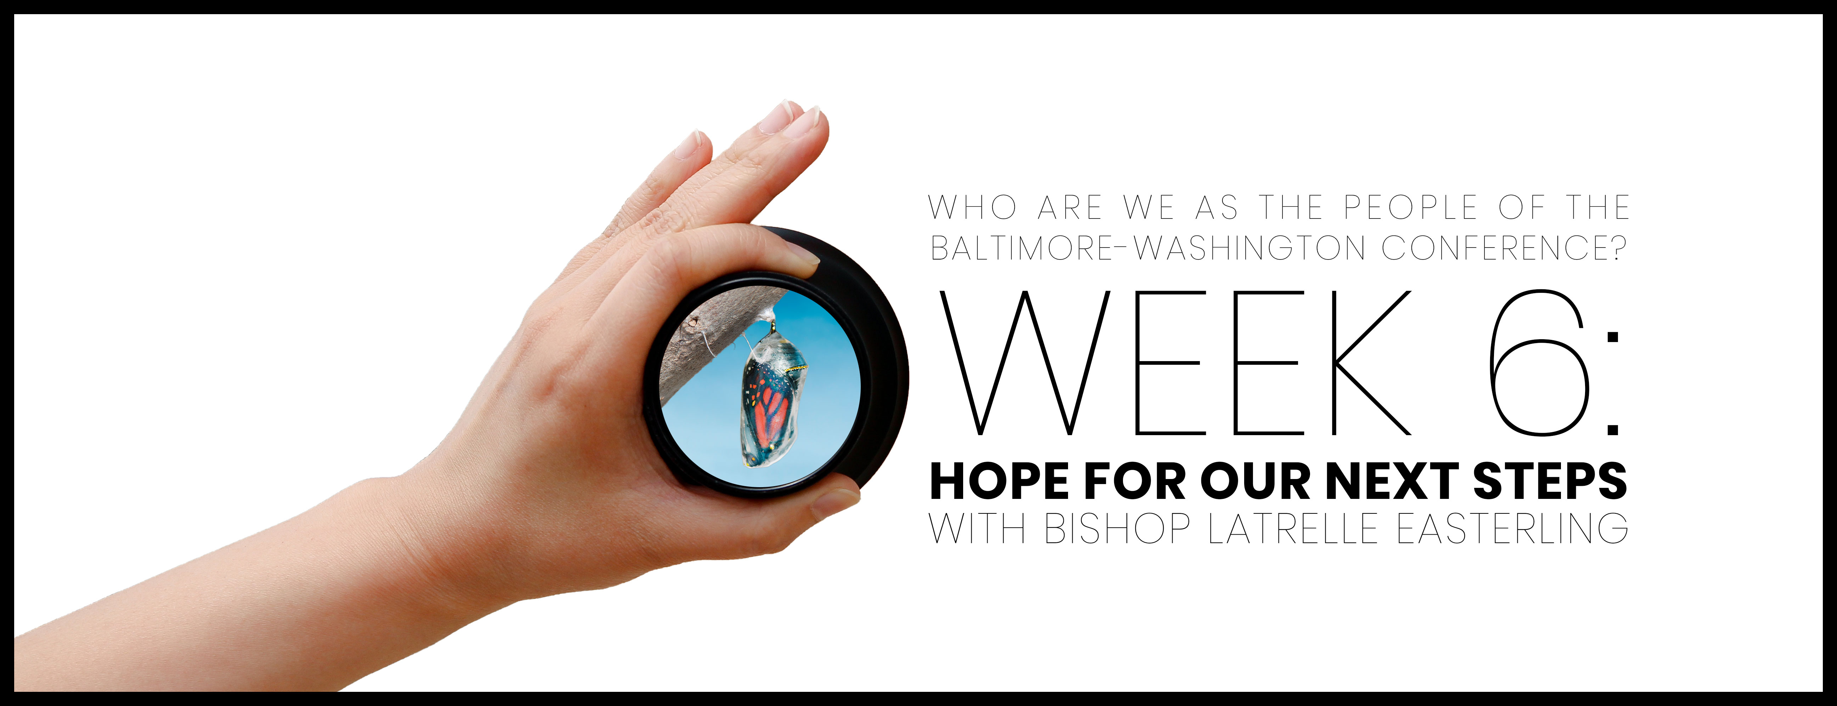

Slide 2

Opening prayer
God, you are here. Unlimited in presence and power, you exist and do exceedingly and abundantly above all we can ask or imagine. Thank You. Great Storyteller, who knows who we are and fills us with Your breath, we are shaped by Your words. Skillfully, meticulously, and lovingly, You’ve formed us as your Image bearers. From generation to generation, you are God and Your mercies are new every morning. Remind us of those intersections where your story transforms our story.
You’ve delivered us from ….[provide a time of silence for people to pause and whisper their personal responses]

Slide 3
Opening prayer
You’ve delivered us for your purpose and not our own.
You’ve delivered us to something that only time can tell.
Lead us in this session and enable us to be present with and for one another,
For your glory to be made known, and
For your will to be done on earth as it is in heaven. Amen.

Slide 4

WHO ARE WE AFFIRMATION
In the gift of this moment, we affirm that we are divinely loved and lovable. We are the children of God. Together, we will learn from the actions and words of one another. Christ’s lessons on love are centered in how we treat others and in how we treat ourselves. We will exercise courage in this study as we share stories of struggle and strength. We will stay at the table and receive those stories with grace. We will not be afraid to launch into the deep. We will commit to the vulnerability necessary to allow God to break us open. We will set and respect boundaries and honor confidentiality together.

Slide 5
WHO ARE WE AFFIRMATION
When uncertainty arises, we will remember the Spirit of “peace that passes our own understanding” and can intercede for us. We will remember that even when we don’t feel “United,” the uniting love of Christ can reveal a pathway to greater wisdom and mutual respect. No matter what, there is a place for each one of us in this study together. Let us hold each other up in prayer, hold each other accountable in love, and trust that our God is making all things new. Thank you for the gift of being present to one another in this holy time.

Slide 6
Lord, you have examined me. You know me. You know when I sit down and when I stand up. Even from far away, you comprehend my plans. You study my traveling and resting. You are thoroughly familiar with all my ways. There isn’t a word on my tongue, Lord, that you don’t already know completely. You surround me—front and back. You put your hand on me. That kind of knowledge is too much for me; it’s so high above me that I can’t reach it. Where could I go to get away from your spirit? Where could I go to escape your presence? If I went up to heaven, you would be there. If I went down to the grave, you would be there too! If I could fly on the wings of dawn, stopping to rest only on the far side of the ocean—even there your hand would guide me; even there your strong hand would hold me tight! If I said,
Psalm 139:1-14, 23-24

Slide 7
“The darkness will definitely hide me; the light will become night around me,” even then the darkness isn’t too dark for you! Nighttime would shine bright as day, because darkness is the same as light to you! You are the one who created my innermost parts; you knit me together while I was still in my mother’s womb. I give thanks to you that I was marvelously set apart. Your works are wonderful—I know that very well.
Examine me, God! Look at my heart! Put me to the test! Know my anxious thoughts! Look to see if there is any idolatrous way in me, then lead me on the eternal path!
Psalm 139:1-14, 23-24

Slide 8

https://public.3.basecamp.com/p/5n9TkR3H2tbANXmAAjTJeyDC

Slide 9

Video with Bishop Latrelle Easterling

Slide 10
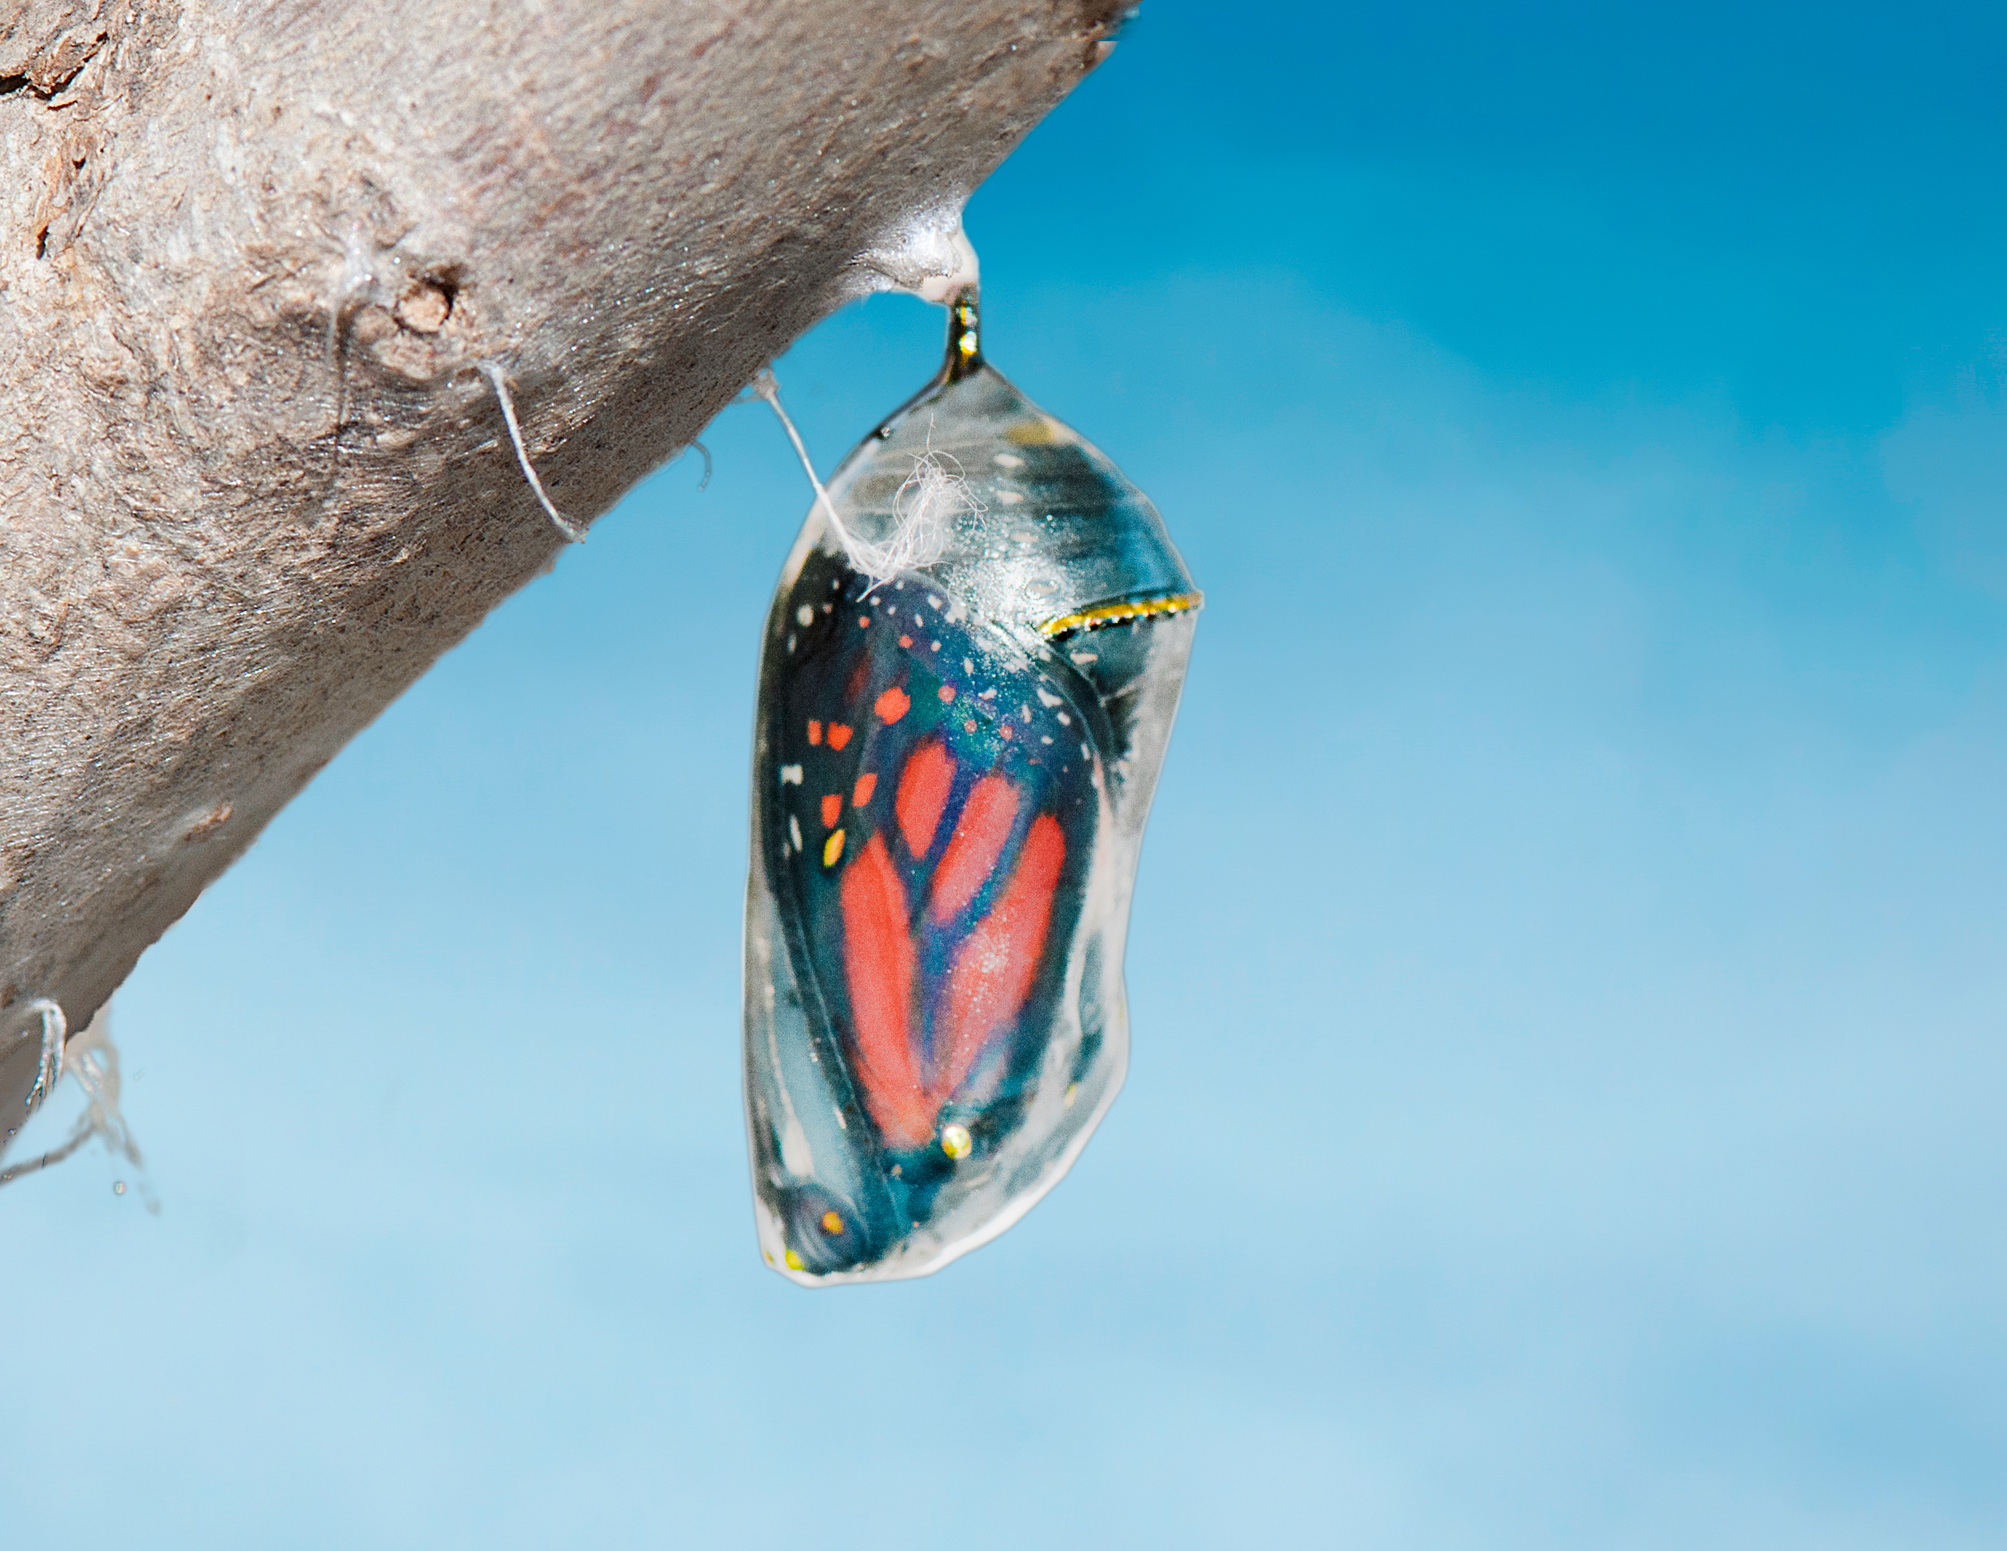
What connections do you draw between the study, your own life and your ministry?

Slide 11
What concepts do you find most challenging? Where are you experiencing cognitive dissonance?

Slide 12
What key concepts or ideas from the study do you think are important to our work within the Baltimore-Washington Conference?

Slide 13
What changes in attitudes, thinking or action will you take as a result of this study?

Slide 14
Closing prayer
As your image bearers, we go into the world to be salt and light.
We go to love like you, to live like you, and to be merciful like you.
We go as
Your covenant community
Your witnesses
Your people

Slide 15
Closing prayer
Your children who are called to go to comfortable and uncomfortable places in seeking to follow Your will.
To likely and unlikely places led by Scripture and informed by reason, tradition, and experience.
We go to be and make disciples of Jesus Christ for the transformation of your world.
In Jesus’ Name, we go together as one, Amen.

