Slide 1
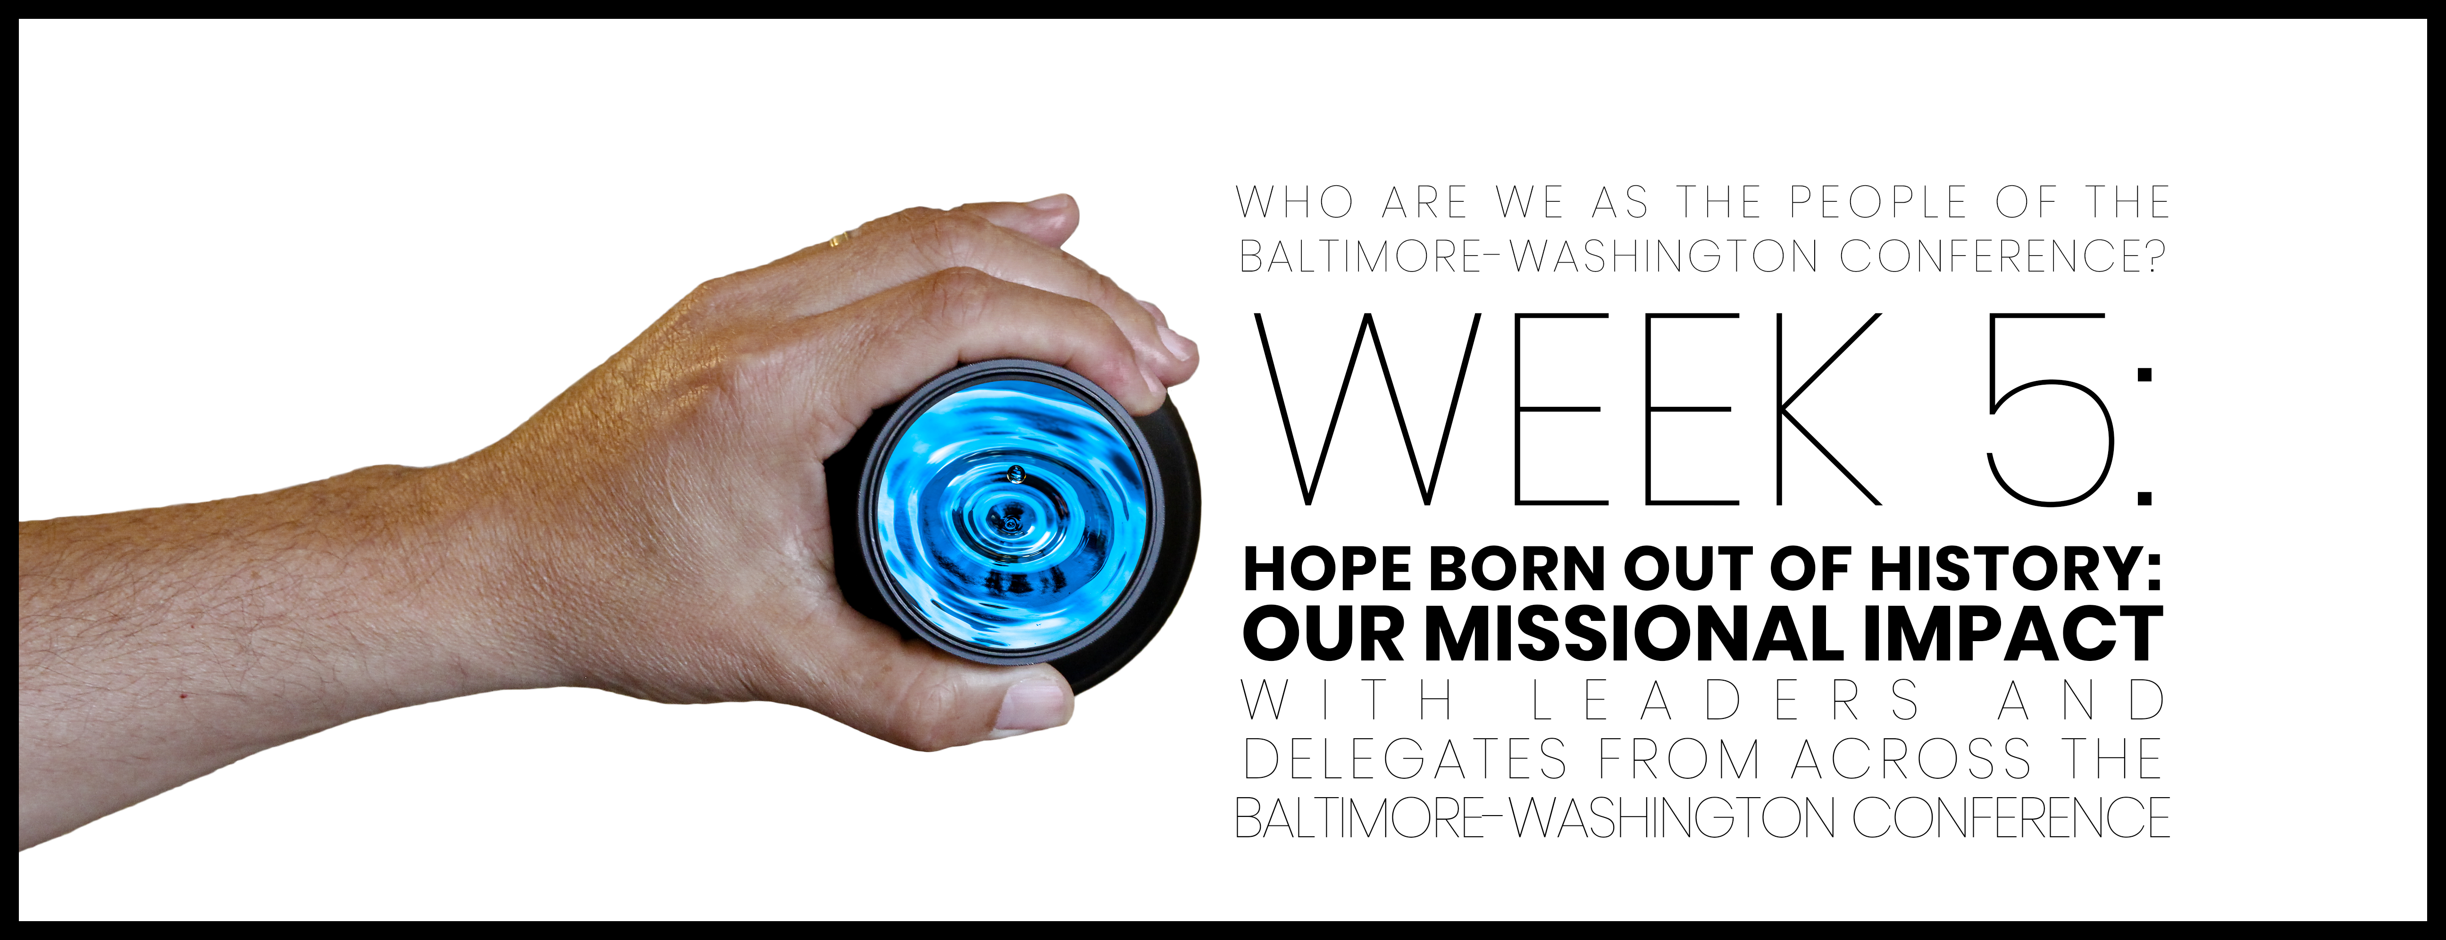

Slide 2

Opening prayer
Omnipotent God: Unlimited is Your power and magnificent is Your name. In the person of Jesus, You’ve shown us how to love and respect. Grant us the humility to love one another with dignity and equity as extensions of ourselves. Omniscient God: You know everything and have infinite awareness, knowledge, and insight into all that concerns us. Teach how to love as You love. Omnipresent God: You are in all places and there is no place devoid of Your healing presence. Teach us how to show up in the world in ways that reflect Your glory and work for liberty and justice for all.

Slide 3
Opening prayer
Redeemer God: You’ve defeated the power of sin and death and You’ve called us to be One. Unite us and bless us, now and forever. Merciful God: You are better to us than we deserve and love us deeper than the human mind can imagine. May we forgive one another as You have forgiven us. Enliven us to make disciples of all nations, baptizing them in the name of the Creator, and of the Redeemer, and of the Sustainer, and teaching them to follow everything Jesus commanded. You are with us not for a moment but for a lifetime. Therefore, we go to make and be Your disciples. Thanks be to God. Amen.

Slide 4

WHO ARE WE AFFIRMATION
In the gift of this moment, we affirm that we are divinely loved and lovable. We are the children of God. Together, we will learn from the actions and words of one another. Christ’s lessons on love are centered in how we treat others and in how we treat ourselves. We will exercise courage in this study as we share stories of struggle and strength. We will stay at the table and receive those stories with grace. We will not be afraid to launch into the deep. We will commit to the vulnerability necessary to allow God to break us open. We will set and respect boundaries and honor confidentiality together.

Slide 5
WHO ARE WE AFFIRMATION
When uncertainty arises, we will remember the Spirit of “peace that passes our own understanding” and can intercede for us. We will remember that even when we don’t feel “United,” the uniting love of Christ can reveal a pathway to greater wisdom and mutual respect. No matter what, there is a place for each one of us in this study together. Let us hold each other up in prayer, hold each other accountable in love, and trust that our God is making all things new. Thank you for the gift of being present to one another in this holy time.

Slide 6
Therefore, go and make disciples of all nations, baptizing them in the name of the Father and of the Son and of the Holy Spirit, teaching them to obey everything that I’ve commanded you. Look, I myself will be with you every day until the end of this present age.”
Matthew 28: 19-20

Slide 7

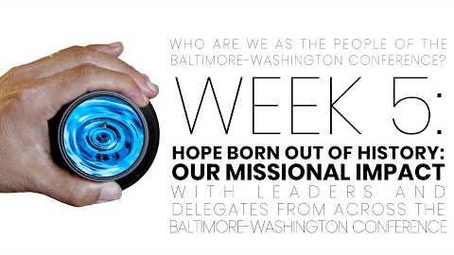
Video with leaders from across the conference

Slide 8

At the beginning of the video, Sharon Milton states that “God reveals Godself as love, and this love is on a mission to transform the world. Missio Dei, ‘God’s mission’ or the ‘sending of God.’” Describe what Missio Dei looks like in your context.

Slide 9
If your church closed tomorrow, would your community notice? If not, how can you reclaim your missional impact?

Slide 10
What does it say of our witness when we withhold our time, talent or treasure? And, how does that withholding influence our lives together?

Slide 11
Beyond the session: Prayer & pathway to journaling
What surprised you or caught your attention?
01
How does the discussion we had apply to your life, your church, our denomination?
02
Where is the Spirit revealing to you areas for growth and transformation?
03
How does what we talked about transform your relationship with God and others?
04
Write a prayer to ask for God’s support and enlightenment, which applies what you learned, and then go forth and live it.
05

