Slide 1
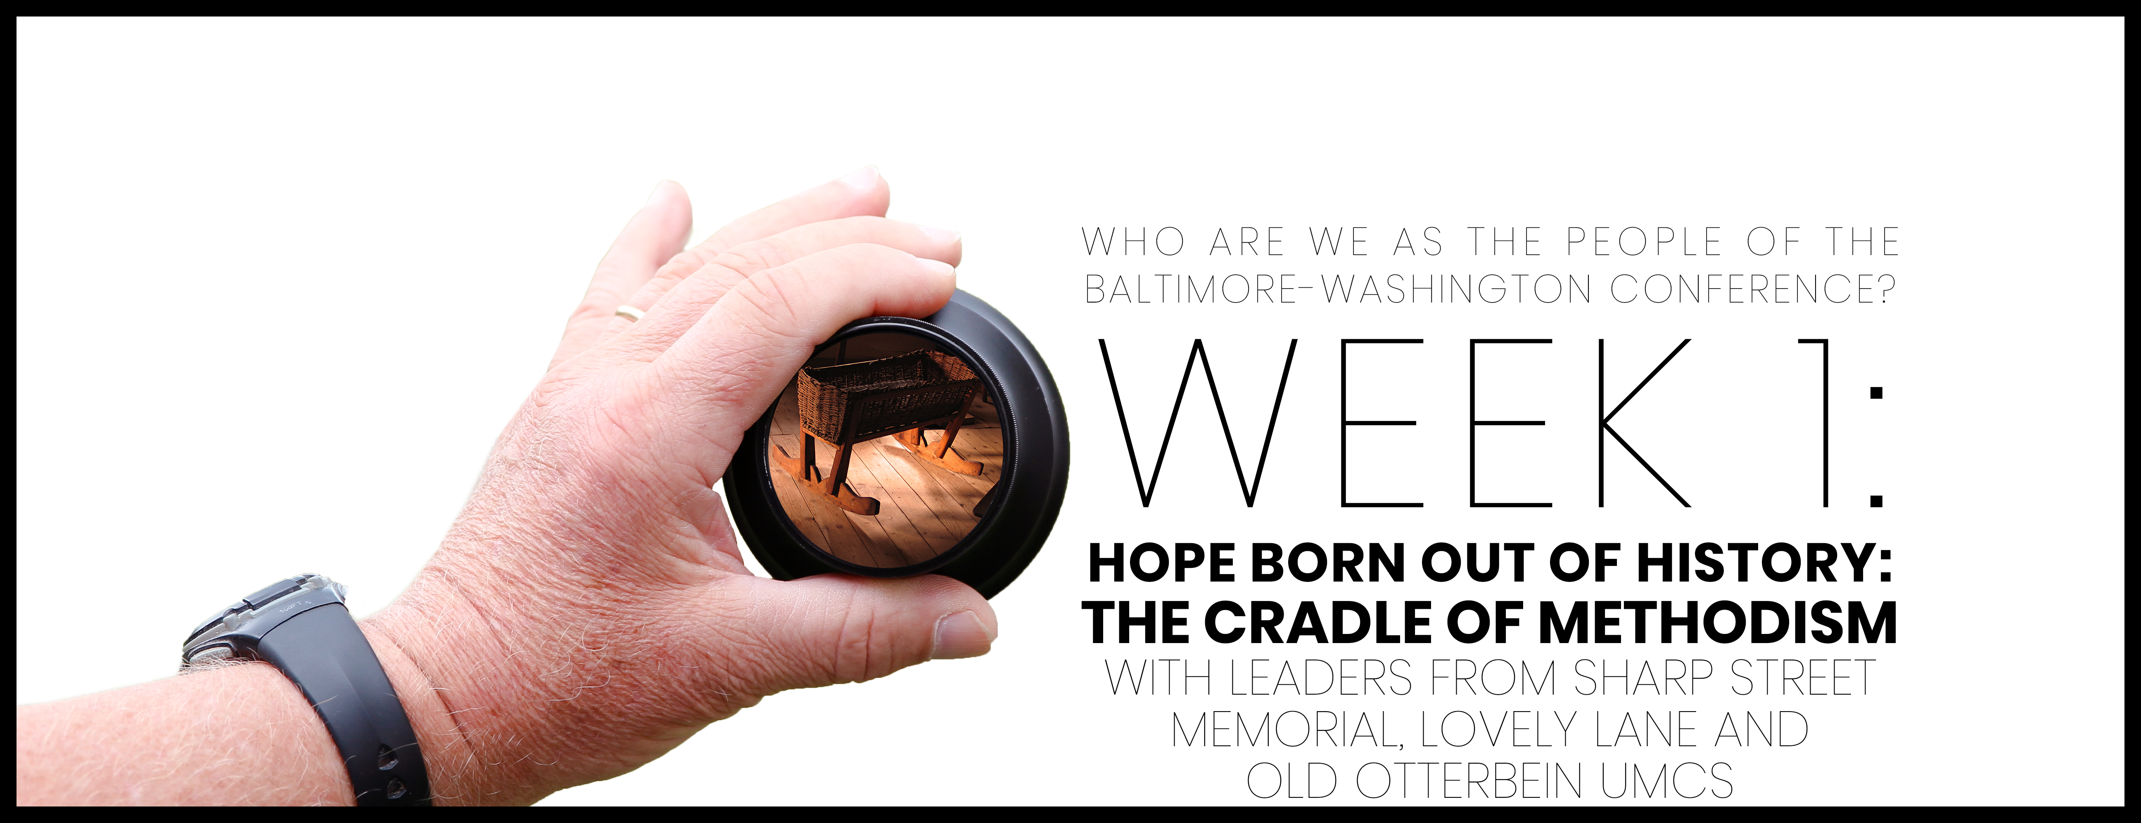

Slide 2

Opening prayer
God of our ancestors, God with us now: we pause to acknowledge Your abiding presence. From generation to generation, You are God and You have included us in Your story of redemption, unconditional love, justice, reconciliation and peace. Thank You. You have given us the gift of Your divine breath. May we use it for Your glory. By the power of Your Holy Spirit, embolden us in this time of study, prayer, and reflection to be doers of Your Word and not hearers only. Let Your will be done on earth as it is in heaven. In the Name of Jesus, we pray. Amen.

Slide 3

WHO ARE WE AFFIRMATION
In the gift of this moment, we affirm that we are divinely loved and lovable. We are the children of God. Together, we will learn from the actions and words of one another. Christ’s lessons on love are centered in how we treat others and in how we treat ourselves. We will exercise courage in this study as we share stories of struggle and strength. We will stay at the table and receive those stories with grace. We will not be afraid to launch into the deep. We will commit to the vulnerability necessary to allow God to break us open. We will set and respect boundaries and honor confidentiality together.

Slide 4
WHO ARE WE AFFIRMATION
When uncertainty arises, we will remember the Spirit of “peace that passes our own understanding” and can intercede for us. We will remember that even when we don’t feel “United,” the uniting love of Christ can reveal a pathway to greater wisdom and mutual respect. No matter what, there is a place for each one of us in this study together. Let us hold each other up in prayer, hold each other accountable in love, and trust that our God is making all things new. Thank you for the gift of being present to one another in this holy time.

Slide 5
The people were filled with expectation, and everyone wondered whether John might be the Christ. John replied to them all, “I baptize you with water, but the one who is more powerful than me is coming. I’m not worthy to loosen the strap of his sandals. He will baptize you with the Holy Spirit and fire. The shovel he uses to sift the wheat from the husks is in his hands. He will clean out his threshing area and bring the wheat into his barn. But he will burn the husks with a fire that can’t be put out.”
Luke 3: 15-17

Slide 6


Slide 7

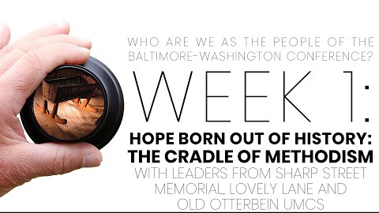
Video with with Rev. Dr. Emora Brannan, Pamela Coleman, Daniel Fisher, Rev. Dr. C. Anthony Hunt, and John Strawbridge

Slide 8
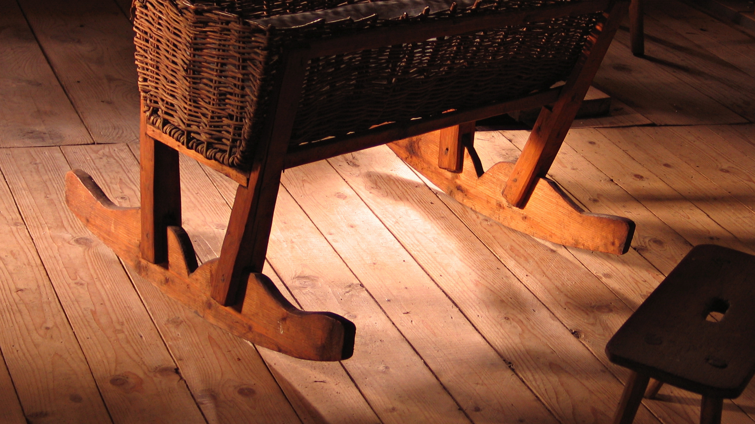
You’ve heard John Strawbridge in his opening say that when people visit Lovely Lane, he says, "welcome home.” How is the Baltimore-Washington Conference home to you?

Slide 9
As we seek to live “earnestly” as Methodists today, what similarities might we hold with our early forbearers, like those at Lovely Lane, Old Otterbein, and Sharp Street churches, and what is distinct about our twenty-first century earnestness and practices?

Slide 10
As you heard the story of our origins as the BWC, it included places to celebrate and places to lament. Where are those places for you today?

Slide 11
Beyond the session: Prayer & pathway to journaling
What surprised you or caught your attention?
01
How does the discussion we had apply to your life, your church, our denomination?
02
Where is the Spirit revealing to you areas for growth and transformation?
03
How does what we talked about transform your relationship with God and others?
04
Write a prayer to ask for God’s support and enlightenment, which applies what you learned, and then go forth and live it.
05

