Slide 1
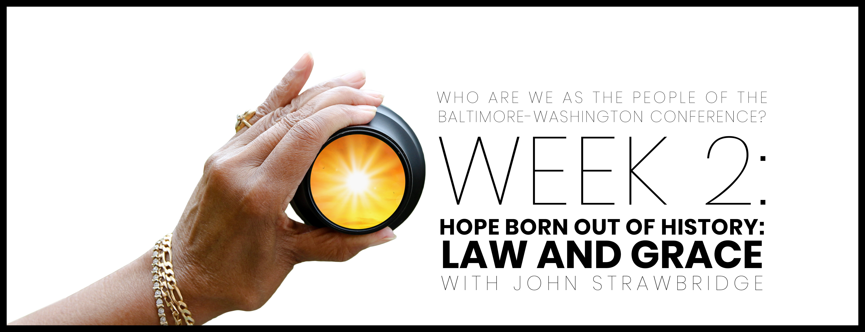

Slide 2

Opening prayer
Hope of the World and Divine Creator: we gather in Your Name. Thank You for all that You are and all that You’ve called us to be. In our hearts, we answer Your call to be... [moment of silence]. Regardless of all that unites and/or divides us, You’ve called us together for such a time as this. Heal us. Unite us. Speak to us. Guide us as we endeavor to be more like You. Root us in Your power and let Thy will be done on earth as it is in heaven. In the Name of Jesus, we ask it all. Amen.

Slide 3

WHO ARE WE AFFIRMATION
In the gift of this moment, we affirm that we are divinely loved and lovable. We are the children of God. Together, we will learn from the actions and words of one another. Christ’s lessons on love are centered in how we treat others and in how we treat ourselves. We will exercise courage in this study as we share stories of struggle and strength. We will stay at the table and receive those stories with grace. We will not be afraid to launch into the deep. We will commit to the vulnerability necessary to allow God to break us open. We will set and respect boundaries and honor confidentiality together.

Slide 4
WHO ARE WE AFFIRMATION
When uncertainty arises, we will remember the Spirit of “peace that passes our own understanding” and can intercede for us. We will remember that even when we don’t feel “United,” the uniting love of Christ can reveal a pathway to greater wisdom and mutual respect. No matter what, there is a place for each one of us in this study together. Let us hold each other up in prayer, hold each other accountable in love, and trust that our God is making all things new. Thank you for the gift of being present to one another in this holy time.

Slide 5
The influential leaders didn’t add anything to what I was preaching—and whatever they were makes no difference to me, because God doesn’t show favoritism. But on the contrary, they saw that I had been given the responsibility to preach the gospel to the people who aren’t circumcised, just as Peter had been to the circumcised. The one who empowered Peter to become an apostle to the circumcised empowered me also to be one to the Gentiles. James, Cephas, and John, who are considered to be key leaders, shook hands with me and Barnabas as equals when they recognized the grace that was given to me. So it was agreed that we would go to the Gentiles, while they continue to go to the people who were circumcised. They asked only that we would remember the poor, which was certainly something I was willing to do.
GALATIANS 2:6-10

Slide 6


Slide 7

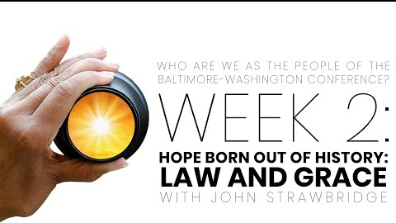
Video with John Strawbridge

Slide 8
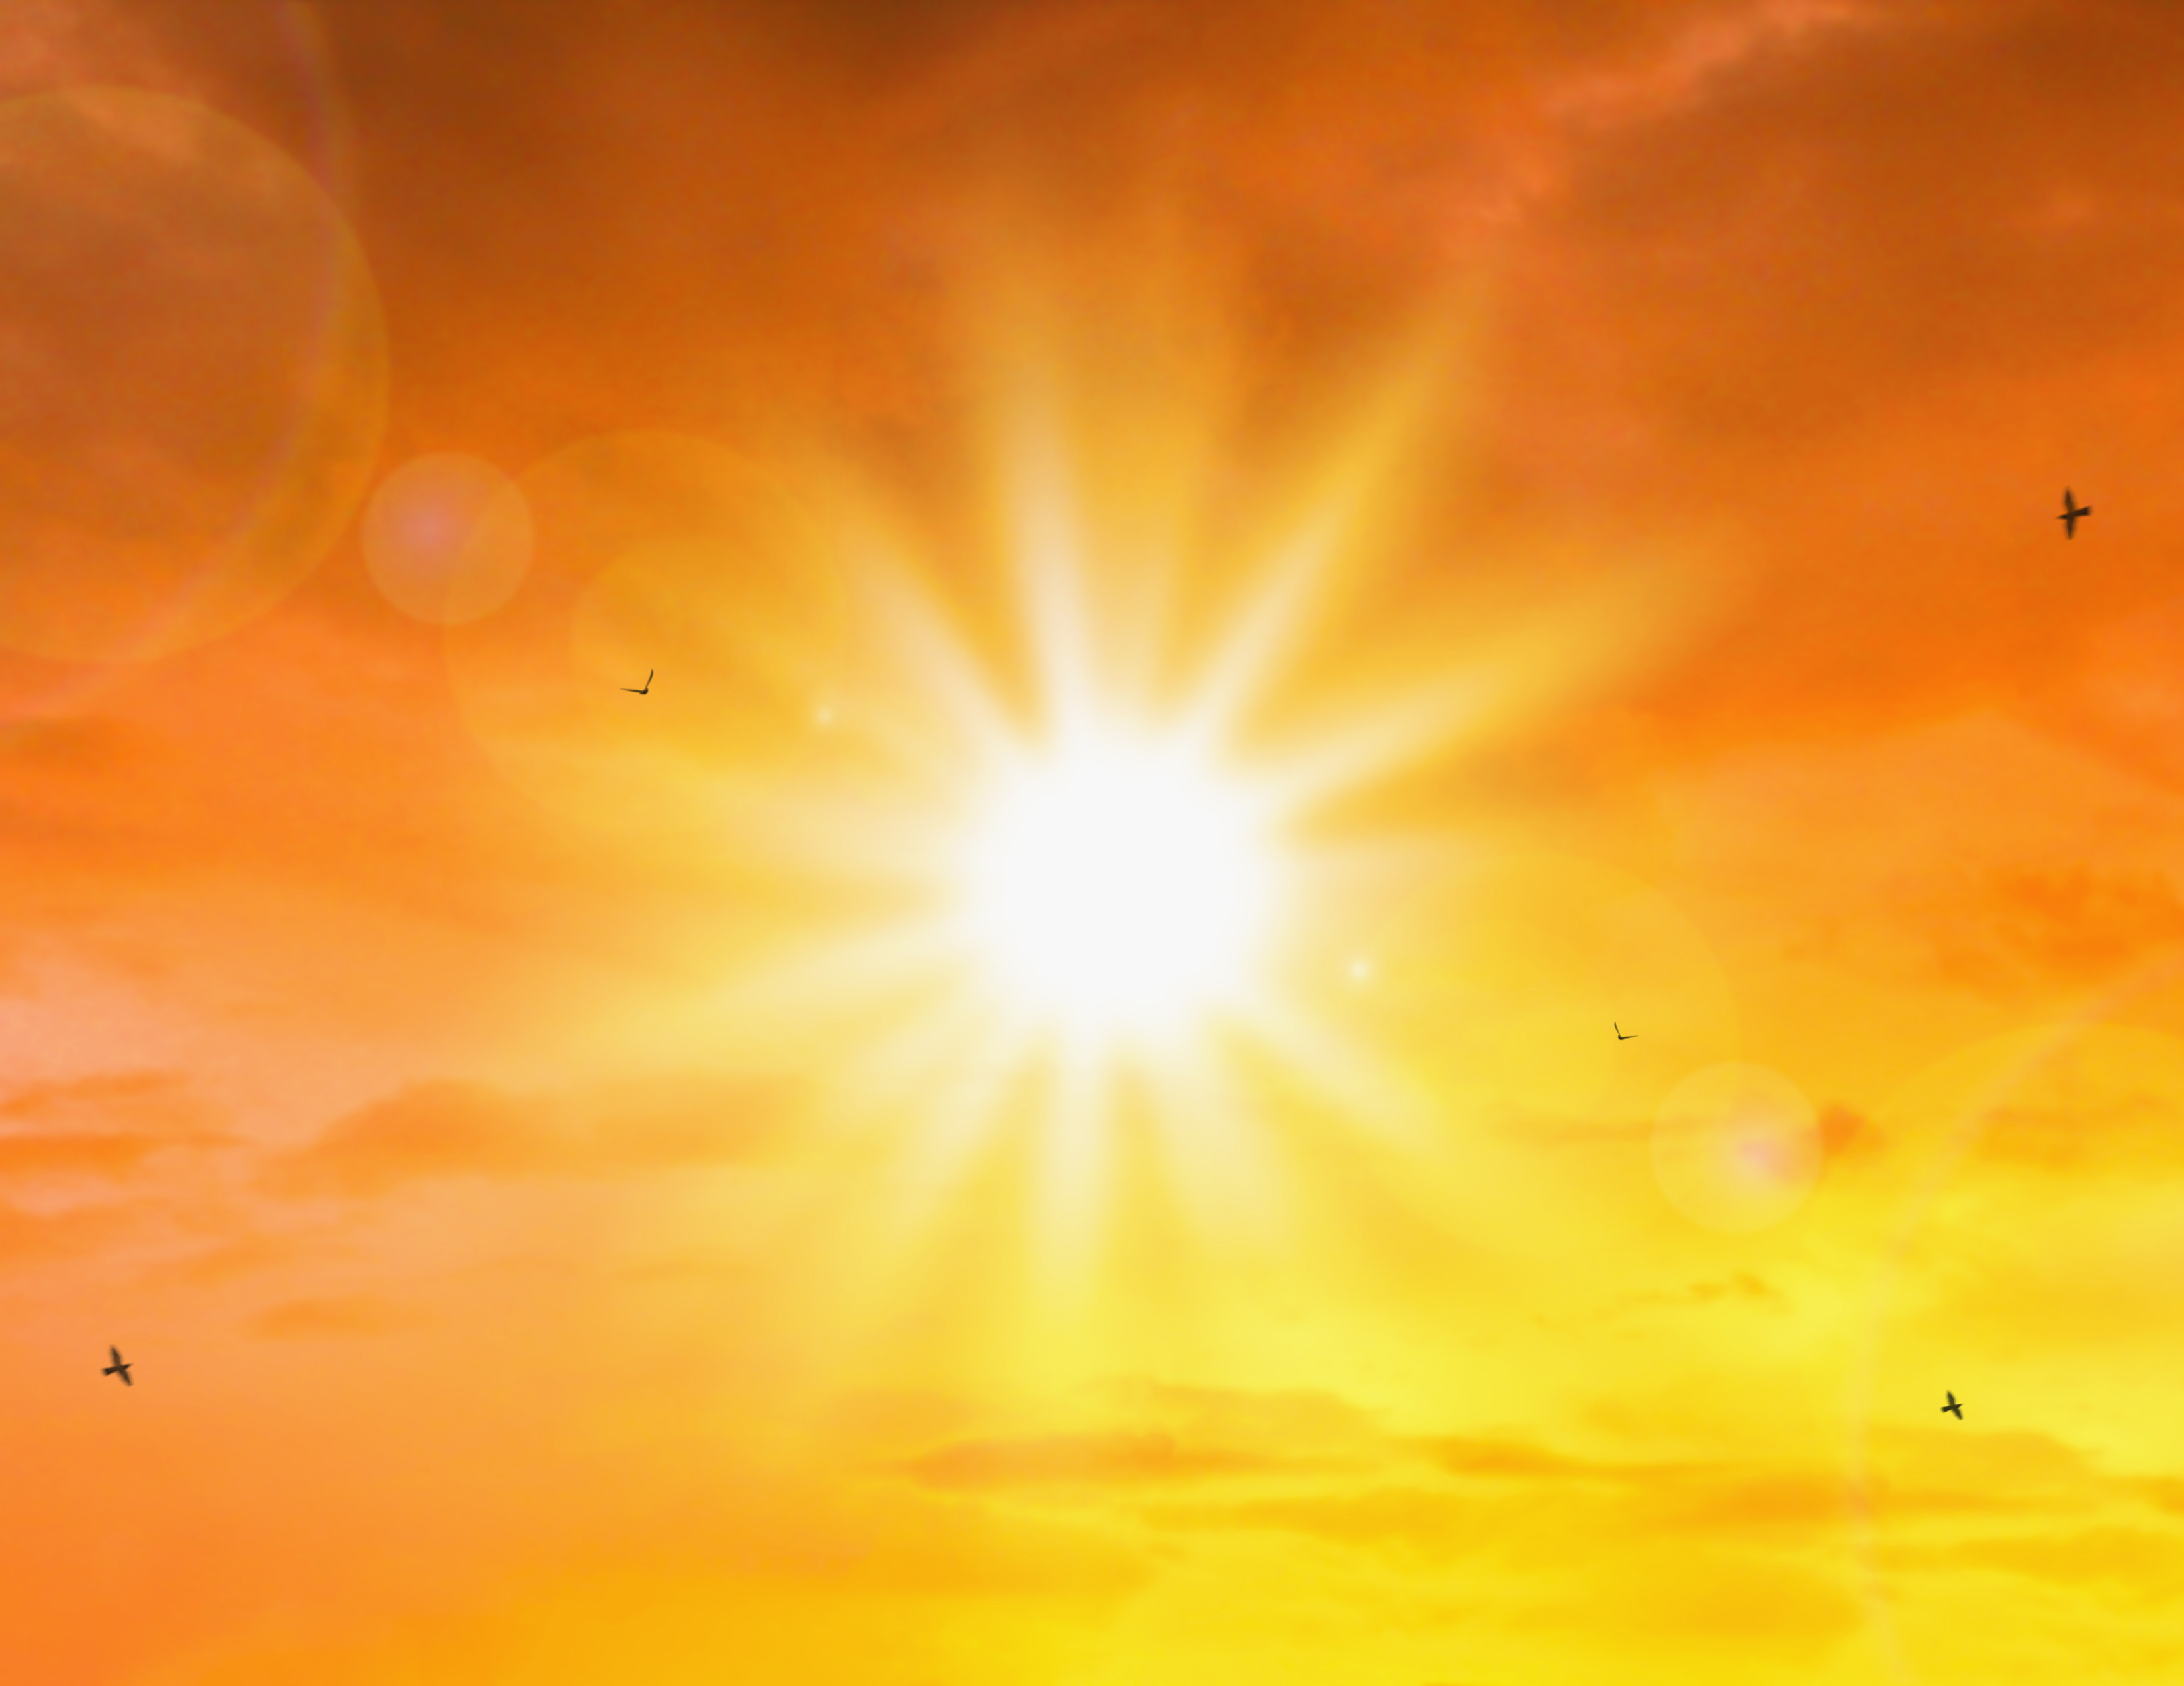
John Strawbridge said, “We need to leave our comfort and go where the conflict is. We need to show a divided world that we are not as different as we fear, because we all have the same spark of the Holy Breath in us.” Share with us a time when your congregation modeled this idea.

Slide 9
What can our denomination’s historic conflicts over law and grace teach us today?

Slide 10
We tend to romanticize the past, and yet, as we are being reminded, our past has not always been perfect. How does our image of a “perfect church” prevent us from doing what is necessary today? As we think of the “perfect church,” perfect for whom?

Slide 11
Beyond the session: Prayer & pathway to journaling
What surprised you or caught your attention?
01
How does the discussion we had apply to your life, your church, our denomination?
02
Where is the Spirit revealing to you areas for growth and transformation?
03
How does what we talked about transform your relationship with God and others?
04
Write a prayer to ask for God’s support and enlightenment, which applies what you learned, and then go forth and live it.
05

