Slide 1
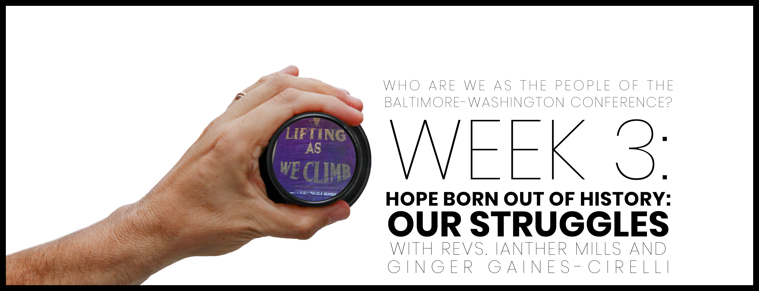

Slide 2

Opening prayer
Gracious and Merciful God who moves among us: Thank You for the gift of Your presence. Thank You for allowing Your Spirit to rest in, speak through, and transform human vessels. Thank You for the gifts of Baptism in Christ and for reminding us that there is neither Jew nor Gentile, neither slave nor free, nor is there male and female, for we are all one in Christ Jesus. Nothing we can do can preclude the work of Your Spirit. Thank You. Lead us in this time of holy conferencing and allow us to wholly experience the fullness of Your liberating love. In the Name of Jesus, we ask it all. Amen.

Slide 3

WHO ARE WE AFFIRMATION
In the gift of this moment, we affirm that we are divinely loved and lovable. We are the children of God. Together, we will learn from the actions and words of one another. Christ’s lessons on love are centered in how we treat others and in how we treat ourselves. We will exercise courage in this study as we share stories of struggle and strength. We will stay at the table and receive those stories with grace. We will not be afraid to launch into the deep. We will commit to the vulnerability necessary to allow God to break us open. We will set and respect boundaries and honor confidentiality together.

Slide 4
WHO ARE WE AFFIRMATION
When uncertainty arises, we will remember the Spirit of “peace that passes our own understanding” and can intercede for us. We will remember that even when we don’t feel “United,” the uniting love of Christ can reveal a pathway to greater wisdom and mutual respect. No matter what, there is a place for each one of us in this study together. Let us hold each other up in prayer, hold each other accountable in love, and trust that our God is making all things new. Thank you for the gift of being present to one another in this holy time.

Slide 5
Before faith came, we were guarded under the Law, locked up until faith that was coming would be revealed, so that the Law became our custodian until Christ so that we might be made righteous by faith.
But now that faith has come, we are no longer under a custodian.
You are all God’s children through faith in Christ Jesus. All of you who were baptized into Christ have clothed yourselves with Christ. There is neither Jew nor Greek; there is neither slave nor free; nor is there male and female, for you are all one in Christ Jesus. Now if you belong to Christ, then indeed you are Abraham’s descendants, heirs according to the promise.
GALATIANS 3:23-29

Slide 6

https://www.oracle.com/be/corporate/careers/culture/diversity.html

Slide 7

Video with ginger gaines-cirelli and ianther mills

Slide 8
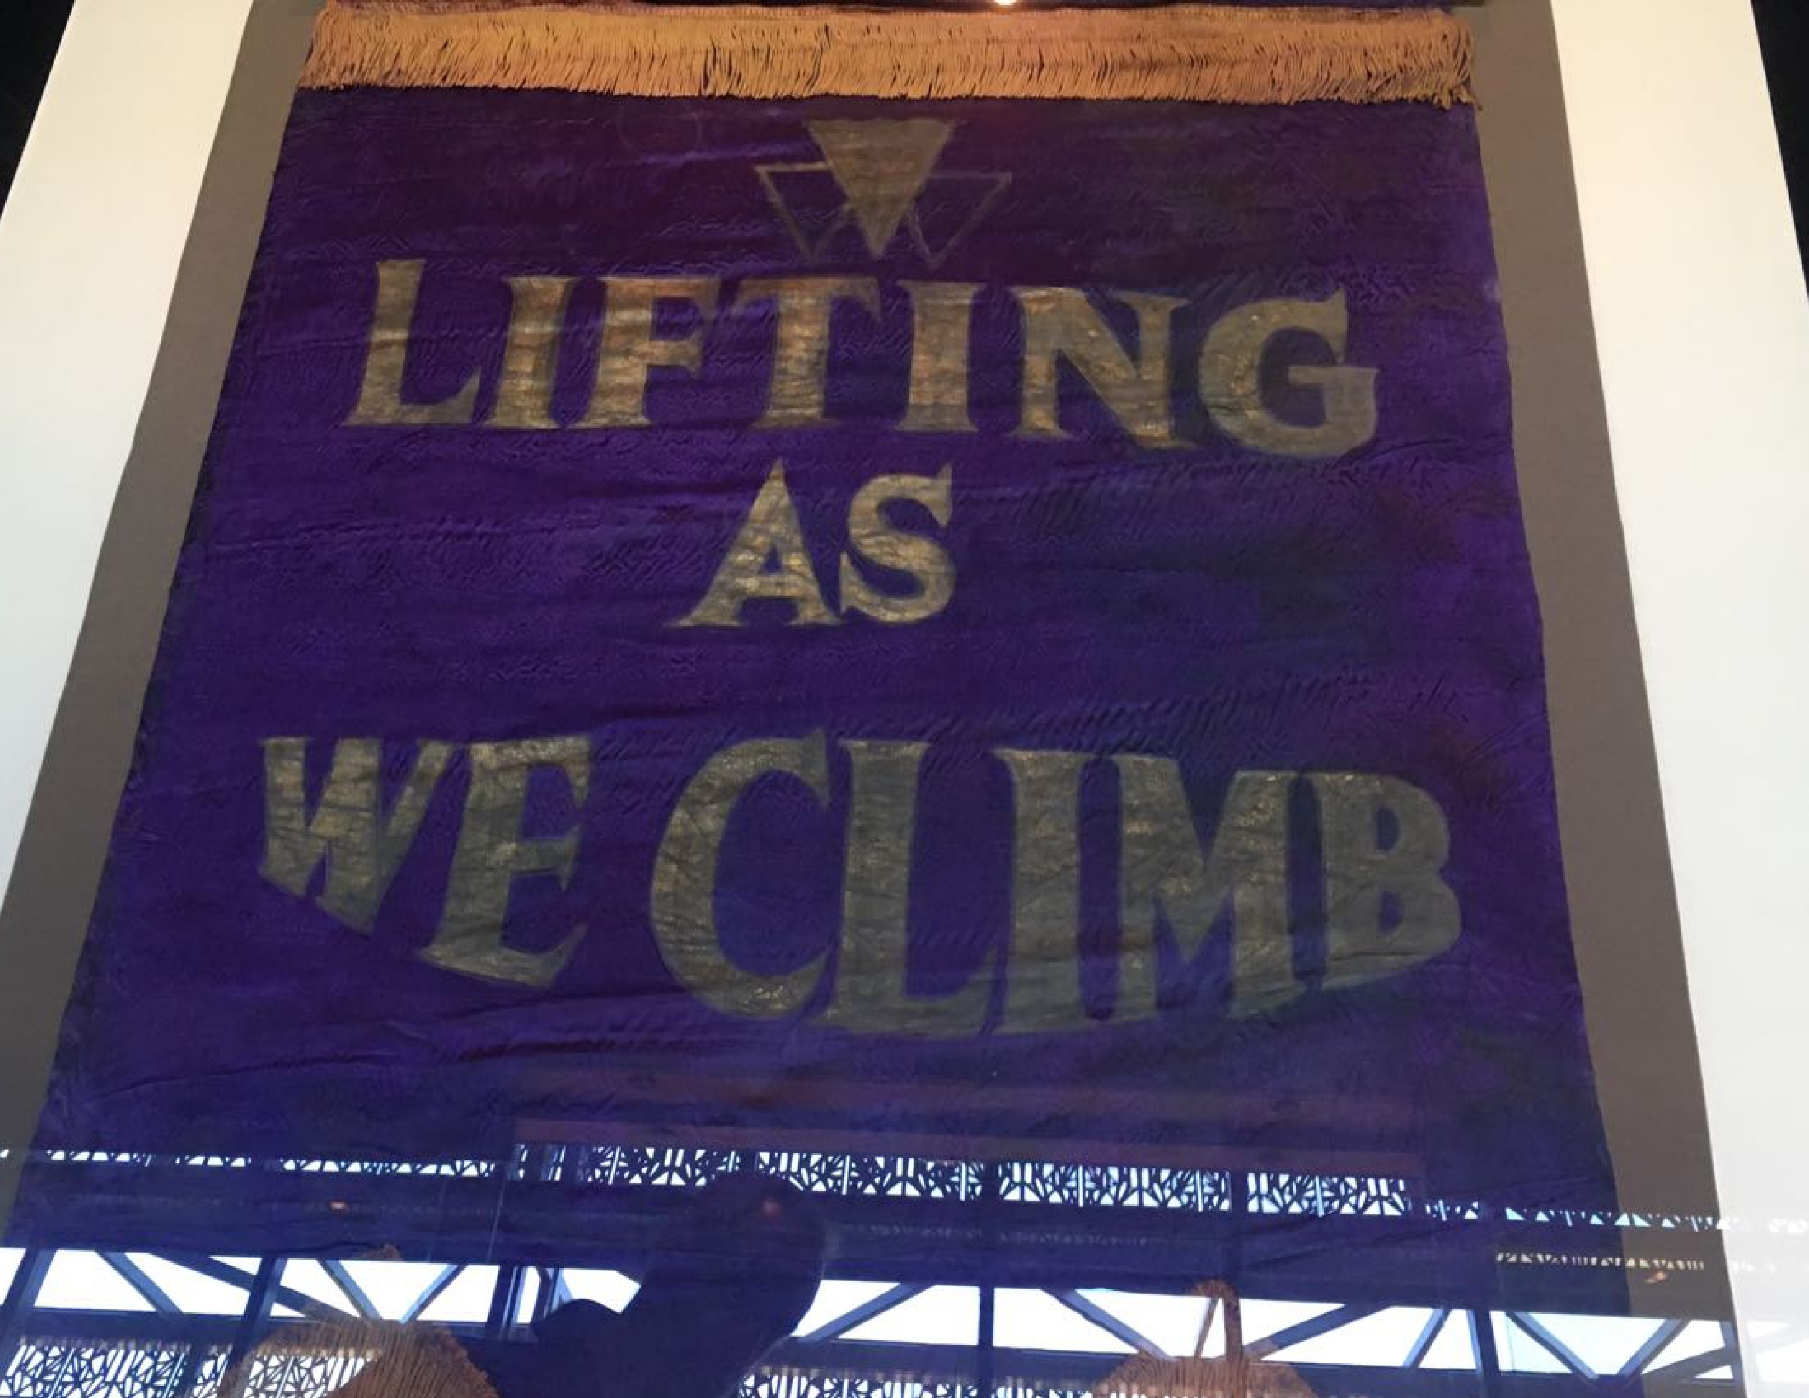
What word or concept emerged for you as we read Galatians 3:23-29? How is the Spirit nudging you to better live into this?

Slide 9
How do we stay connected and work in shared mission when we hold conflicting views on who can hold the power in leadership?

Slide 10
If you are really honest with yourself, who would you not accept as a pastor or other leader? Are these people present in your context?

Slide 11
Beyond the session: Prayer & pathway to journaling
What surprised you or caught your attention?
01
How does the discussion we had apply to your life, your church, our denomination?
02
Where is the Spirit revealing to you areas for growth and transformation?
03
How does what we talked about transform your relationship with God and others?
04
Write a prayer to ask for God’s support and enlightenment, which applies what you learned, and then go forth and live it.
05

