Slide 1
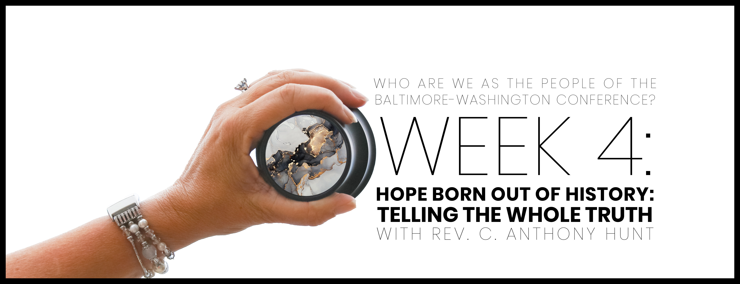

Slide 2

Opening prayer
Triune God: You are with us. Creator of community and the unity of creation, You have claimed us as Your very own. You’ve made us One people. We are One Nation, indivisible under the power of Your existence. You have created humanity in Your image. Nothing in our limited vision can distort that truth. You are the Way the Truth and the Life. You are the Truth that perfects our limited knowledge. You are the Life that gives us purpose and animation. You are the Reason that we live, move and have our being. Thank You for all that You are and for all that You call us to be this day. As we dwell together in unity, speak Lord, and bestow Your blessings upon us. In the Name of Jesus, we ask it all. Amen.

Slide 3

WHO ARE WE AFFIRMATION
In the gift of this moment, we affirm that we are divinely loved and lovable. We are the children of God. Together, we will learn from the actions and words of one another. Christ’s lessons on love are centered in how we treat others and in how we treat ourselves. We will exercise courage in this study as we share stories of struggle and strength. We will stay at the table and receive those stories with grace. We will not be afraid to launch into the deep. We will commit to the vulnerability necessary to allow God to break us open. We will set and respect boundaries and honor confidentiality together.

Slide 4
WHO ARE WE AFFIRMATION
When uncertainty arises, we will remember the Spirit of “peace that passes our own understanding” and can intercede for us. We will remember that even when we don’t feel “United,” the uniting love of Christ can reveal a pathway to greater wisdom and mutual respect. No matter what, there is a place for each one of us in this study together. Let us hold each other up in prayer, hold each other accountable in love, and trust that our God is making all things new. Thank you for the gift of being present to one another in this holy time.

Slide 5
Therefore, go and make disciples of all nations, baptizing them in the name of the Father and of the Son and of the Holy Spirit, teaching them to obey everything that I’ve commanded you. Look, I myself will be with you every day until the end of this present age.”
psalm 133: 1-3

Slide 6


Slide 7

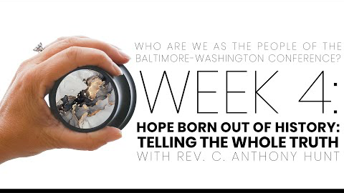
Video with Dr. C. Anthony Hunt

Slide 8

How do we acknowledge and affirm the full humanity of all people?

Slide 9
In what ways, as individuals and churches, might we commit to telling and embracing our stories?

Slide 10
What does God expect of us when it comes to overcoming racism and other forms of segregation? What are we prepared to do to work toward it?

Slide 11
Beyond the session: Prayer & pathway to journaling
What surprised you or caught your attention?
01
How does the discussion we had apply to your life, your church, our denomination?
02
Where is the Spirit revealing to you areas for growth and transformation?
03
How does what we talked about transform your relationship with God and others?
04
Write a prayer to ask for God’s support and enlightenment, which applies what you learned, and then go forth and live it.
05

