Slide 1
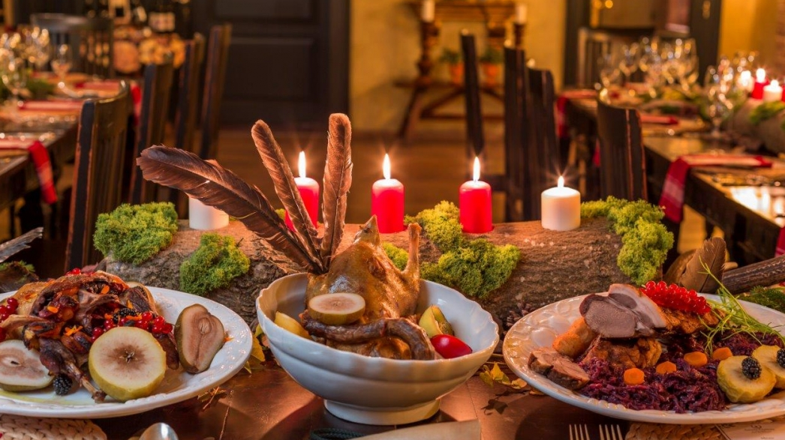
Esther 1:1-9
First Banquet: 180 Days

Slide 2
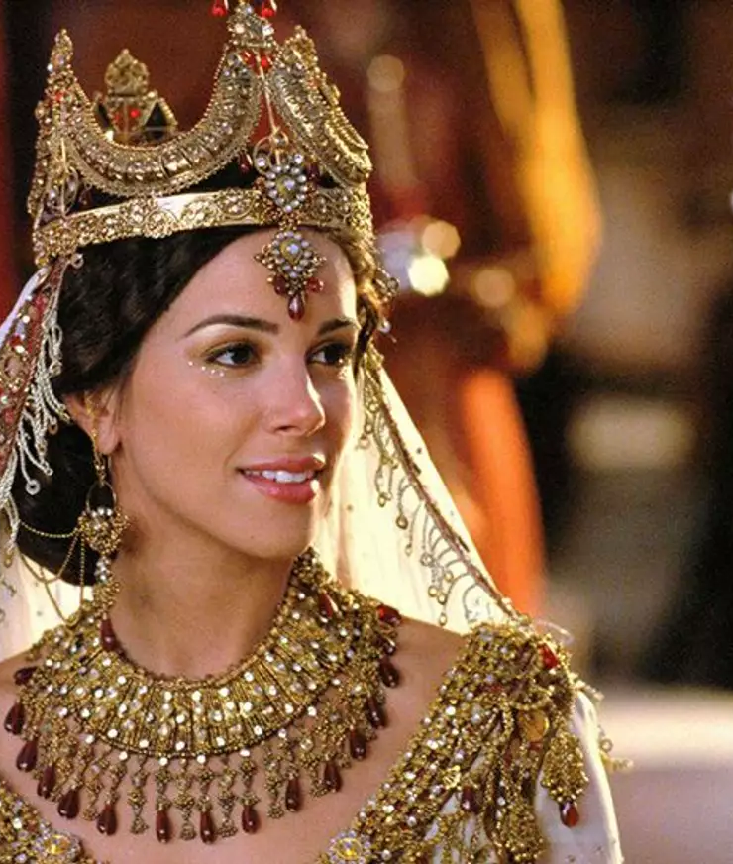
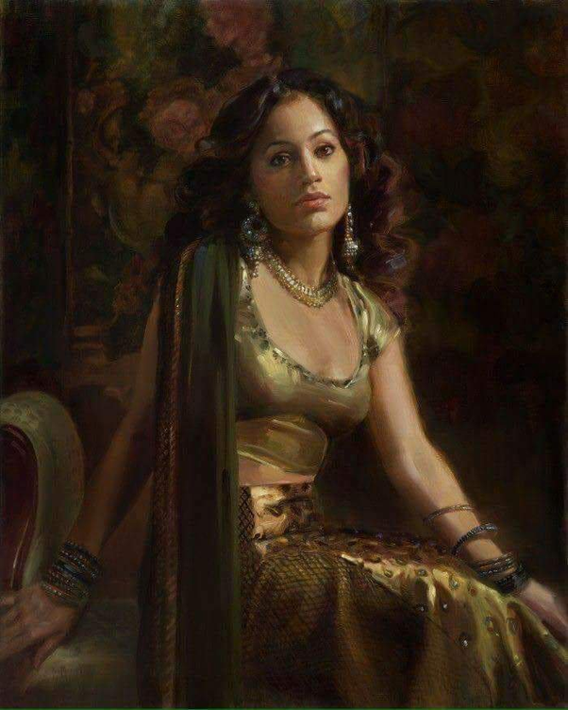
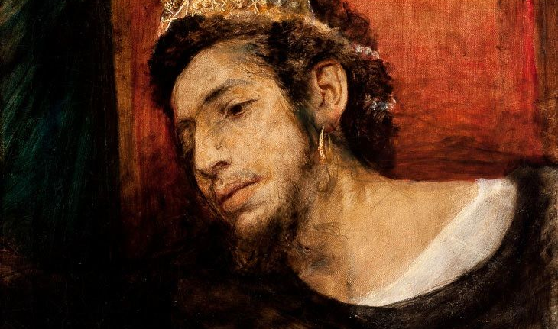
Agenda at a Glance
Ahasuerus,
Hundred and twenty-seven provinces from India to Ethiopia,
In Susa,
In the third year of his reign,
He gave a banquet for all his officials and ministers. The army of Persia and Media and the nobles and governors of the provinces were present,
He displayed the great wealth of his kingdom and the splendor and pomp of his majesty for many days,
one hundred and eighty days in all.
A second banquet: for the people, taking 7 days, in the garden of the palace
Luxurious and extravagant decorations
A third banquet: Vashti for the women in the palace of the king.

Slide 3
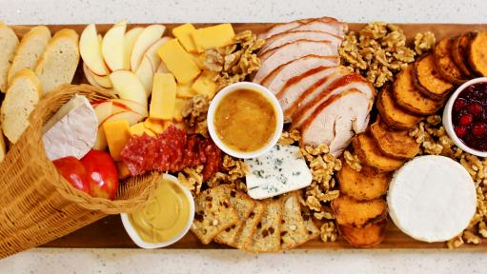
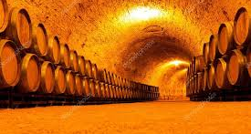
Introduction
The first nine verses of chapter one set the stage for the entire book. Three distinct banquets celebrate Xerxes great power and wealth. A central character of the story is introduced, and an anti-Persian bias is well-established, even before Esther and Mordecai appear on the scene. But almost from the beginning, the author points to the fact that this is a work of fiction and not history.

Slide 4

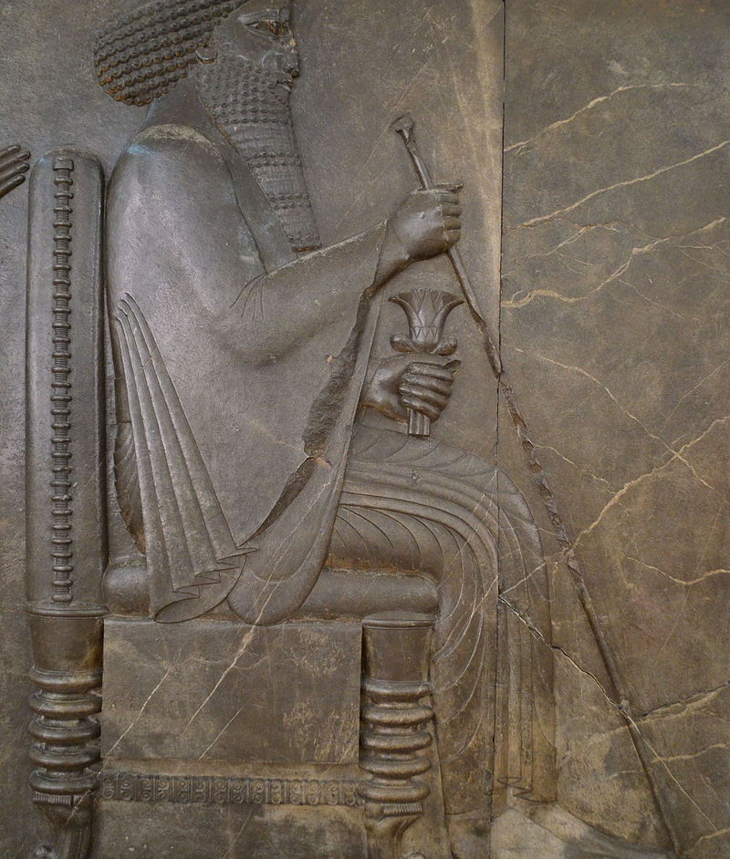
Ahasuerus = Xerxes
There is no Ahasuerus in Persia, but readers would have known who it was. Experts disagree, but “Linguistic and historical evidence indicate that Xerxes… is meant.” (NIB.) Xerxes the Great, was the fourth King of Kings of the Iranian Achaemenid Empire, ruling from 486 to 465 BC. He was the son and successor of Darius the Great (r. 522–486 BC) and his mother was Atossa, a daughter of Cyrus the Great (r. 550–530 BC), the founder of the Achaemenid empire. (WP)
Like his father, he ruled the empire at its territorial apex. He ruled from 486 BC until his assassination in 465 BC at the hands of Artabanus, the commander of the royal bodyguard.
Xerxes I is notable in Western history for his invasion of Greece in 480 BC.
Calles “King of Kings, the God King, Xerxes the Great” he was known for his building campaigns throughout the empire and especially in Susa.
Cyrus the Great (550-530 BCE)
Cambyses
Darius I (522-486 BCE)
Xerxes (486-465 BCE)
Artaxerxes I
Darius II
Artaxerxes II

Slide 5
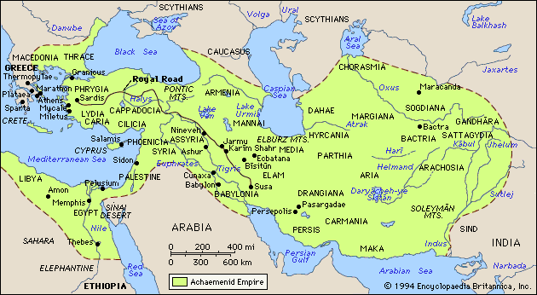
Hundred and twenty-seven provinces from India to Ethiopia,

Slide 6

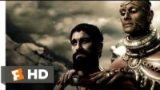

Slide 7
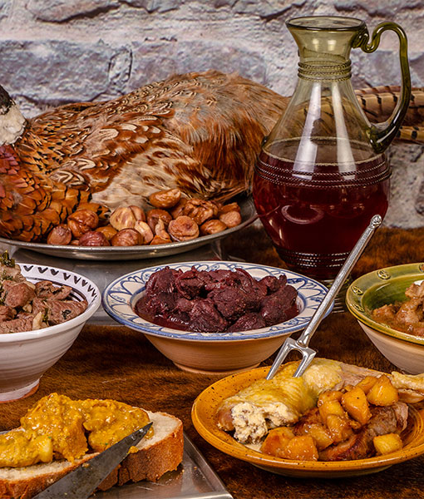
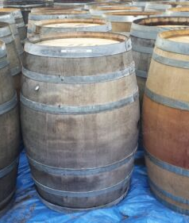
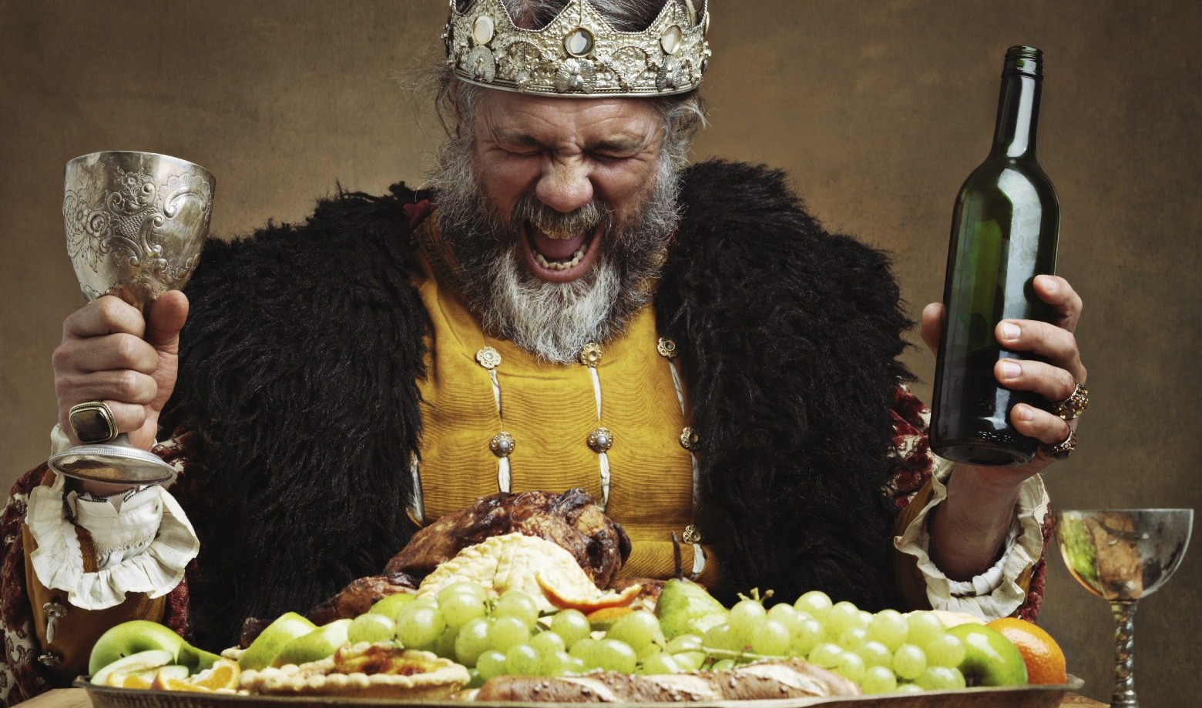
He gave a banquet for all his officials and ministers. The army of Persia and Media and the nobles and governors of the provinces were present
This first banquet is a prologue to the entire story. It sets the tone: Luxury, bureaucracy, excess.
The Persian court is decently lavish and mired in protocol.
King Ahasuerus is all powerful and totally inept.
This Ahasuerus bears no resemblance to the original Xerxes, but it is a fictional character, a comic figurehead concerned with the trappings of power but exercising little of his own. (JSB)

Slide 8
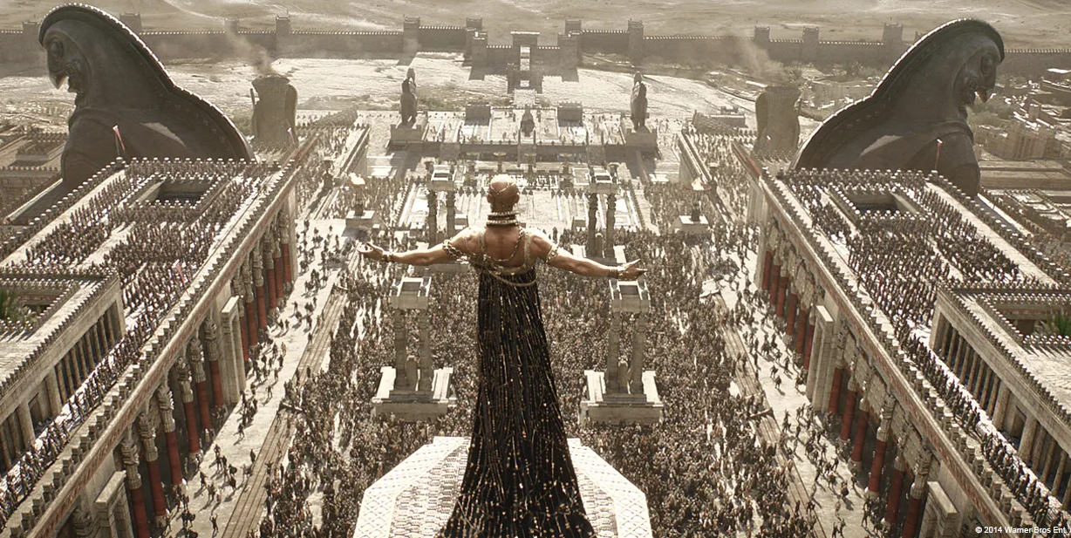
He displayed the great wealth of his kingdom and the splendor and pomp of his majesty for many days, one hundred and eighty days in all.
1. The banquet is taking place in Susa, (Fortress Shushan): This is one of four Persian capitals (Ecbatana, Babylon, Persepolis.) This is the main administrative capital and the kings winter residence.
2. The Kings Table: This is a tradition to bring the wealth of the nations to the king and bestow honor on faithful subjects.
Persian parties are known for the large amounts of wine. The rule for drinking was simple: No restrictions. (JSB)
3. It is likely that the numbers “121 provinces” or “180 days in all” are exaggerations meant to heighten the anti-Jewish polemic. “These are debouched foreigners. These are not righteous Jews. These are the others.”

Slide 9
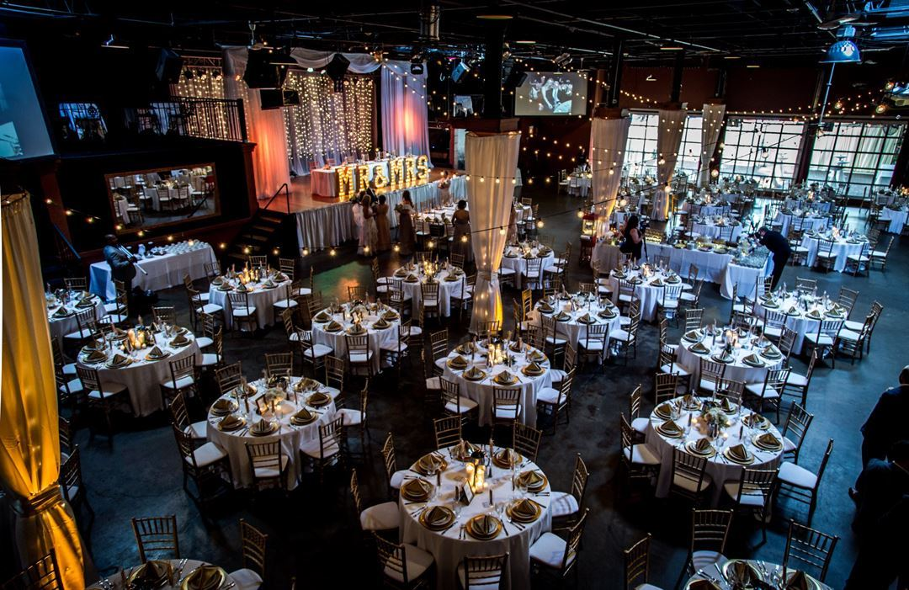
A second banquet: for the people, taking 7 days, in the garden of the palace:
1. These banquets serve the purpose of celebrating three years in which he quelled rebellions in Egypt and Babylon, establishing his reign on a secure foundation. So secure was he that he allowed his entire empire to come to a halt for six months while they partied.
2. A special ruling was passed for this banquet. Whereas guest were expected to match the King drink by drink, in this banquet there is no compulsion. People could drink as much or as little as they wanted.
c

Slide 10
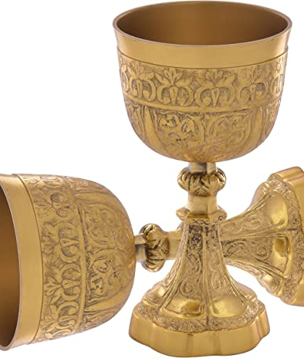
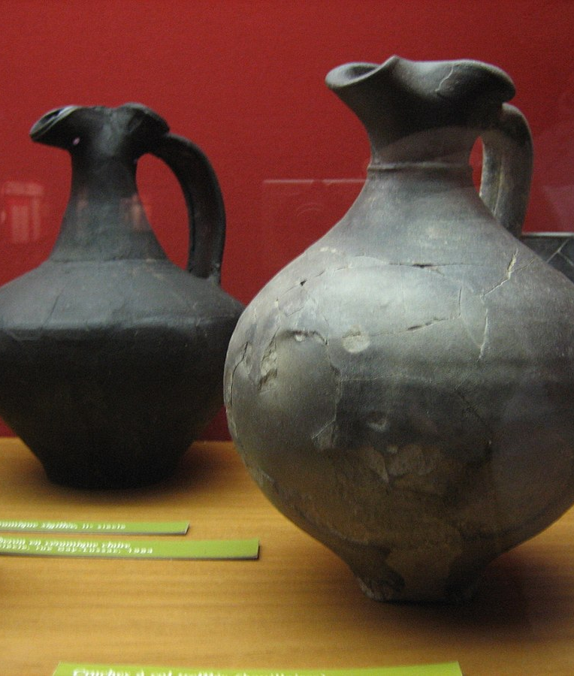
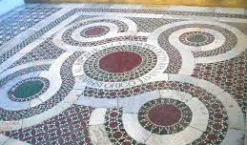
Luxurious and extravagant feast
1. There were white cotton curtains and blue hangings tied with cords of fine linen and purple to silver rings and marble pillars.
2. Couches of gold and silver,
3. A mosaic pavement of porphyry, marble, mother-of-pearl, and colored stones.
4. Drinks were served in golden goblets, goblets of different kinds,
5. The royal wine was lavished in accordance with the bounty of the king.
6. Drinking was by flagons, without restraint; for the king had given orders to all the officials of his palace to do as each one desired.
7. Men, women, and drinking

Slide 11
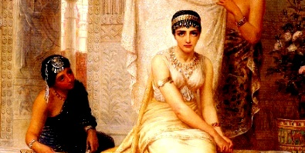
A third banquet: Vashti for the women in the palace of the king.
Amestris = Queen for Life
No historical Evidence of Existence
Despite the veneer of historicity
Vashti’s appearance in the story
Point the reader to the fact that this
Is fiction. A nice story.
The Queen hosts a party
For the women only (Drinking?)
Perhaps this points to the summons and future downfall.
LXX vs. Mass
c

Slide 12
LXX Chapter 1:1
[In the second year of the reign of Artaxerxes the great king, on the first of Nisan, Mardochaeus the son of Jarius, the son of Semeias, the son of Casaus, of the tribe of Benjamine, a Jew dwelling in the city Susa, a great man, serving in the king's palace, saw a vision. Now he was of the captivity which Nabuchodonosor king of Babylon had carried captive from Jerusalem, with Jachonias the king of Judea. And this was his dream: Behold, voices and a noise, thunders and earthquake, tumult upon the earth. And, behold, two great serpents came forth, both ready for conflict, and there came from them a great voice, and by their voice every nation was prepared for battle, even to fight against the nation of the just. And, behold, a day of darkness and blackness, tribulation and anguish, affection and tumult upon the earth. And all the righteous nation was troubled, fearing their own afflictions; and they prepared to die, and cried to God: and from their cry there came as it were a great river from a little fountain, much water. And light and the sun arose, and the lowly were exalted, and devoured the honorable. And Mardochaeus who had seen this vision and what God desired to do, having awoke, kept it in his heart, and desired by all means to interpret it, even till night. And Mardochaeus rested quiet in the palace with Gabatha and Tharrha the king's two chamberlains, eunuchs who guarded the palace. And he heard their reasoning and searched out their plans, and learnt that they were preparing to lay hands on king Artaxerxes: and he informed the king concerning them. And the king examined the two chamberlains, and they confessed, and were executed. And the king wrote these things for a memorial: also Mardochaeus wrote concerning these matters. And the king commanded Mardochaeus to attend in the palace, and gave gifts for this service. And Aman the son of Amadathes the Bugean was honorable in the sight of the king, and he endeavored to hurt Mardochaeus and his people, because he was jealous.

Slide 13

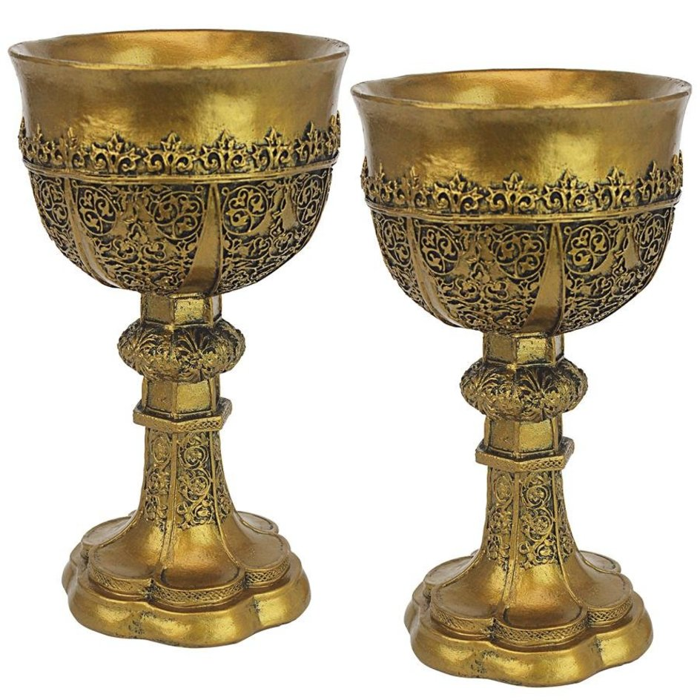
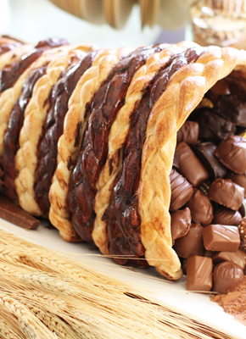
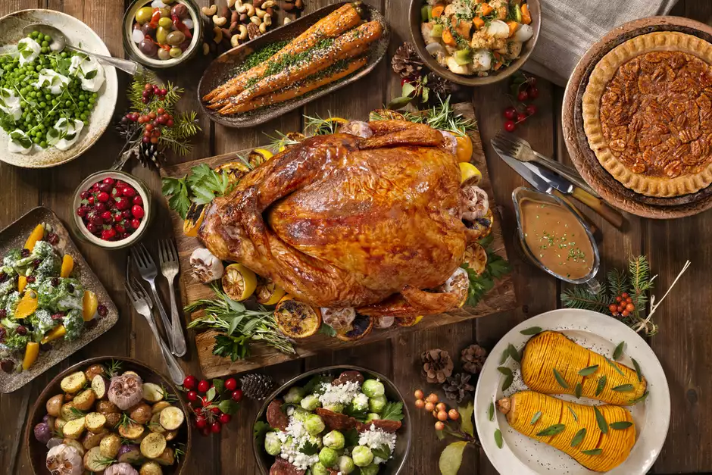
Summary
The stage has been set and we are introduced to a clownish king who acts in imprudent ways (1. Calls all the powerful princes, generals, officials, ministers from his 121 provinces to come to a six-month-banquet. Who is taking care of business in the provinces? Does he have no enemies left throughout the known world? 2. Encourages the excessive use of alcohol. Would drunk foreigners cause a security threat within a walled city? Who is to protect the women in Susa? 3. Spends freely for six months with hundreds if not thousands of people. Is this wise spending? Will this flaunting of wealth arouse the jealousy of would-be enemies? Have we learned nothing from 2 Kings 20:12-19? Is this level of stupidity purposeful on the part of the writer? Is this political mockery? We will see the answers to these questions over the next few weeks.

Slide 14
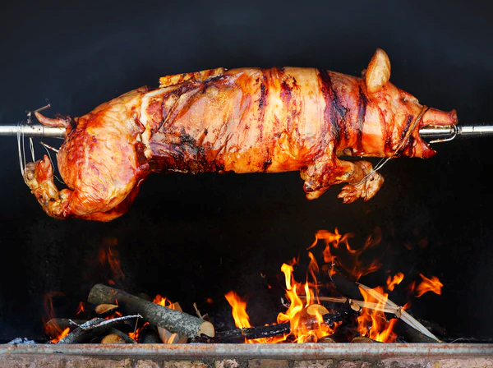
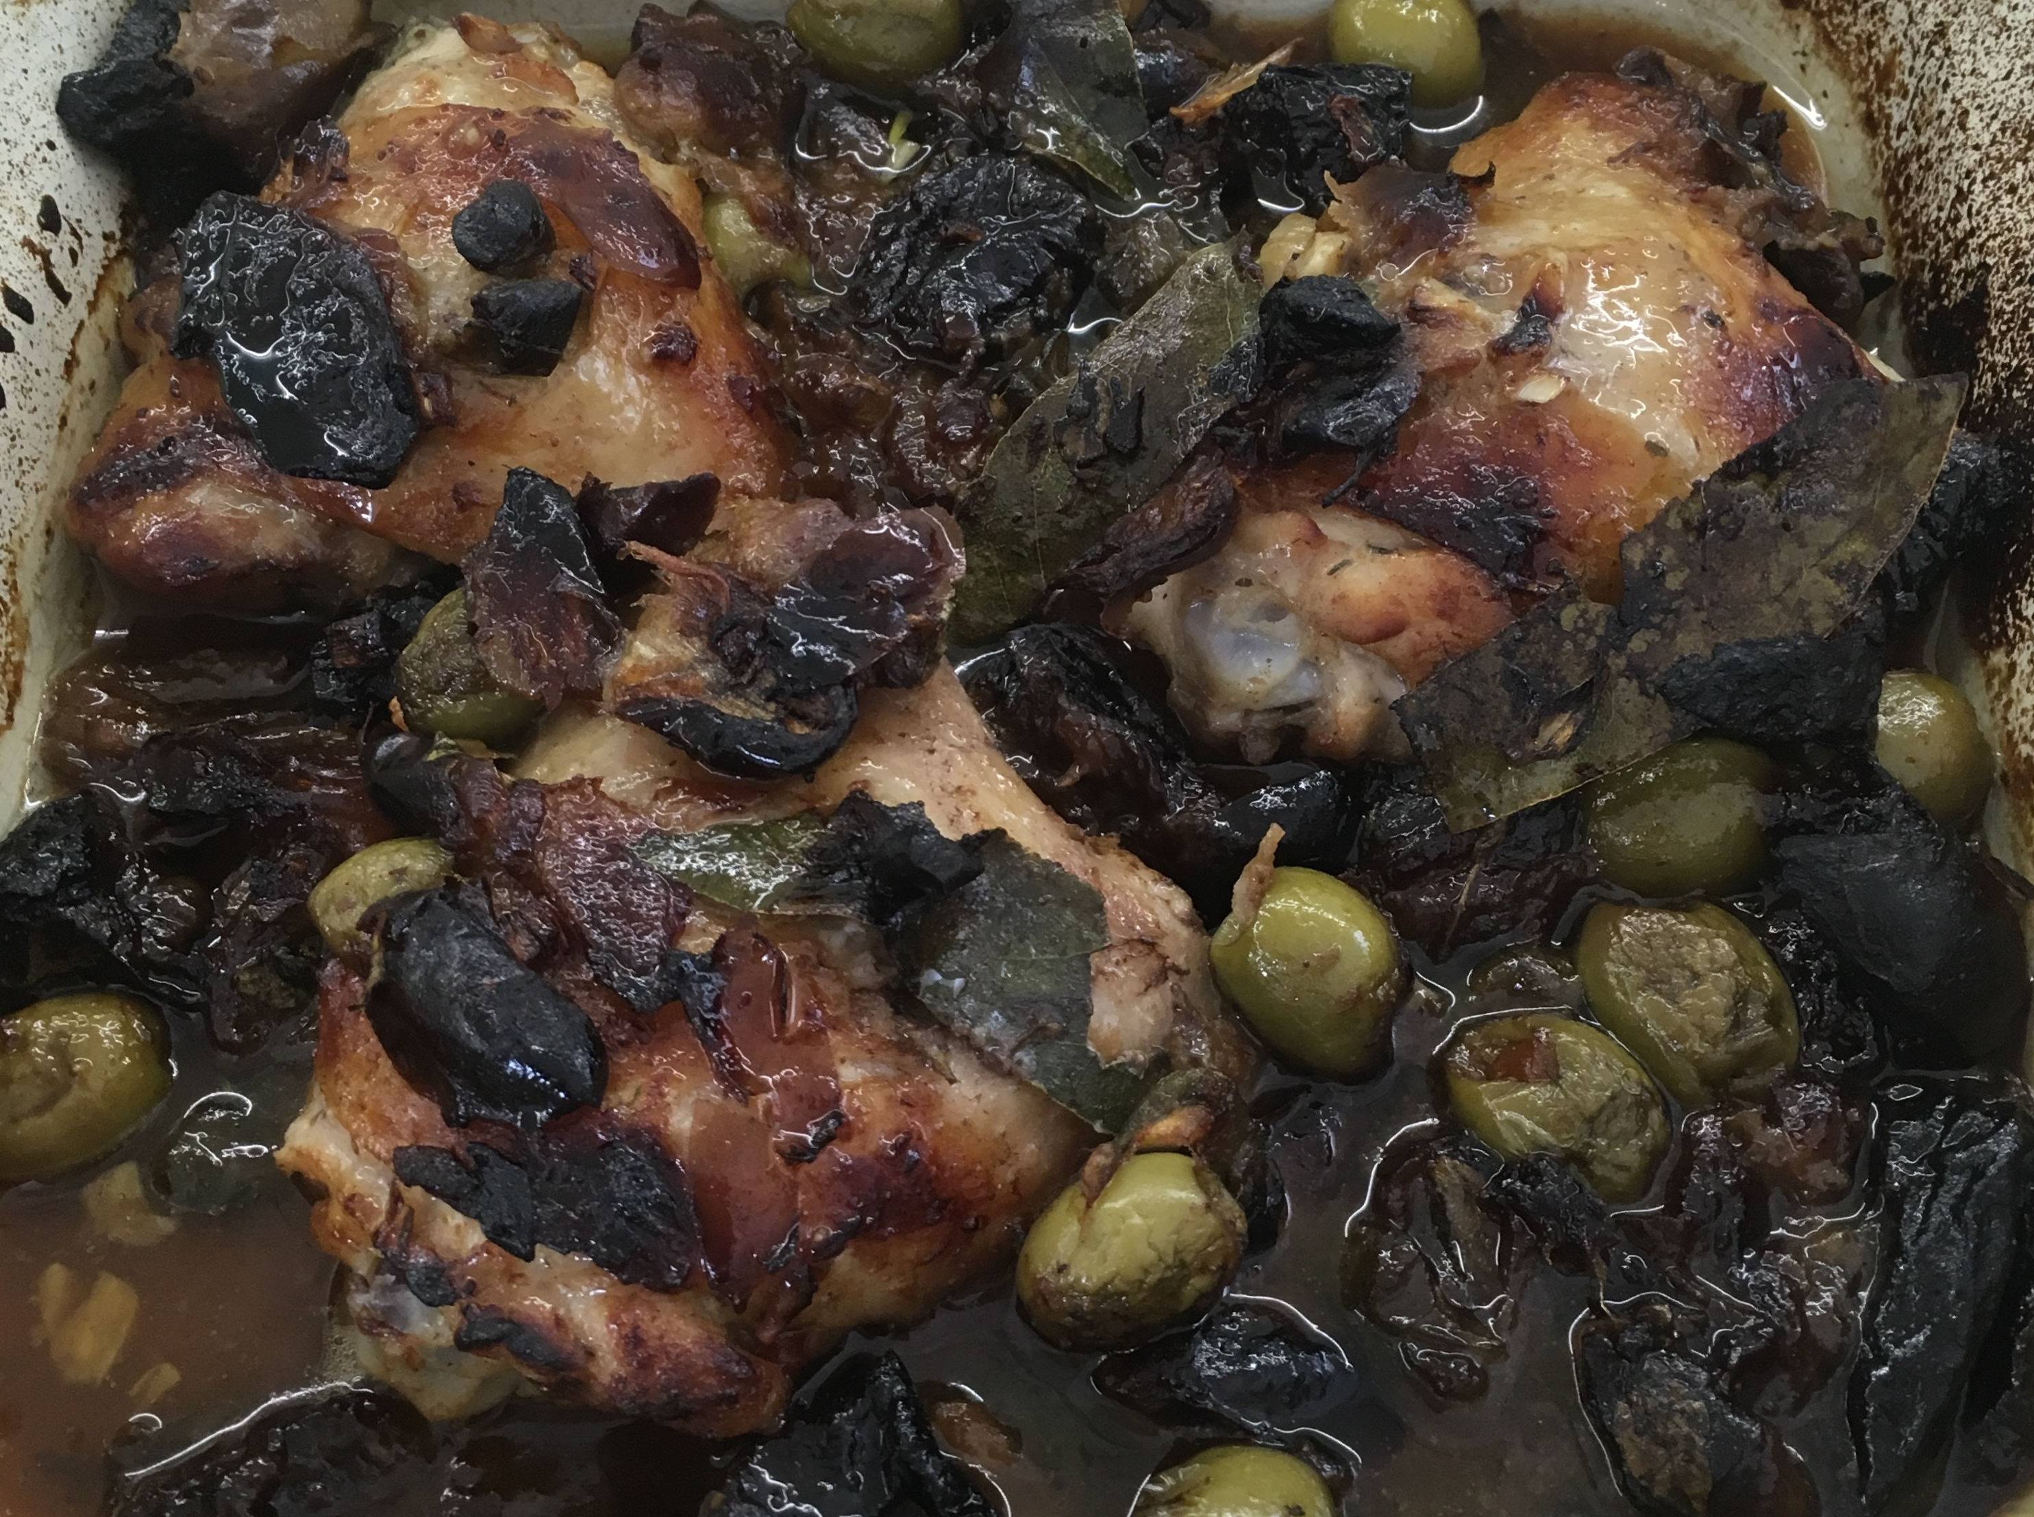
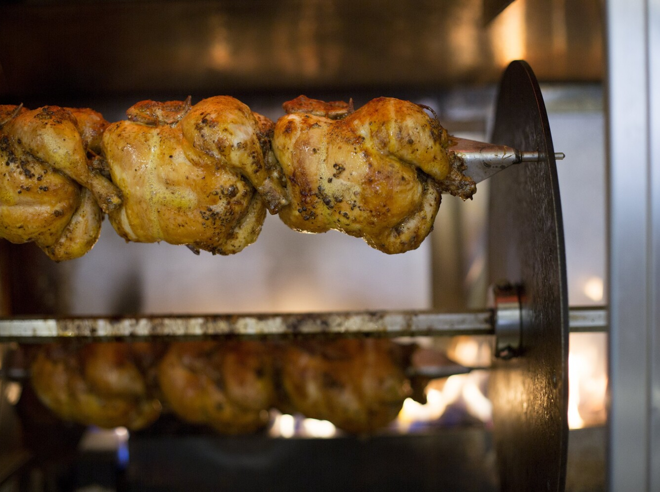
Closing Prayer

