Slide 1


Slide 2
Proximity, Power and Proclamation
John 4:1-30
Turn to page 1618 in your pew bibles

Slide 3
Proximity, power, and proclamation produce new life and freedom.

Slide 4
Proximity facilitates fellowship in Christ that destroys cultural barriers.
Notes:
Proximity facilitates fellowship in Christ that destroys cultural barriers. Jesus comes to the Samaritan women so that his Spirit may dwell in her. Jesus’ goal is that we be one people, the body of Christ even though we may be of different races, ethnicities or cultures.
Eph. 2:15…His purpose was to create in himself one new humanity out of the two, thus making peace, and in one body to reconcile both of them to God through the cross, by which he put to death their hostility.

Slide 5
Jesus “had to go through Samaria” to confront the smoldering enmity between the Jews and the Samaritans.

Slide 6
John 4:9-10
The Samaritan woman said to him, “You are a Jew and I am a Samaritan woman. How can you ask me for a drink?” (For Jews do not associate with Samaritans.) Jesus answered her, “If you knew the gift of God and who it is that asks you for a drink, you would have asked him and he would have given you living water.”
Notes:
Joshua 23:6-8New International Version (NIV)
⁶ “Be very strong; be careful to obey all that is written in the Book of the Law of Moses, without turning aside to the right or to the left. ⁷ Do not associate with these nations that remain among you; do not invoke the names of their gods or swear by them. You must not serve them or bow down to them. ⁸ But you are to hold fast to the Lord your God, as you have until now.

Slide 7
John 4:21-23
Woman,” Jesus replied, “believe me, a time is coming when you will worship the Father neither on this mountain nor in Jerusalem. You Samaritans worship what you do not know; we worship what we do know, for salvation is from the Jews.
“Yet a time is coming and has now come when the true worshippers will worship the Father in the Spirit and in the truth, for they are they are the kind of worshippers the Father seeks.”
Notes:
An authentic worship of God by means of His spirit and His word would replace the laws given to Israel. This new worship is far superior to the law for the word of God would be in our hearts and minds by means of the Spirit.

Slide 8
Application
Life in the spirit of God is to break down the barriers to unity created by our cultural preferences and interests. But has it? Are our cultural preferences and interests separating God’s people?
Notes:
Life is the Spirit is faith working its way out in love.
I see some positive signs in our fellowship. Like in our Awanas Ministry where we people from our church, from Restoration and Life Church that meets in our facility later this after noon, and members of Korean Churches in Madison have come together to serve and make this ministry possible and I pray we are establishing good friendships in the process. But I wonder aloud if when people of color come to High Point on a typical Sunday if it feels like a place they would want to call their home church. Are we being like Christ and reaching out to them to welcome them into the family or are we mostly indifferent to their presence among us?

Slide 9
Proximity, power and proclamation produce new life and freedom.
Proximity facilitates fellowship in Christ that destroys cultural barriers.
Power authenticates God’s message.

Slide 10
Power authenticates God’s message.

Slide 11
John 4:16-19
He told her, “Go, call your husband and come back.”
“I have no husband,” she replied.
Jesus said to her, “You are right when you say you have no husband. The fact is, you have had five husbands, and the man you now have is not your husband. What you have just said is quite true.”
“Sir”, the woman said, “I can see that you are a prophet.”

Slide 12
God’s power:
Convicts people of sin.
Convinces people of the truth.
Converts the non-Christian.
Conveys God’s glory.

Slide 13
Proximity, power, and proclamation produce new life and freedom.
Proximity facilitates fellowship in Christ that destroys cultural barriers.
Power authenticates God’s message.
Proclamation explains how to receive new life.

Slide 14
Proclamation explains how to receive new life.

Slide 15
Gospel Proclamation
The Samaritan Woman
Nicodemus
She must receive living water (4:10)
She must bring her sins out in the open (4:17-18)
She must worship in the Spirit and in the truth (4:24)
He must be born of the Spirit (3:5)
He must have his sins forgiven (3:14)
He must walk in the light and not the darkness (3:21)

Slide 16
Gospel Proclamation
God is our Creator
Man is in rebellion
Jesus is our Savior
Repentance and Faith is our Response
Godliness (Substance) is our new way of life

Slide 17
Proximity, power, and proclamation produce new life and freedom.
Proximity facilitates fellowship in Christ that destroys cultural barriers.
Power authenticates God’s message.
Proclamation explains how to receive new life.

Slide 18
Proximity, power, and proclamation produce new life and freedom.
Freedom enables us to join Jesus is his work

Slide 19
John 4:28-30
Then, leaving her water jar, the woman went back to the town and said to the people, “Come see a man who told me everything I ever did. Could this be the Messiah?” They came out of town and made their way toward him.

Slide 20
Freedom to join Jesus in his work
The Samaritan women tells her people what she knows. What she knows about Jesus is not much: “Come, see a man who told me everything I ever did. Could this be the Messiah?”
We have the same ability as the Samaritan woman. We can tell people what we know about God and invite them to come and see Jesus.

Slide 21
Freedom to join Jesus in his work
She was amazed by the grace of God and wanted others to receive the same priceless benefit.
We tell people about stuff that impresses us all the time. I did so just this past week…
Notes:
She was amazed by the grace of God and wanted others to receive the same benefit

Slide 22

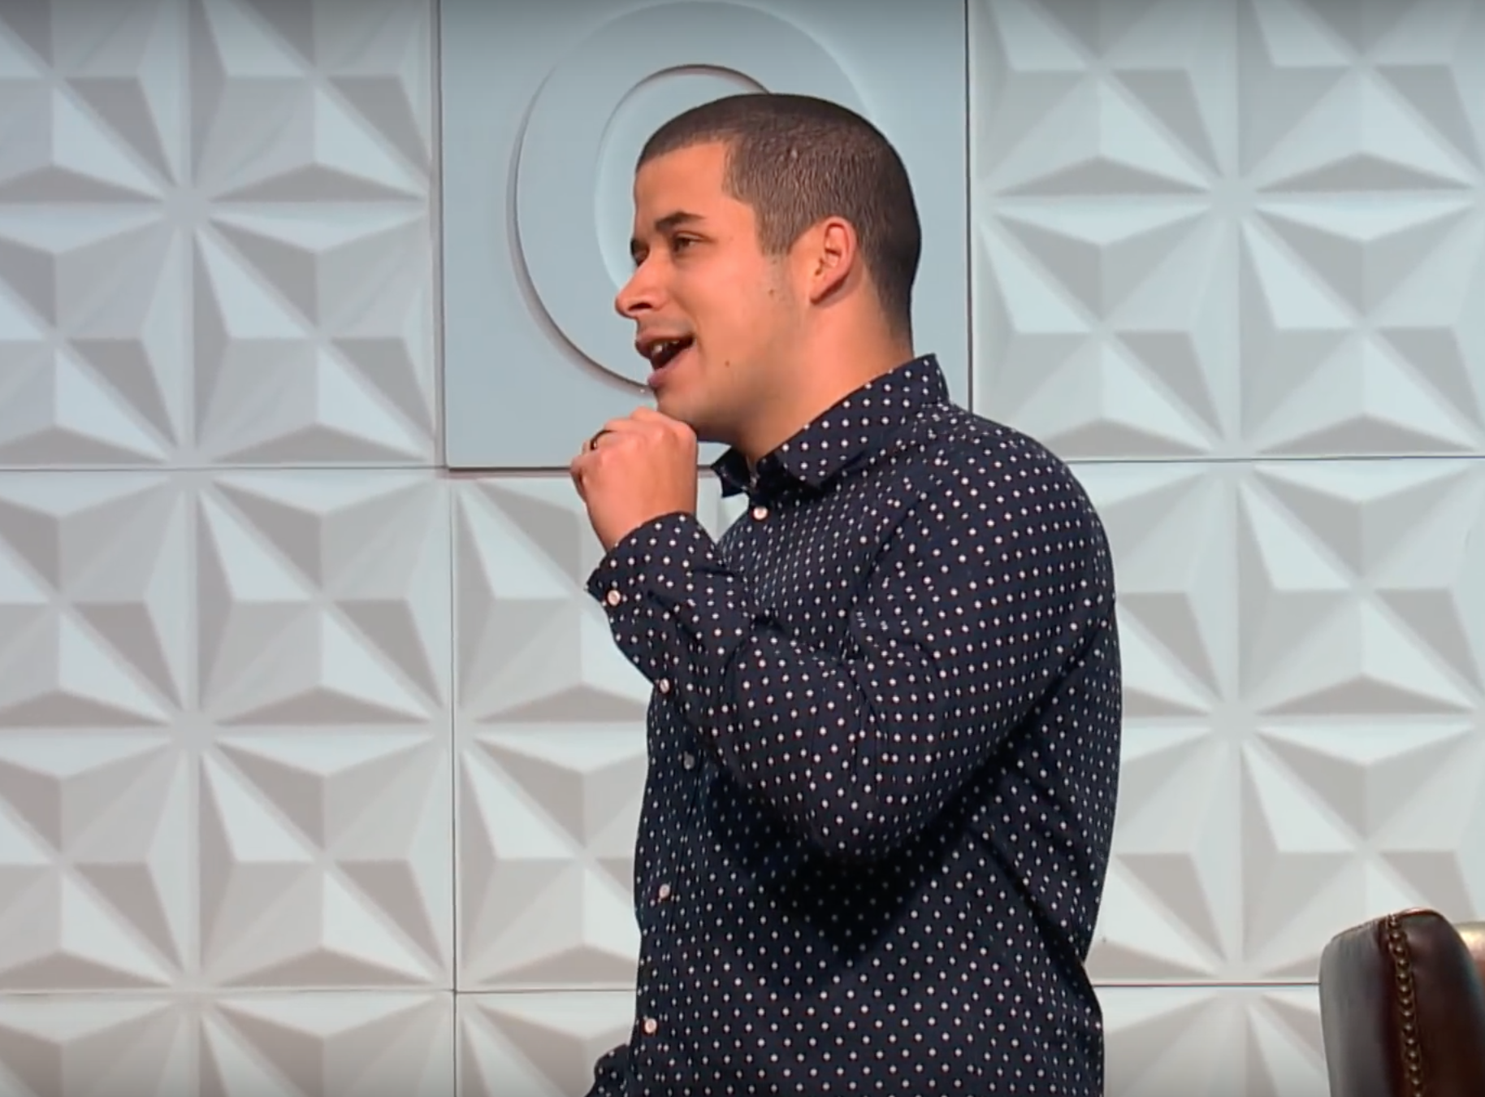
How Do We Stop The Objectification Of Women?
KIM BIDDLE
JEFFERSON BETHKE
Notes:
Kim Biddle
Jefferson Bethke

Slide 23
Where can we invite people to come and see Jesus today?
At church
In small group
Women’s and men’s ministry
Wherever the saints are in fellowship
Wherever a Christian is (since Christ dwells in every Christian)

Slide 24
Proximity, power, and proclamation produce new life and freedom.

