Slide 1
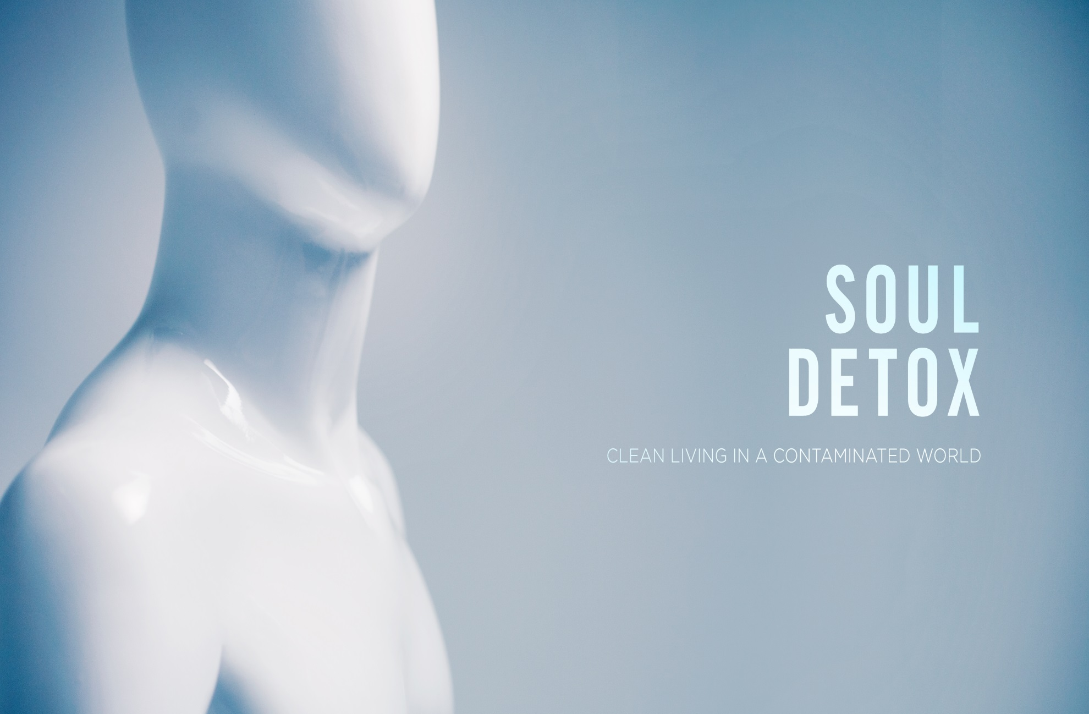

Slide 2
Germs are Everywhere!
Session 1

Slide 3
Bottom Line
We need to clean more than our skin!

Slide 4
Books for Further Study
“Victory Over The Darkness” Neil T. Anderson
“Soul Detox” Craig Groeschel
“Designed to be like Him” J. Dwight Pentecost

Slide 5
The Detox Craze
A multimillion dollar industry
  Teas
  Shakes
  Foods
  Even various stretches and massages!
Hundreds of different herbal supplements and options for hundreds of differing ailments and problems
Based on the premise that we are slowly picking up toxins from the world around us and from the foods that we eat as we live our normal everyday lives. Toxins that these products claim to help remove from our bodies.

Slide 6
If our bodies need to be cleansed from these daily toxins that we are exposed to then….Shouldn’t we ask the question
What about our souls?
What are we being exposed to?
(Go-Kart racing analogy)

Slide 7
1 Peter 2:11 NLT
Dear Friends, I warn you as temporary residents and foreigners to keep away from worldly desires that wage war against your very souls.

Slide 8
3 Toxins to Avoid in our Lives
Toxic Behaviors- February
Toxic Emotions- March
Toxic Influences- April

Slide 9
Toxic Behaviors
Septic Thoughts
  Telling ourselves the Truth
Lethal Language
  Experience Life-giving Words
Hazardous Waste
  Uncovering Hidden Sins

Slide 10
Septic Thoughts- Highs and Lows- Telling ourselves the Truth
Highs
  Are we mentally honest with ourselves? (American Idol)
  For he flatters himself in his own eyes
  that his iniquity cannot be found out and hated.
  The words of his mouth are trouble and deceit;
  he has ceased to act wisely and do good. (Psalm 36:2-3)
  We think more highly of ourselves than we should
  Have you ever heard yourself say this?
    I don’t have a problem with this
    Its really no big deal
    Its not as bad as most people
    I can quit anytime I want
    This is just the way I am

Slide 11
Peter may be a good example to avoid in this area
  Peter answered him, “Though they all fall away because of you, I will never fall away.” (Matthew 26:33)
  Soon after he denies even knowing who Jesus 3 times!
Is someone trying to tell you something about yourself?
  Maybe its time to slow down and really think about it.
  The ear that listens to life-giving reproof
  will dwell among the wise.
  Whoever ignores instruction despises himself,
  but he who listens to reproof gains intelligence. (Proverbs 15:31-32)

Slide 12
Lows
How do you speak to yourself?
Positive or negative?
For the weapons of our warfare are not of the flesh but have divine power to destroy strongholds.⁵ We destroy arguments and every lofty opinion raised against the knowledge of God, and take every thought captive to obey Christ(2 Corinthians 10:4-5)
4 types of poisonous thoughts/ Thought Bondage
  1.Pessimism- Consistent negative thoughts
  2.Anxiety- Consistent worried thoughts
  3.Bitterness- Consistent discontented thoughts
  4.Criticism- Consistent judgmental thoughts

Slide 13
Pessimism- negative thoughts about yourself, others or life in general
  I don’t have what it takes, I’ll never get ahead, I can’t do it all, No one appreciates me, my hair looks awful, I have nothing to wear, I wish Lyn would not have asked Courtney to do this today!
Anxiety- Rational and Irrational
  Marriage, children, economy, gas prices!!!
Bitterness- “I wish”- Dissatisfaction Guaranteed!
  Husband, car, clothes, job, time, vacation or bigger kitchen!
Criticism- you have the talent of finding fault with everything; buildings, companies, churches and even what we just ate for lunch!
  You are slowly creating a mindset of discontentedness!!
As you allow these weeds to grow they will eventually choke out the Truth! Weed your Garden! Take them Captive!

Slide 14
Lethal Language- Experience Life Giving Words
“Words that do not give the light of Christ increase the darkness.” Mother Teresa
Hide me from the secret plots of the wicked,
from the throng of evildoers,
who whet their tongues like swords,
who aim bitter words like arrows, (Psalm 64:2-3)
  Creative words create and Destructive words destroy
  Hurtful words crush and helpful words build up
  Toxic words poison and soothing words heal
There is one whose rash words are like sword thrusts,
but the tongue of the wise brings healing (Proverbs 12:18)
Try this out!
  If you think something good…say it!

Slide 15
Hazardous Waste- Uncovering Hidden Sins
“Sin is not hurtful because it is forbidden, it is forbidden because it is hurtful” Benjamin Franklin
Our first reaction to our sin is to cover it up.
  Adam and Eve
  Cain and Able
  David and Bathsheba
Hiding our sins might make life easier for the moment, but it always becomes worse over time!
  Whoever conceals his transgressions will not prosper,
  but he who confesses and forsakes them will obtain mercy (Proverbs 28:13)
  Confess don’t’ Conceal...Everyone gets caught eventually!

Slide 16
Let’s Get Clean!
Have mercy on me, O God,
according to your steadfast love;
according to your abundant mercy
blot out my transgressions.
Wash me thoroughly from my iniquity,
and cleanse me from my sin! (Psalm 51:1-2)
Create in me a clean heart, O God,
and renew a right spirit within me.
Cast me not away from your presence,
and take not your Holy Spirit from me.
Restore to me the joy of your salvation,
and uphold me with a willing spirit. (Psalm 51:10-12)

Slide 17
Toxic Behaviors Application Questions
Toxic Thoughts
  Is someone trying to tell you something?
  How do you speak to yourself?
Lethal Language
  Generally speaking, are you building others up or tearing them down?
  Is God being worshiped all the time with your mouth?
Hazardous Waste
  Is there some waste in your life that needs to be exposed?
  What stood out to you during this session?

