Slide 1
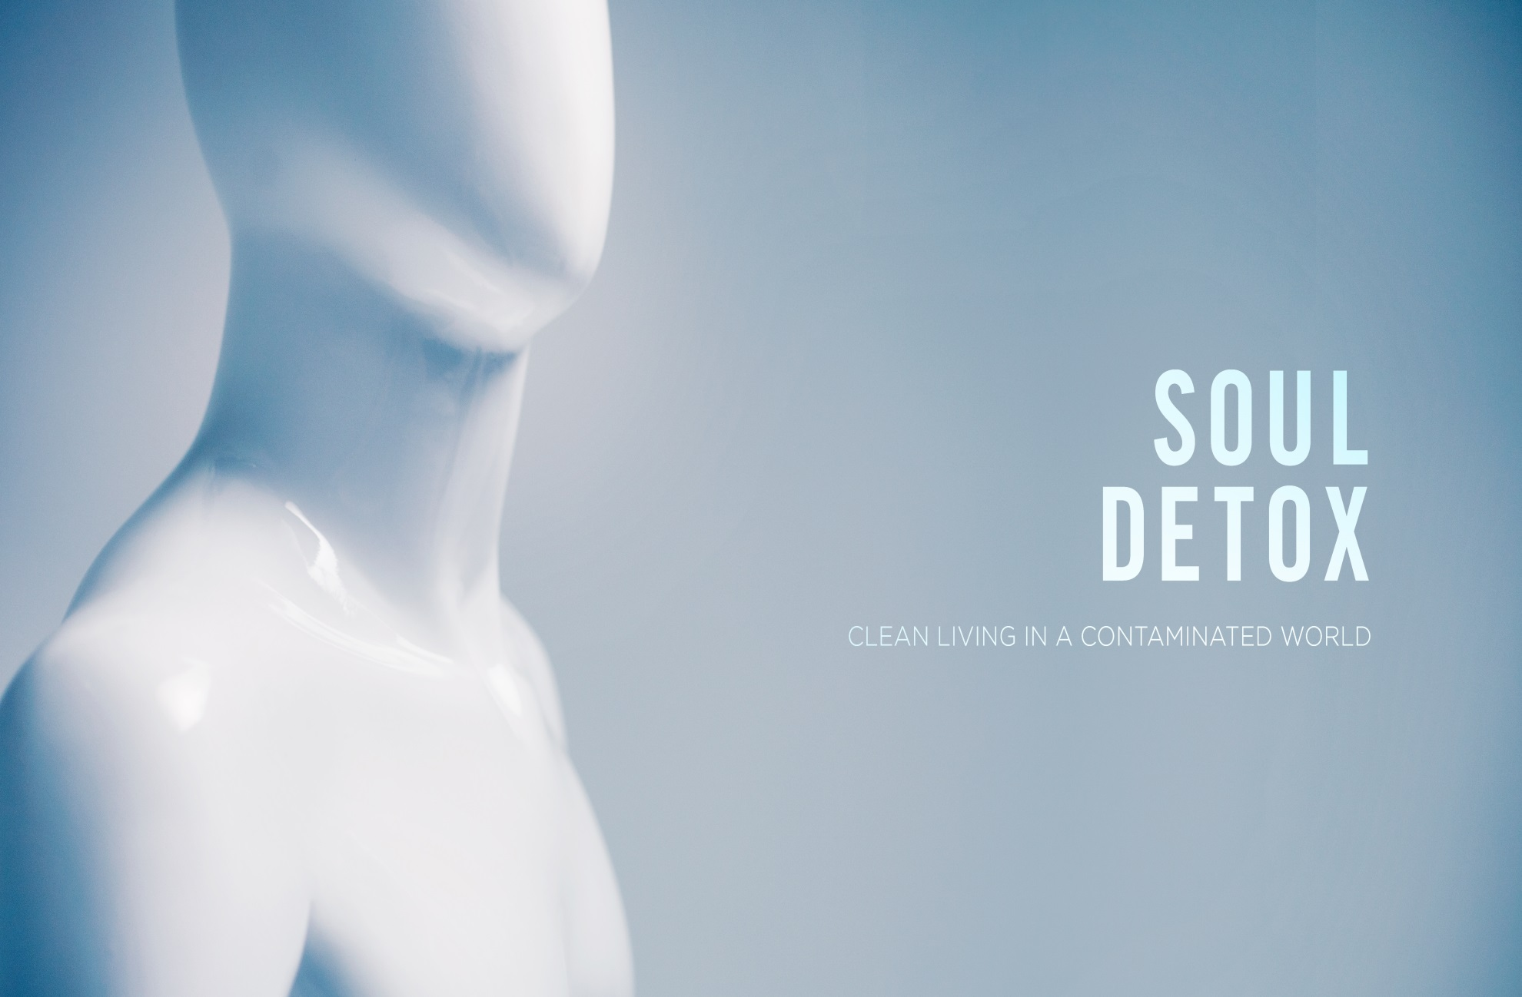

Slide 2
Emotions!!!

Slide 3
Bottom Line
Don’t be so Emotional!

Slide 4
Toxic Emotions
Bitter Roots
  Digging up Resentment
Green with Envy
  The Poison Ivy of Comparison
Scare Pollution
  Unlocking the Hold of Fear

Slide 5
Bitter Roots- Digging up Resentment
Bitterness never draws us closer to God
  Bitterness is a non-productive, toxic emotion, usually resulting from resentment over unmet needs or wants
Strive for peace with everyone, and for the holiness without which no one will see the Lord. See to it that no one fails to obtain the grace of God; that no “root of bitterness” springs up and causes trouble, and by it many become defiled; (Hebrews 12:14-15)
  Bitterness is a choice
  A choice that can be aimed at others or even God
  It originates from a faulty view of our relationship with God
    Provision
    Love
    Patience
  Christ’s command to forgive does not come with exceptions.

Slide 6
Green with Envy- The Poison Ivy of Comparison
“Envy is the art of counting the other fellows blessings instead of your own”- Harold Coffin
Envy is when you resent Gods’ goodness in other people’s lives and ignore God’s goodness in your own life.
Our consumerist culture thrives on envy
What is it in your life? Money, career, appearance, relationships
Check out this rebuke!!!
  But if you have bitter jealousy and selfish ambition in your hearts, do not boast and be false to the truth. This is not the wisdom that comes down from above, but is earthly, unspiritual, demonic. For where jealousy and selfish ambition exist, there will be disorder and every vile practice (James 3:14-16)

Slide 7
A tranquil heart gives life to the flesh,
but envy makes the bones rot. (Proverbs 14:30)
Fight Envy
  Guard against comparing yourself as much as possible
  Train yourself to not use “better than” and “worse than” when talking about other people and their stuff
  Learn to rejoice with others
  Better is the sight of the eyes than the wandering of the appetite: this also is vanity and a striving after wind (Ecclesiastes 6:9)
  Its better to focus on what you have than what you don’t…if not your just chasing the wind.
  The greatest way to fight consumerism is to give.

Slide 8
Scare Pollution- Unlocking the Hold of Fear
“When I feel fearful emotions overtaking me, I just close my eyes and thank God that He is still on the throne, reigning over everything, and I take comfort in His control over the affairs of my life.” John Wesley
The more fear we allow into our lives, the more we will struggle to grow spiritually.
Studies show that babies are only born with 2 fears
  Falling
  Loud noises
This tells me that all of our fears are learned fears!

Slide 9
Generally, most fears fall into 4 categories
1. Fear of Loss
  Relationally
  Financially
  Job (security, image and purpose)
2. Fear of Failure
  I’m not qualified
  I don’t know what I am doing
  I am not up for this challenge
3. Fear of Rejection
  Relationships
  People pleasing mindset
4. Fear of the Unknown
  What does the future hold?

Slide 10
God is sovereign!
  For God gave us a spirit not of fear but of power and love and self-control (2Timothy 1:7)
Fear is faith put into the wrong things!
What you fear reveals what you value.

Slide 11
Let’s Get Clean!
When I am afraid,
I put my trust in you.
In God, whose word I praise,
in God I trust; I shall not be afraid.
What can flesh do to me? (Psalm 56:3-4)
Then you will call upon me and come and pray to me, and I will hear you. You will seek me and find me, when you seek me with all your heart (Jeremiah 29:12-13)
Where can I find him?
  Prayer
  Scripture
  Community

Slide 12
Dealing with Emotions
Suppress it- Unhealthy
  Covering it
  Ignoring it
Express it- Unhealthy
  Thoughtlessly lashing out
  Telling everybody everything
Acknowledge it- Healthy
  Openly and honestly express our feeling to God
  Tell other who can help and encourage

Slide 13
Toxic Emotions Discussion Questions
Roots of Bitterness
  Is there any bitterness in your life?
  Do you have an accurate understanding of our relationship with God?
Green with Envy
  Have you allowed the world to manipulate your thinking?
  Take a minute and confess God’s goodness in your life
Scare Pollution
  Confess what your scared of
  Take a minute and pray for one another
  What stood out to you in this session?

