Slide 1
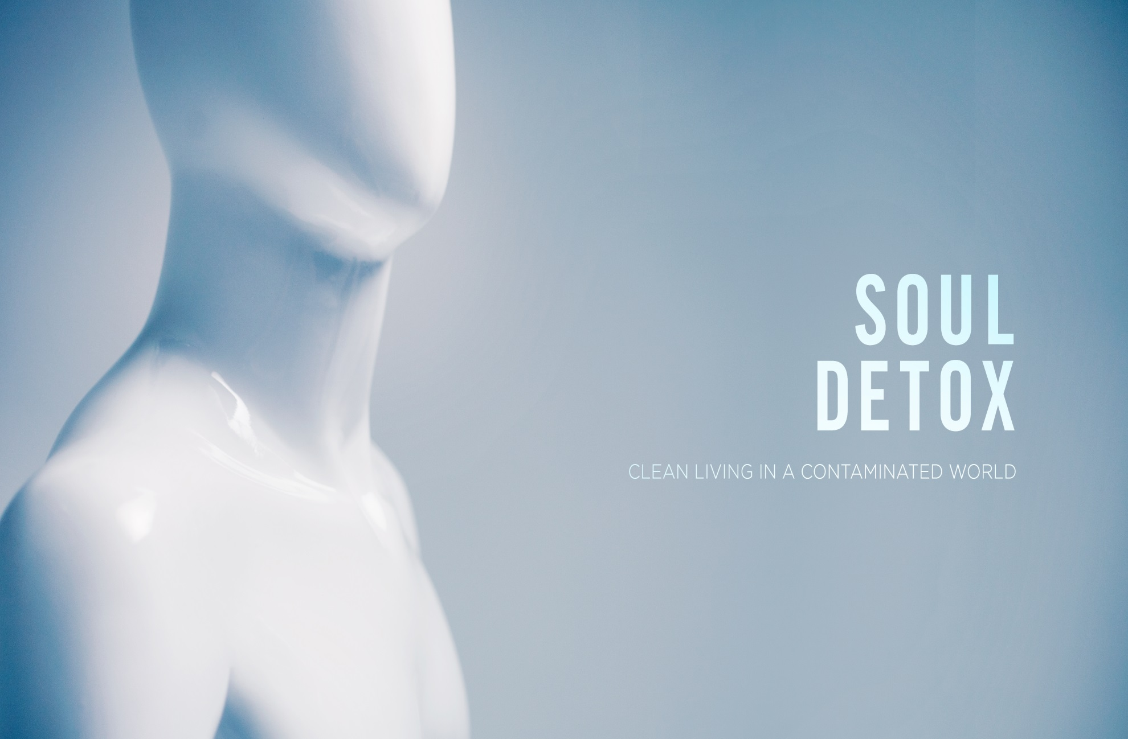

Slide 2
Toxic Influences
Mood Poisoning
  Purging the False Promise of Materialism
Germ Warfare
  Cleaning out Cultural Toxins
Radioactive Relationships
  Loving Unhealthy People without Getting Sick

Slide 3
Mood Poisoning – Purging the promise of Materialism
Our culture oozes with toxic materialism. A lying spirit tells the masses that more money and better things are the two tickets we need for admission to the life we desire. If we have the right label, gadgets, toys, cars, houses and 401k’s then we’ll be happy, secure and significant.
For what will it profit a man if he gains the whole world and forfeits his soul? Or what shall a man give in return for his soul? (Matthew 16:26)
This idea of materialism slowly wears away at our soul and leaves our hands full but our hearts empty.
We become so distracted that we will soon find ourselves ineffective
Materialism creates a spirit of entitlement and reveals a faulty understanding of our significance as children of God.

Slide 4
Materialism and our Significance- 3 Roots of Significance
Goals
  Difficulty reaching Goals
  Working on the wrong goals
  Ultimate goal- applying godly character traits to our lives
Time
  What is forgotten in time is of little significance; what is remembered for eternity is of great significance
  Focus your time on significant eternal activities
Quality
  Do fewer things well
  Relationships- its nice to know a lot of people, commit to a few

Slide 5
Germ Warfare- Cleaning out Cultural Toxins
Let’s go to the Movies!
  Movie analogy
    Have you ever had a friend lead you astray
    Recent movie analogy
    100x- (Hangover)
Media by itself is not inherently bad, but consuming spiritually toxic media without discernment will slowly kill you
Your boasting is not good. Do you not know that a little leaven leavens the whole lump? Cleanse out the old leaven that you may be a new lump, as you really are unleavened. For Christ, our Passover lamb, has been sacrificed (1 Corinthians 5:6-7)
Remove the leaven…take action
Don’t let culture change you…you change it!

Slide 6
A little bit won’t hurt?
  brownie analogy
We need to ask ourselves what’s in the media the we are eating?
The Bachelor?
  1. Everyone is Hot
  2. Love is best found on helicopters flying over waterfalls
  Single people walk away questioning their significance
Young people walk away questioning their future
Married people walk away questioning their marriage

Slide 7
Do not be conformed to this world, but be transformed by the renewal of your mind, that by testing you may discern what is the will of God, what is good and acceptable and perfect. (Romans 12:2)
Questions to ask concerning conformity?
1. Am I being entertained by sin?
  Funny doesn't make wrong right
2. Is this pleasing to God?
  If it doesn't honor God, don’t eat it!
3. Does this attract me to Christ, or distract me from Him?
4. Does sin have it’s consequence?

Slide 8
Radioactive Relationships- Loving unhealthy People without Getting Sick
“Associate with men of good quality if you esteem your own reputation; for it is better to be alone than in bad company.” George Washington
  People in our lives can be a blessing or a curse
  They can lead you closer to Christ or drag you further away from Him
  They can be your greatest spiritual asset or greatest spiritual curse!
Do not be deceived: “Bad company ruins good morals.” (1 Corinthians 15:3)

Slide 9
3 common types of toxic people
1. Chronic Critics
  They can find fault in everything
  Their judgmental spirit can clog your heart
  Their gossip effects your opinion of others
  Israelites in desert complained 14x
2. Controller
  Overbearing and force their opinions on you
  Eventually they will begin to make all of your decisions for you
3. Tempter
  They push you to do things that you normally wouldn’t
  Influence you negatively
Build a fence and learn to say no
  Set healthy boundaries
  The righteous choose their friends carefully,
  but the way of the wicked leads them astray. (Proverbs 12:26)

Slide 10
Let’s Get Clean!
Religion that is pure and undefiled before God, the Father, is this: to visit orphans and widows in their affliction, and to keep oneself unstained from the world. (James 1:27)
In order to keep oneself unspotted from the world…do these things.
The command is to do.
If you want to be clean take action and put yourself in a position to get clean.
  Fight materialism- give your money away
  Fight culture- turn it off
  Fight negative influence- tell them no

Slide 11
Toxic Influences Discussion Questions
Mood Poisoning
  Do you place your significance in your stuff?
Germ Warfare
  Have you been lulled asleep by you culture?
  What needs to change?
Radioactive Relationships
  Who needs to go?
  Do you need to build a fence?
  Are you personally any of the people that we described?

