Slide 1


Slide 2

Value of Ephesians
Presents the purpose and plan of God for the Church
Relation between positional truth and experiencing it in one’s life – Position and Practice
Supremacy of Christ in God’s eternal plan
Emphasizes God’s sovereign grace in the lives of believers

Slide 3

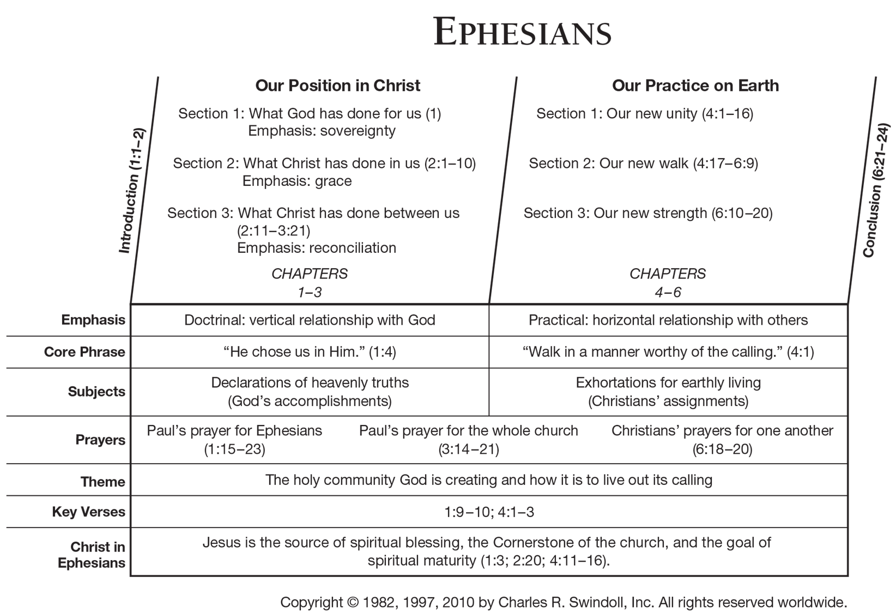

Slide 4
Book of Ephesians
What it means to be in Christ
What it means to be one with Christ
What it means to be a part of the body of Christ, the church of which He is the head
What it means to be master-planned into the body before the world began

Slide 5
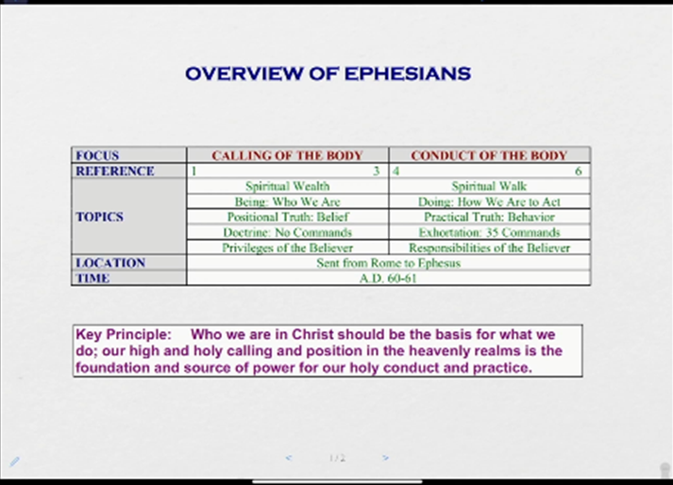
Book of Ephesians

Slide 6
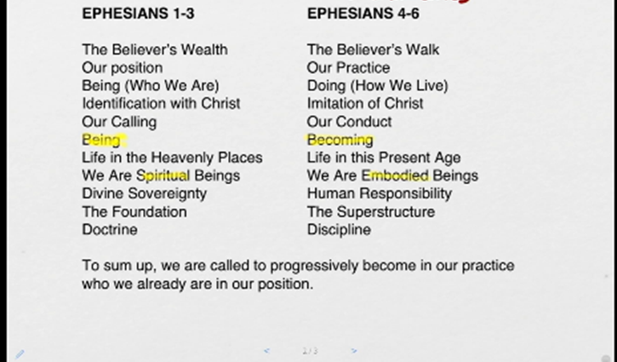
Book of Ephesians

Slide 7
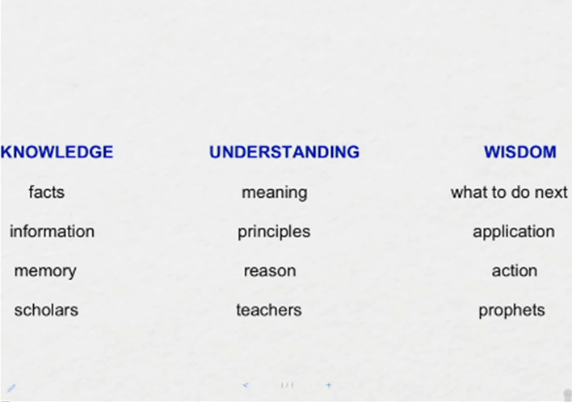
Book of Ephesians

Slide 8
Ephesians 5:15-21 (KJV)
15 See then that ye walk circumspectly, not as fools, but as wise,
16 Redeeming the time, because the days are evil.
17 Wherefore be ye not unwise, but understanding what the will of the Lord is.
18 And be not drunk with wine, wherein is excess; but be filled with the Spirit;

Slide 9
Ephesians 5:15-21 (KJV) cont.
19 Speaking to yourselves in psalms and hymns and spiritual songs, singing and making melody in your heart to the Lord;
20 Giving thanks always for all things unto God and the Father in the name of our Lord Jesus Christ;
21 Submitting yourselves one to another in the fear of God.

Slide 10
Process for Spirit-Filled Living
Salvation: Christ gave His life for us
Sanctification: Christ gives His life to us
Service: Christ lives His life through us – as us

Slide 11
What Does the Worthy Walk Involve?
Walk in Humility – Ephesians 4:1-3
Walk in Unity – Ephesians 4:4-16
A Different Walk – Ephesians 4:17-32
Ephesians 5:
  Love Walk
  Light Walk
  Wisdom Walk
  Spirit Walk

Slide 12
Ephesians 5 – Spiritual Walk
Walk in Love Ephesians 5:1-2
Walk as children of Light Ephesians 5:3-14
Walk in Truth (Wisdom) Ephesians 5:15-17

Slide 13
Ephesians 5 – Spiritual Walk
Walk in Love Ephesians 5:1-2
Walk as children of Light Ephesians 5:3-14
Walk in Truth (Wisdom) Ephesians 5:15-17

Slide 14
Portrait of a Fool
Definition of a fool: Psalm 14:1
Characteristics of a fool:
  He lives a life which by its function denies God – Psalm14:1; I Corinthians 2:14
  Because he denies the true God, he inevitably becomes his own god – Proverbs 12:15
  He will mock sin – Proverbs 14:9
  He has a dramatic effect on others – Proverbs 15:2
  He instructs others in the same foolishness – Proverbs 16:22
Summary – Proverbs 1:7

Slide 15
7 Characteristics of the Wise
Humility
Loyalty
Teachability
Righteousness
Godly Speech
Forgiveness
Thoughtfulness

Slide 16
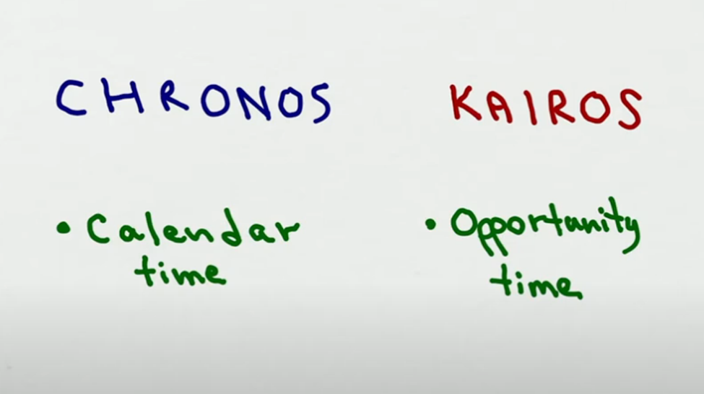

Slide 17
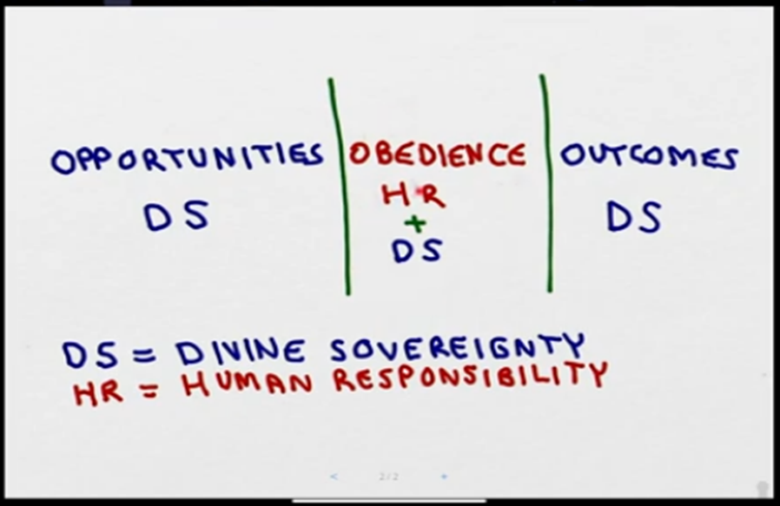
Spiritual Life

Slide 18
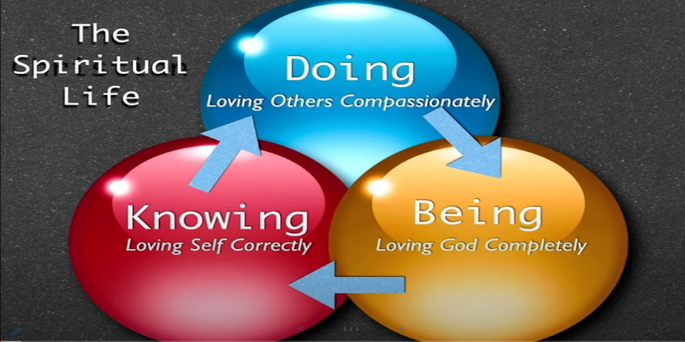

Slide 19
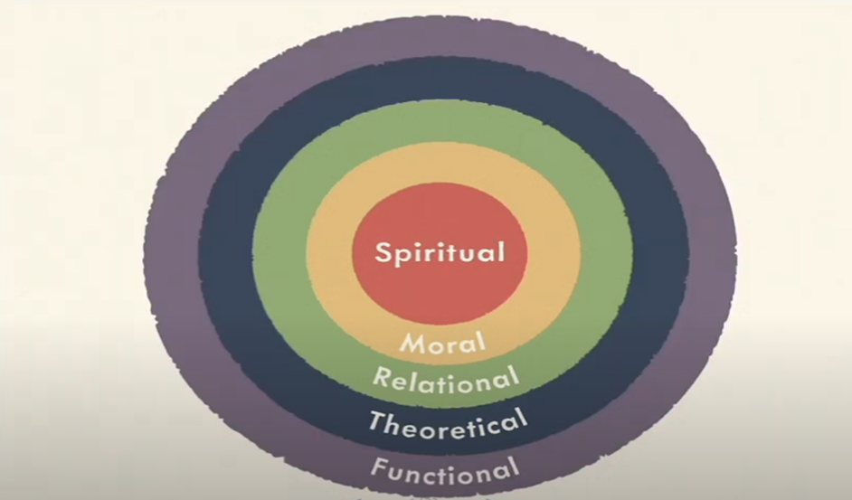
Spiritual Life: Spheres of Excellence

Slide 20
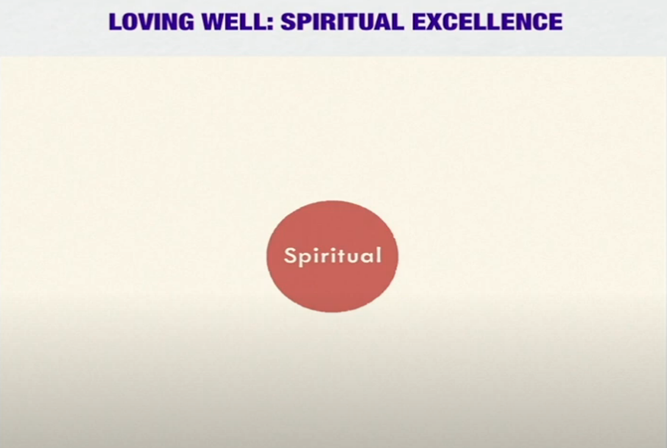
LOVING WELL: Spiritual Excellence

Slide 21
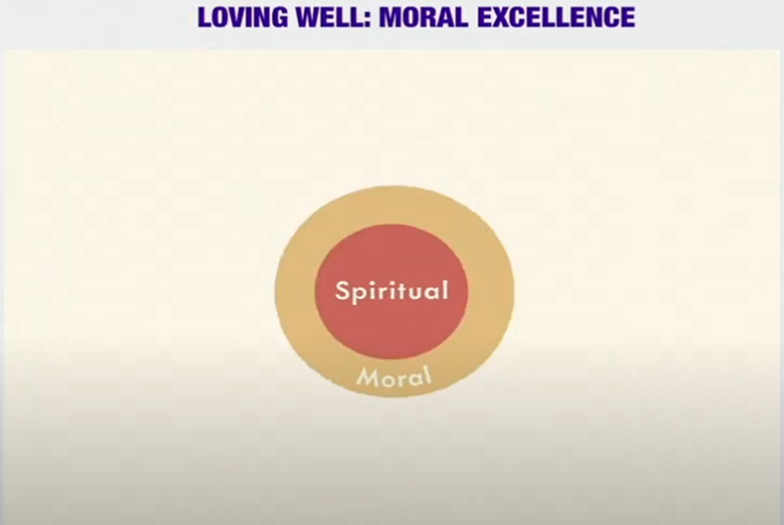
LOVING WELL: Moral Excellence

Slide 22
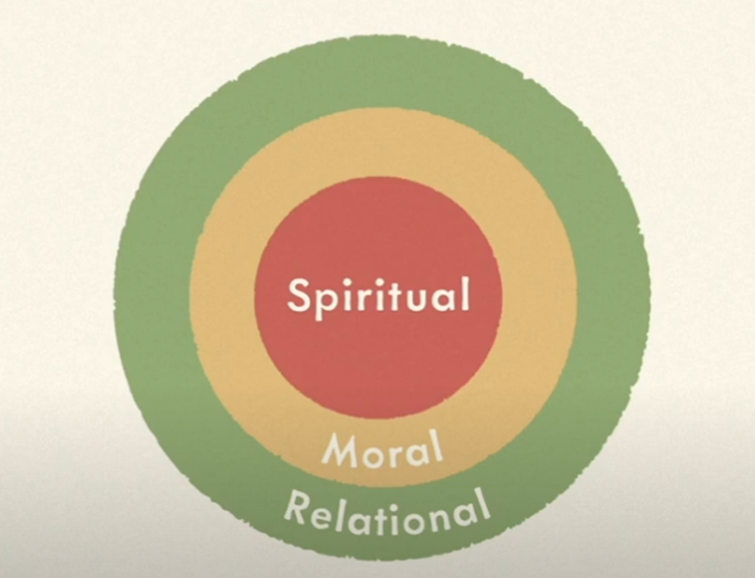
LOVING WELL: Relational Excellence

Slide 23
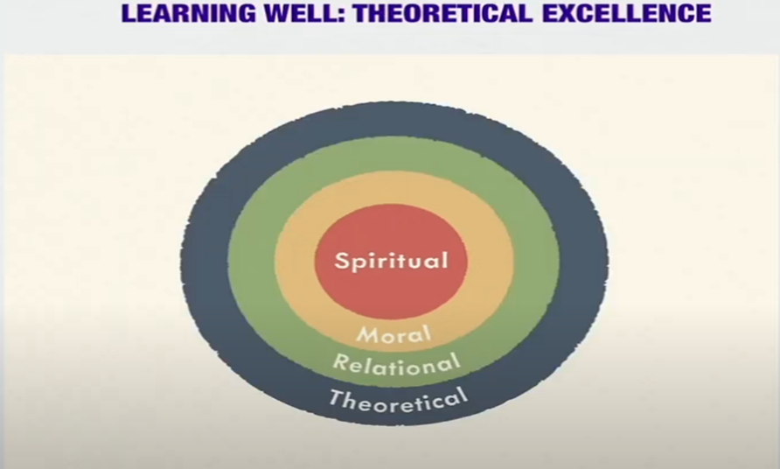
LEARNING WELL: Theoretical Excellence

Slide 24
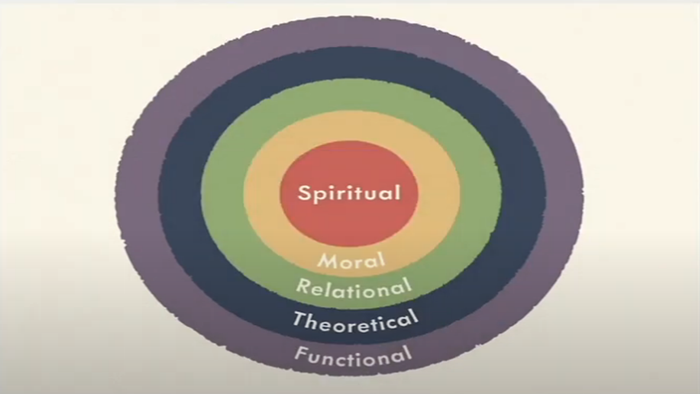
LIVING WELL: Functional Excellence

Slide 25
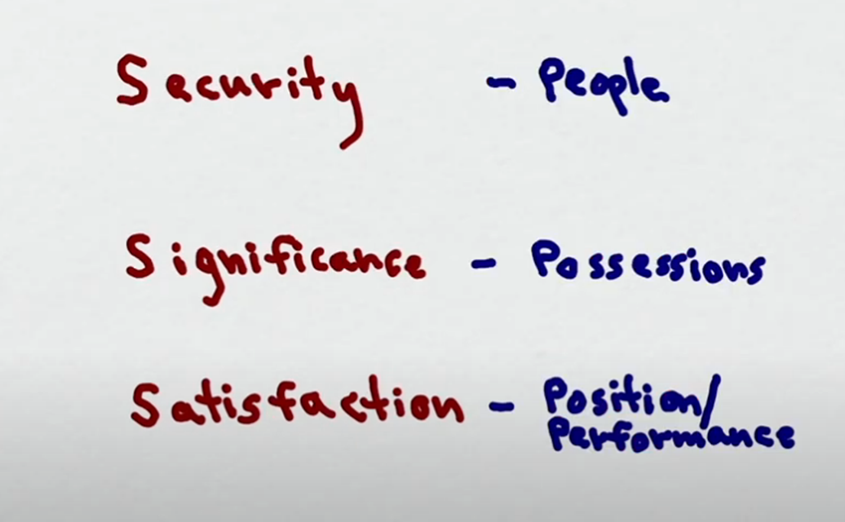
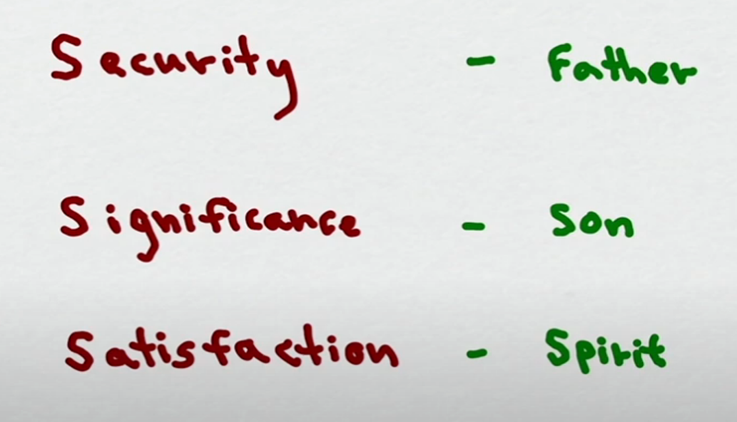
True Spiritual Life
Where it is not found
Where it is found

Slide 26
Principles from Ephesians 5:15-21
Spirituality requires alertness to dangers and opportunities.(5:15)
God wants us to make the most of the time that He gives us.(5:16)
Christians apply God’s will to their experience as the standard of understanding and rule of conduct.(5:17)
There is a limited comparison between being under the control of a substance and under the control of the Spirit.(5:18)

Slide 27
Principles from Ephesians 5:15-21
God puts Spirit-filled believers under a higher instrumentality for His working.(5:18b)
Worship is a manifestation of being filled with the Spirit.(5:19)
The believer is to minister to the Lord with the heart.(5:19b)
Gratitude is recognition of what God has done for us in Christ without our merit. (5:20)
The motive for giving deference to other Christians is our Lord. (5:21)

