Slide 1


Slide 2

Ephesians 5:15-21 (KJV)
15 See then that ye walk circumspectly, not as fools, but as wise,
16 Redeeming the time, because the days are evil.
17 Wherefore be ye not unwise, but understanding what the will of the Lord is.
18 And be not drunk with wine, wherein is excess; but be filled with the Spirit;

Slide 3
Ephesians 5:15-21 (KJV) cont.
19 Speaking to yourselves in psalms and hymns and spiritual songs, singing and making melody in your heart to the Lord;
20 Giving thanks always for all things unto God and the Father in the name of our Lord Jesus Christ;
21 Submitting yourselves one to another in the fear of God.

Slide 4




Court of Life
Judge
Bailiff
Clerk
Witness
Defender
Prosecutor
Defendant
Plaintiff
Notes:
Bailiff: Provide security for the courtroom, the judge, and all parties involved

Slide 5

Court of Life
John 6:44
John 15:26
Father
Holy Spirit
Scribe
Believer
2 Timothy 3:16
He who represents himself has a fool for a client. - Abraham Lincoln
Romans 3:23
Pro se
Jesus
John 6:35
Sinner
Word
Romans 3:10
Notes:
John 15:26 But when the Comforter is come, whom I will send unto you from the Father, even the Spirit of truth, which proceedeth from the Father, he shall testify of me:
John 6:44 No man can come to me, except the Father which hath sent me draw him: and I will raise him up at the last day.

Slide 6
Looking Deeper
Every Defendant Stands Alone
  Satan can’t be the scapegoat
  Blaming others won’t work
Only those who plead guilty can expect grace
  Confess with your mouth and believe in your heart
  All are guilty of sin
  In need of God’s grace
  The LORD, Jesus is the Christ

Slide 7
Romans 3:10 As it is written, There is none righteous, no, not one:
John 6:35 And Jesus said unto them, I am the bread of life: he that cometh to me shall never hunger; and he that believeth on me shall never thirst.
Romans 3:23 For all have sinned, and come short of the glory of God;
2 Timothy 3:16 All Scripture is God-breathed and is useful for teaching, rebuking, correcting and training in righteousness, (NIV)
John 15:26 But when the Comforter is come, whom I will send unto you from the Father, even the Spirit of truth, which proceedeth from the Father, he shall testify of me:
John 6:44 No man can come to me, except the Father which hath sent me draw him: and I will raise him up at the last day.

Slide 8
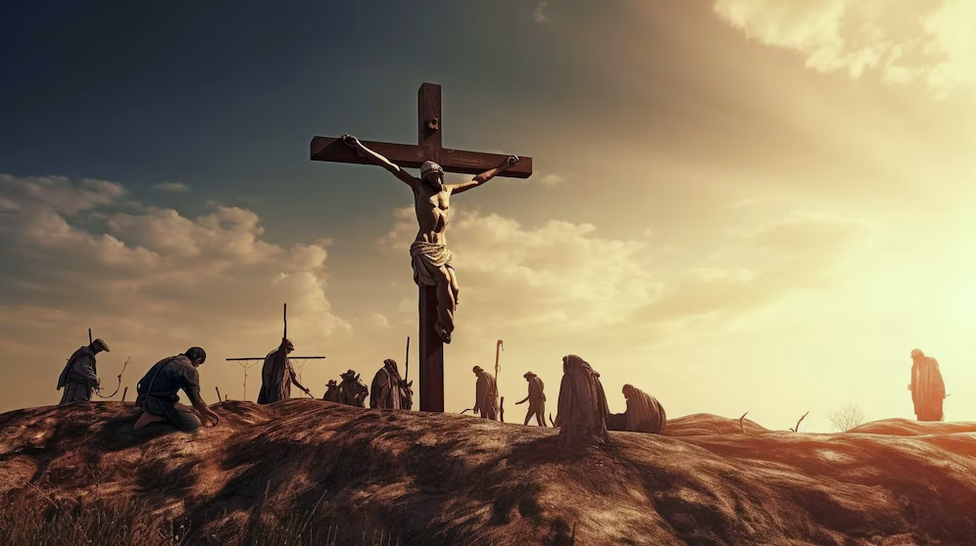
Describe this image with one word.
https://img.freepik.com/premium-photo/images-jesus-christ-cross-calvary_747552-5811.jpg?w=2000

Slide 9

Describe this image with one word.
https://img.freepik.com/premium-photo/images-jesus-christ-cross-calvary_747552-5811.jpg?w=2000

Slide 10

Describe this image with one word.
https://www.freepik.com/premium-ai-image/jesus-christ-watching-earth-from_172718747.htm#fromView=image_search_similar&page=1&position=29&uuid=25e96b73-08d0-45af-b6e7-2367441cf0c6&query=black+Jesus+Return+to+earth

Slide 11
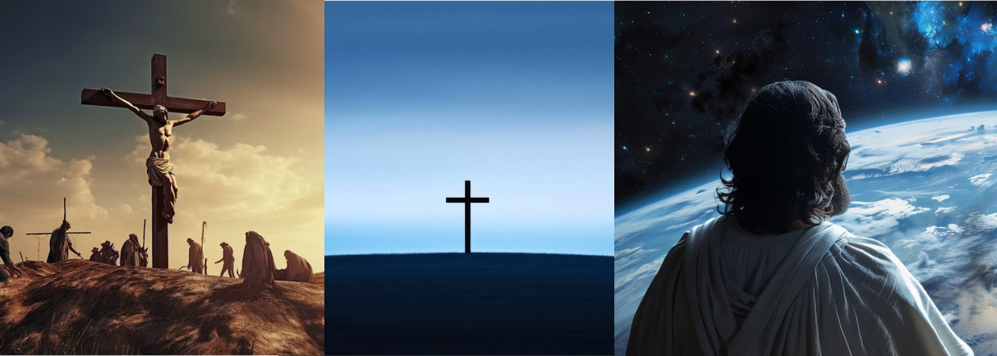
The Gospel Message
He Died
He Rose
He’s Coming Again

Slide 12
Five Types of Witnesses
Lay witness: This consists of any witness testifying without any qualified knowledge in the area they are testifying for. However, they must still limit themselves to giving testimony on subjects they are knowledgeable about.
Eyewitness: Anyone who saw or heard an event take place relevant to the case.
Fact witness: A fact witness is someone who gives testimony on facts concerning the case, usually reciting authoritative sources.
Character witness: A character witness is someone who can testify on individual’s positive or negative personality traits. This may be used to confirm motivations during a case, for instance.
Expert witness: Someone who can give an expert opinion about evidence. For instance, a musician, knowledgeable in music theory, to give an analysis or testimony on whether a piece of music was stolen from another artist or if it breaches copyright.

Slide 13
Be a Witness
Character Witness
Ephesians 5 (KJV)
15 See then that ye walk circumspectly, not as fools, but as wise,
16 Redeeming the time, because the days are evil.
Fact Witness
17 Wherefore be ye not unwise, but understanding what the will of the Lord is.

Slide 14
Be a Witness
Witness Types | Ephesians 5: 15-21
 | 15 See then that ye walk circumspectly, not as fools, but as wise, 16 Redeeming the time, because the days are evil.
 | 17 Wherefore be ye not unwise, but understanding what the will of the Lord is.
 | 18 And be not drunk with wine, wherein is excess; but be filled with the Spirit;
 | 19 Speaking to yourselves in psalms and hymns and spiritual songs, singing and making melody in your heart to the Lord;
 | 20 Giving thanks always for all things unto God and the Father in the name of our Lord Jesus Christ;
 | 21 Submitting yourselves one to another in the fear of God.
Character
Fact
Expert
Lay
Eyewitness
Character
(John 13:35)

Slide 15

Process for Spirit-Filled Living
Salvation: Christ gave His life for us
Sanctification: Christ gives His life to us
Service: Christ lives His life through us – as us

Slide 16
Witness
Be A
For Jesus

